Slide 1




Word of the Day
Summer Term 2021
Week 38 – 28th June 2021
'Words unlock the doors to a world of understanding...'

Slide 2

This Week's Words
Grasshopper
Shinobi
sauce
assume
bowl
capable
utensil
initial
homemade
mitigate
chop
specific

Slide 3
Grasshopper (Tier 1)
sauce
bowl
utensil
homemade
chop

Slide 4
Shinobi (Tier 2)
assume
capable
initial
mitigate
specific

Slide 5

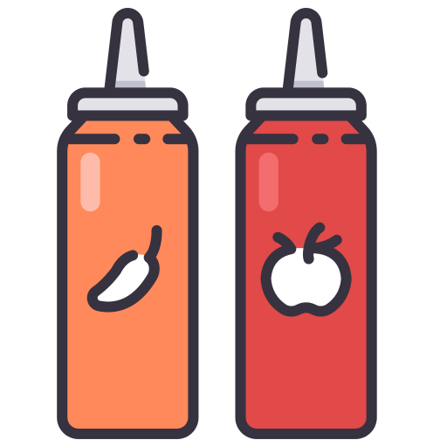
Grasshopper Word of the Day
sauce
Word Class
Word of the Day:
(noun)
(sauce)
Pronunciation / Syllables
Definition:
A sauce is a thick liquid which is served with other food.
Julie poured sauce onto her lunch.
Phrases: | spicy sauce | tasty sauce
Synonym: | Antonym: | Rhyme: | Link Word:
dressing |  | horse | dip
dip |  | force | cover

Slide 6

Grasshopper Word of the Day
bowl
Word Class
Word of the Day:
(noun)
(bowl)
Pronunciation / Syllables
Definition:
A bowl is a round container with a wide uncovered top. Some kinds of bowl are used, for example, for serving or eating food from.
The children stirred a mixture in the bowl.
Phrases: | round, yellow bowl | the mixing bowl
Synonym: | Antonym: | Rhyme: | Link Word:
dish |  | whole | plates
basin |  | control | eating

Slide 7

Grasshopper Word of the Day
utensil
Word Class
Word of the Day:
(noun)
(u-ten-sil)
Pronunciation / Syllables
Definition:
Utensils are tools or objects that you use in order to help you to cook or to do other tasks in your home.
Utensils for cooking were in the kitchen.
Phrases: | smooth, metal utensils | sharp and dangerous utensils
Synonym: | Antonym: | Rhyme: | Link Word:
tool |  | pencil | cooking
device |  |  | kitchen

Slide 8

Grasshopper Word of the Day
homemade
Word Class
Word of the Day:
(noun)
(home-made)
Pronunciation / Syllables
Definition:
Something that is homemade has been made in someone's home, rather than in a store or factory.
The cake was homemade.
Phrases: | delicious, homemade cake | warm, homemade cake
Synonym: | Antonym: | Rhyme: | Link Word:
 |  |  | history
 |  |  | food

Slide 9

Grasshopper Word of the Day
chop
Word Class
Word of the Day:
(verb)
(chop)
Pronunciation / Syllables
Definition:
If you chop something, you cut it into pieces with strong downward movements of a knife or an axe.
The cook chopped the different vegetables.
Phrases: | quickly chop | carefully chop
Synonym: | Antonym: | Rhyme: | Link Word:
dice |  | stop | cooking
mince |  | shop | fire

Slide 10

Shinobi Word of the Day
assume
Word Class
Word of the Day:
(verb)
(as-sume)
Pronunciation / Syllables
Definition:
If you assume that something is true, you imagine that it is true, sometimes wrongly.
Everyone assumed it was Jimmy’s fault .
Phrases: | assume nothing | unfair to assume
Synonym: | Antonym: | Prefix / Suffix: | Rhyme: | Link Word:
presume |  | re- | resume | police
suspect |  | -ed | bloom | crime

Slide 11

Shinobi Word of the Day
capable
Word Class
Word of the Day:
(adjective)
(ca-pa-ble)
Pronunciation / Syllables
Definition:
If a person or thing is capable of doing something, they have the ability to do it.
No-one realised that Jimmy was capable of this.
Phrases: | extremely capable | capable of anything
Synonym: | Antonym: | Prefix / Suffix: | Rhyme: | Link Word:
 | incapable | in- | escapable | person
 |  |  |  | skill

Slide 12

Shinobi Word of the Day
initial
Word Class
Word of the Day:
(adjective)
(in-i-tial)
Pronunciation / Syllables
Definition:
You use initial to describe something that happens at the beginning of a process.
His initial thought was that Jimmy was innocent.
Phrases: | my initial thought | initial ideas
Synonym: | Antonym: | Prefix / Suffix: | Rhyme: | Link Word:
first | final | -ly | official | beginning
primary |  |  | artificial | second

Slide 13

Shinobi Word of the Day
mitigate
Word Class
Word of the Day:
(verb)
(mit-i-gate)
Pronunciation / Syllables
Definition:
To mitigate something means to make it less unpleasant, serious, or painful.
Mr Robson couldn’t mitigate the effect of Jimmy’s actions.
Phrases: | tried to mitigate | effectively mitigated
Synonym: | Antonym: | Prefix / Suffix: | Rhyme: | Link Word:
reduce | aggravate | -ed | reiterate | pain
diminish | increase |  |  | happiness

Slide 14

Shinobi Word of the Day
specific
Word Class
Word of the Day:
(adjective)
(spe-cif-ic)
Pronunciation / Syllables
Definition:
If someone is specific, they give a description that is precise and exact. You can also use specific to describe their description.
Mrs Woods was specific about Jimmy’s consequence.
Phrases: | needed specific details | specific and precise
Synonym: | Antonym: | Prefix / Suffix | Rhyme: | Link Word:
definite | general | -ly | terrific | words
precise | vague | -ify | prolific | detail

Slide 15
Vocabulary Laboratory
Describe / Definition:
Use it in a sentence:
Focus Word (write below):
Word Class:
Synonyms: (words with same / similar meaning) | Antonyms: (words with opposite meaning)
Rhymes: (words that sound the same) | Link Words: (Example: football = pitch, team, player)
Draw your sentence:

Slide 16

Vocabulary Visualiser
Draw the Grasshopper words and bring them to life.
Word: sauce | Word: bowl
Word: utensil | Word: chop

Slide 17

Vocabulary Visualiser
Draw the Shinobi words and bring them to life.
Word: assume | Word: capable
Word: initial | Word: specific

Slide 18
Matching Meanings
Draw lines from the Grasshopper words to their definitions.
Grasshopper Word
sauce
bowl
utensil
homemade
chop
Grasshopper Definitions
A *** is a round container with a wide uncovered top. Some kinds of bowl are used, for example, for serving or eating food from.
Something that is *** has been made in someone's home, rather than in a store or factory.
A *** is a thick liquid which is served with other food.
If you *** something, you cut it into pieces with strong downward movements of a knife or an axe.
*** are tools or objects that you use in order to help you to cook or to do other tasks in your home.

Slide 19
Matching Meanings
Draw lines from the Shinobi words to their definitions.
Shinobi Word
assume
capable
initial
mitigate
specific
Shinobi Definitions
You use *** to describe something that happens at the beginning of a process.
If you *** that something is true, you imagine that it is true, sometimes wrongly.
If someone is ***, they give a description that is precise and exact. You can also use *** to describe their description.
If a person or thing is *** of doing something, they have the ability to do it.
To *** something means to make it less unpleasant, serious, or painful.

Slide 20
sauce
bowl

Slide 21
utensil
homemade

Slide 22
chop
assume

Slide 23
capable
initial

Slide 24
mitigate
specific

