Slide 1
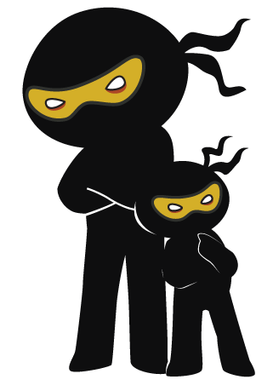



Word of the Day
Summer Term 2021
Week 31 – 3rd May 2021
'Words unlock the doors to a world of understanding...'

Slide 2

This Week's Words
Grasshopper
Shinobi
save
gingerly
unlock
fond
crack
cherish
hang
chaos
bury
snare

Slide 3
Grasshopper (Tier 1)
save
unlock
crack
hang
bury

Slide 4
Shinobi (Tier 2)
gingerly
fond
cherish
chaos
snare

Slide 5


Grasshopper Word of the Day
save
Word Class
Word of the Day:
(verb / noun)
(save)
Pronunciation / Syllables
Definition:
If you save someone or something, you help them to avoid harm or to escape from a dangerous or unpleasant situation.
Jenny saved the chocolate bunny from the sunshine.
Phrases: | saved for a | needed to save the
Synonym: | Antonym: | Rhyme: | Link Word:
rescue | endanger | cave | person
 |  | behave | money

Slide 6

Grasshopper Word of the Day
unlock
Word Class
Word of the Day:
(verb)
(un-lock)
Pronunciation / Syllables
Definition:
If you unlock something such as a door, a room, or a container that has a lock, you open it using a key.
Mrs Barnet unlocked the iPad to start the lesson.
Phrases: | carefully unlock | couldn’t unlock
Synonym: | Antonym: | Rhyme: | Link Word:
unfasten | lock | block | door
 |  | rock | phone

Slide 7

Grasshopper Word of the Day
crack
Word Class
Word of the Day:
(verb / noun)
(crack)
Pronunciation / Syllables
Definition:
If something hard cracks, or if you crack it, it becomes slightly damaged, with lines appearing on its surface.
There was a crack on the new television screen.
Phrases: | didn’t mean to crack | completely cracked
Synonym: | Antonym: | Rhyme: | Link Word:
break |  | black | break
snap |  | stack | glass

Slide 8
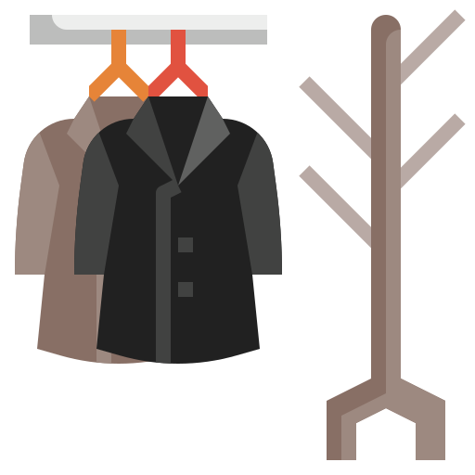
Grasshopper Word of the Day
hang
Word Class
Word of the Day:
(verb)
(hang)
Pronunciation / Syllables
Definition:
If something hangs in a high place or position, or if you hang it there, it is attached there so it does not touch the ground.
Phillip needed to hang his coat on the correct peg.
Phrases: | quickly hung | heeded to hang
Synonym: | Antonym: | Rhyme: | Link Word:
put up | take down | sang | clothes
suspend |  | gang | wardrobe

Slide 9

Grasshopper Word of the Day
bury
Word Class
Word of the Day:
(verb)
(bur-y)
Pronunciation / Syllables
Definition:
To bury something means to put it into a hole in the ground and cover it up with earth.
The dog buried a bone in the ground.
Phrases: | needed to bury the | buried underground
Synonym: | Antonym: | Rhyme: | Link Word:
hide | reveal | merry | bone
conceal |  | very | body

Slide 10
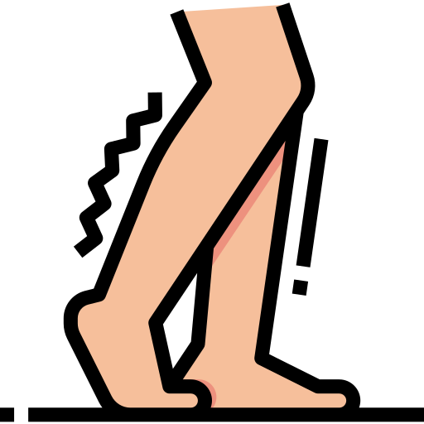
Shinobi Word of the Day
gingerly
Word Class
Word of the Day:
(adverb)
(gin-ger-ly)
Pronunciation / Syllables
Definition:
If you do something gingerly, you do it in a careful manner, usually because you expect it to be dangerous, unpleasant, or painful.
Mr Newing walked gingerly after the PE lesson.
Phrases: | walked gingerly | moved gingerly
Synonym: | Antonym: | Prefix / Suffix: | Rhyme: | Link Word:
carefully | recklessly |  | injury | move
timidly |  |  |  | action

Slide 11

Shinobi Word of the Day
fond
Word Class
Word of the Day:
(adjective)
(fond)
Pronunciation / Syllables
Definition:
If you are fond of someone, you feel affection for them.
Everyone was fond of the new school dog.
Phrases: | was extremely fond of | very fond of
Synonym: | Antonym: | Prefix / Suffix: | Rhyme: | Link Word:
adoring | unfeeling | -ly | bond | animal
devoted |  |  | pond | object

Slide 12

Shinobi Word of the Day
cherish
Word Class
Word of the Day:
(verb)
(cher-ish)
Pronunciation / Syllables
Definition:
If you cherish someone or something, you take good care of them because you love them.
Henry cherished his friendship with Alan.
Phrases: | had always cherished | cherished the
Synonym: | Antonym: | Prefix / Suffix: | Rhyme: | Link Word:
adore |  | -ed | perish | friend
love |  | -ing | garish | item

Slide 13

Shinobi Word of the Day
chaos
Word Class
Word of the Day:
(noun)
(cha-os)
Pronunciation / Syllables
Definition:
Chaos is a state of complete disorder and confusion.
It could sometimes be chaotic in the school office.
Phrases: | was total chaos | it was chaotic
Synonym: | Antonym: | Prefix / Suffix: | Rhyme: | Link Word:
disorder | order | -tic |  | work
mayhem |  |  |  | place

Slide 14

Shinobi Word of the Day
snare
Word Class
Word of the Day:
(verb)
(snare)
Pronunciation / Syllables
Definition:
If someone snares something, they get it in a clever way, perhaps by deceiving people.
The children had been snared by the interesting visitor.
Phrases: | had snared the | planned to snare the
Synonym: | Antonym: | Prefix / Suffix | Rhyme: | Link Word:
trap |  | -ed | share | person
catch |  |  | aware | animal

Slide 15
Vocabulary Laboratory
Describe / Definition:
Use it in a sentence:
Focus Word (write below):
Word Class:
Synonyms: (words with same / similar meaning) | Antonyms: (words with opposite meaning)
Rhymes: (words that sound the same) | Link Words: (Example: football = pitch, team, player)
Draw your sentence:

Slide 16

Vocabulary Visualiser
Draw the Grasshopper words and bring them to life.
Word: save | Word: unlock
Word: crack | Word: bury

Slide 17

Vocabulary Visualiser
Draw the Shinobi words and bring them to life.
Word: gingerly | Word: cherish
Word: chaos | Word: snare

Slide 18
Matching Meanings
Draw lines from the Grasshopper words to their definitions.
Grasshopper Word
save
unlock
crack
hang
bury
Grasshopper Definitions
If you *** something such as a door, a room, or a container that has a lock, you open it using a key.
To *** something means to put it into a hole in the ground and cover it up with earth.
If you *** someone or something, you help them to avoid harm or to escape from a dangerous or unpleasant situation.
If something *** in a high place or position, or if you hang it there, it is attached there so it does not touch the ground.
If something hard ***, or if you *** it, it becomes slightly damaged, with lines appearing on its surface.

Slide 19
Matching Meanings
Draw lines from the Shinobi words to their definitions.
Shinobi Word
gingerly
fond
cherish
chaos
snare
Shinobi Definitions
*** is a state of complete disorder and confusion.
If you do something ***, you do it in a careful manner, usually because you expect it to be dangerous, unpleasant, or painful.
If someone *** something, they get it in a clever way, perhaps by deceiving people.
If you are *** of someone, you feel affection for them.
If you *** someone or something, you take good care of them because you love them.

Slide 20






Display Slips
The following slides are for classroom display. As you teach each Word of the Day, words can be displayed in the classroom to enable pupils to use the taught vocabulary in an independent manner.

Slide 21
save
unlock

Slide 22
crack
hang

Slide 23
bury
gingerly

Slide 24
fond
cherish

Slide 25
chaos
snare

