Slide 1
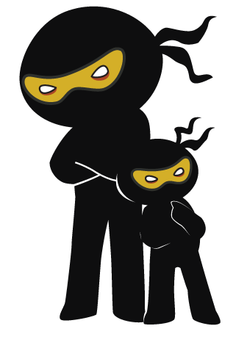



Word of the Day
Summer Term 2021
Week 32 – 10th May 2021
'Words unlock the doors to a world of understanding...'

Slide 2

This Week's Words
Grasshopper
Shinobi
dozen
appetite
duo
unfamiliar
fortnight
divert
talent
mimic
suitcase
convenient

Slide 3
Grasshopper (Tier 1)
dozen
duo
fortnight
talent
suitcase

Slide 4
Shinobi (Tier 2)
appetite
unfamiliar
divert
mimic
convenient

Slide 5


Grasshopper Word of the Day
dozen
Word Class
Word of the Day:
(noun)
(doz-en)
Pronunciation / Syllables
Definition:
If you have a dozen things, you have twelve of them.
The children used a dozen eggs to create a cake.
Phrases: | a dozen birds | a dozen cakes
Synonym: | Antonym: | Rhyme: | Link Word:
twelve |  | cousin | eggs
 |  |  | people

Slide 6

Grasshopper Word of the Day
duo
Word Class
Word of the Day:
(noun)
(duo)
Pronunciation / Syllables
Definition:
You can refer to two people together as a duo, especially when they have something in common.
The brave duo explored the caves.
Phrases: | the intrepid duo | the deadly duo
Synonym: | Antonym: | Rhyme: | Link Word:
pair |  | owe | children
two |  |  | team

Slide 7
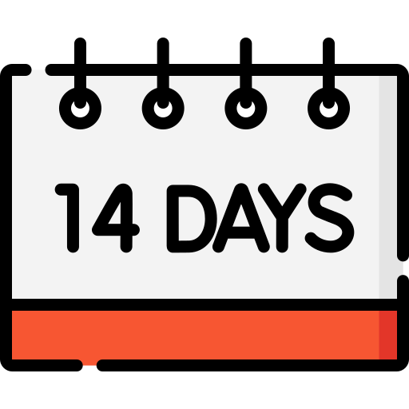
Grasshopper Word of the Day
fortnight
Word Class
Word of the Day:
(noun)
(fort-night)
Pronunciation / Syllables
Definition:
A fortnight is a period of two weeks.
Jenn was going to her caravan for a fortnight.
Phrases: | a fortnight abroad | a fortnight until
Synonym: | Antonym: | Rhyme: | Link Word:
fourteen |  |  | holiday
two weeks |  |  | weeks

Slide 8

Grasshopper Word of the Day
talent
Word Class
Word of the Day:
(noun)
(tal-ent)
Pronunciation / Syllables
Definition:
Talent is the natural ability to do something well.
Everyone was excited for the talent show.
Phrases: | an extreme talent | was talented
Synonym: | Antonym: | Rhyme: | Link Word:
ability |  | gallant | sport
knack |  | balance | famous

Slide 9

Grasshopper Word of the Day
suitcase
Word Class
Word of the Day:
(noun)
(suit-case)
Pronunciation / Syllables
Definition:
A suitcase is a box or bag with a handle and a hard frame in which you carry your clothes when you are travelling.
Juan packed his clothes into a suitcase for his holiday.
Phrases: | a strong suitcase | packed the suitcase
Synonym: | Antonym: | Rhyme: | Link Word:
case |  | trace | travel
holdall |  | lace | transport

Slide 10

Shinobi Word of the Day
appetite
Word Class
Word of the Day:
(noun)
(ap-pe-tite)
Pronunciation / Syllables
Definition:
Your appetite is your desire to eat. Someone's appetite for something is their strong desire for it.
Class 9 has an appetite for learning.
Phrases: | has a huge appetite | appetite had dwindled
Synonym: | Antonym: | Prefix / Suffix: | Rhyme: | Link Word:
hunger | aversion | -s | write | food
craving |  |  |  | learning

Slide 11

Shinobi Word of the Day
unfamiliar
Word Class
Word of the Day:
(adjective)
(un-fa-mil-iar)
Pronunciation / Syllables
Definition:
If something is unfamiliar to you, you know nothing or very little about it, because you have not seen or experienced it before.
Sheena was unfamiliar with the email address.
Phrases: | new and unfamiliar | rather unfamiliar
Synonym: | Antonym: | Prefix / Suffix: | Rhyme: | Link Word:
unknown | familiar |  |  | internet
strange |  |  |  | stranger

Slide 12

Shinobi Word of the Day
divert
Word Class
Word of the Day:
(verb)
(di-vert)
Pronunciation / Syllables
Definition:
To divert, is to make someone or something go via or be drawn to something that wasn’t originally intended.
The dog on the playground was diverted out of the gate.
Phrases: | needed to divert | they were diverted
Synonym: | Antonym: | Prefix / Suffix: | Rhyme: | Link Word:
channel |  | -ion | hurt | traffic
avert |  | -ing | alert | attention

Slide 13

Shinobi Word of the Day
mimic
Word Class
Word of the Day:
(verb)
(mim-ic)
Pronunciation / Syllables
Definition:
If you mimic the actions or voice of a person or animal, you imitate them, usually in a way that is meant to be amusing or entertaining.
Fred liked to mimic his teacher’s sayings.
Phrases: | loved to mimic | mimic exactly
Synonym: | Antonym: | Prefix / Suffix: | Rhyme: | Link Word:
imitate |  | -ist | gimmick | behaviour
copy |  | -ism |  | words

Slide 14

Shinobi Word of the Day
convenient
Word Class
Word of the Day:
(adjective)
(con-ven-ient)
Pronunciation / Syllables
Definition:
If you describe a place as convenient, you are pleased because it is near to where you are, or because you can reach another place from there quickly and easily.
Mr Rhodes was tired, so he sat on the convenient chair.
Phrases: | close and convenient | conveniently located
Synonym: | Antonym: | Prefix / Suffix | Rhyme: | Link Word:
handy | awkward | -er |  | seating
opportune | inconvenient | -ed |  | moment

Slide 15
Vocabulary Laboratory
Describe / Definition:
Use it in a sentence:
Focus Word (write below):
Word Class:
Synonyms: (words with same / similar meaning) | Antonyms: (words with opposite meaning)
Rhymes: (words that sound the same) | Link Words: (Example: football = pitch, team, player)
Draw your sentence:

Slide 16

Vocabulary Visualiser
Draw the Grasshopper words and bring them to life.
Word: dozen | Word: duo
Word: fortnight | Word: suitcase

Slide 17
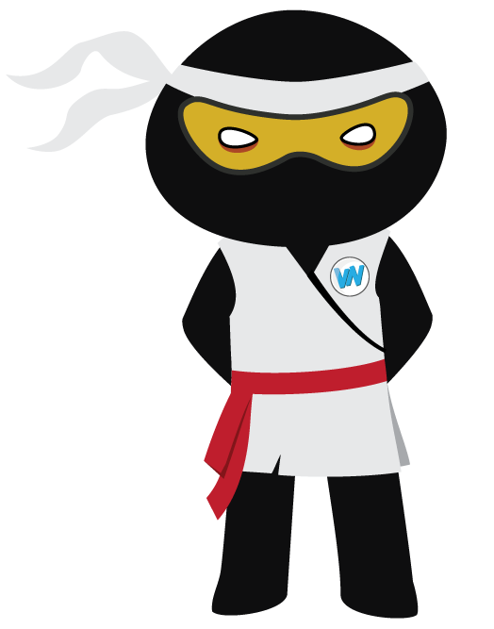
Vocabulary Visualiser
Draw the Shinobi words and bring them to life.
Word: appetite | Word: divert
Word: mimic | Word: convenient

Slide 18
Matching Meanings
Draw lines from the Grasshopper words to their definitions.
Grasshopper Word
dozen
duo
fortnight
talent
suitcase
Grasshopper Definitions
A *** is a period of two weeks.
A *** is a box or bag with a handle and a hard frame in which you carry your clothes when you are travelling.
You can refer to two people together as a ***, especially when they have something in common.
If you have a *** things, you have twelve of them.
*** is the natural ability to do something well.

Slide 19
Matching Meanings
Draw lines from the Shinobi words to their definitions.
Shinobi Word
appetite
unfamiliar
divert
mimic
convenient
Shinobi Definitions
Your *** is your desire to eat. Someone’s *** for something is their strong desire for it.
To ***, is to make someone or something go via or be drawn to something that wasn’t originally intended.
If you *** the actions or voice of a person or animal, you imitate them, usually in a way that is meant to be amusing or entertaining.
If you describe a place as ***, you are pleased because it is near to where you are, or because you can reach another place from there quickly and easily.
If something is *** to you, you know nothing or very little about it, because you have not seen or experienced it before.

Slide 20






Display Slips
The following slides are for classroom display. As you teach each Word of the Day, words can be displayed in the classroom to enable pupils to use the taught vocabulary in an independent manner.

Slide 21
dozen
duo

Slide 22
fortnight
talent

Slide 23
suitcase
appetite

Slide 24
unfamiliar
divert

Slide 25
mimic
convenient

