Slide 1




Word of the Day
Spring Term 2021
Week 25 – 15th March 2021
'Words unlock the doors to a world of understanding...'

Slide 2

This Week's Words
Grasshopper
Shinobi
brush
habitat
serve
routine
grow
adjacent
feed
retrieve
construct
tentative

Slide 3
Grasshopper (Tier 1)
brush
serve
grow
feed
construct

Slide 4
Shinobi (Tier 2)
habitat
routine
adjacent
retrieve
tentative

Slide 5



Grasshopper Word of the Day
brush
Word Class
Word of the Day:
(verb / noun)
(brush)
Pronunciation / Syllables
Definition:
If you brush something or brush something such as dirt off it, you clean it or tidy it using a brush.
Alicia brushed her hair each morning.
Phrases: | gently brush | wash and brush
Synonym: | Antonym: | Rhyme: | Link Word:
stroke |  | crush | hair
caress |  | rush | sweeping

Slide 6

Grasshopper Word of the Day
serve
Word Class
Word of the Day:
(verb)
(serve)
Pronunciation / Syllables
Definition:
If something serves people or an area, it provides them with something that they need.
Mrs Barker served the children their lunches.
Phrases: | serve the children | kindly serve
Synonym: | Antonym: | Rhyme: | Link Word:
 |  | curve | food
 |  | nerve | customer

Slide 7

Grasshopper Word of the Day
grow
Word Class
Word of the Day:
(verb)
(grow)
Pronunciation / Syllables
Definition:
When people, animals, and plants grow, they increase in size and change physically over a period of time.
The grass began to grow in the sunlight.
Phrases: | suddenly grow | slowly grow
Synonym: | Antonym: | Rhyme: | Link Word:
sprout | fail | know | hair
develop | shrink | below | children

Slide 8
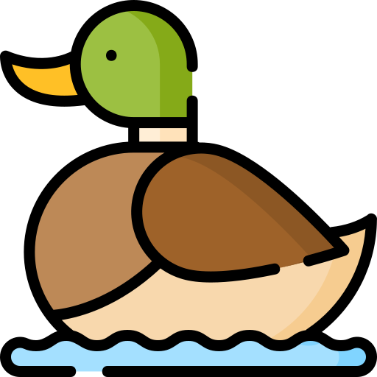

Grasshopper Word of the Day
feed
Word Class
Word of the Day:
(verb)
(feed)
Pronunciation / Syllables
Definition:
If you feed a person or animal, you give them food to eat and sometimes actually put it in their mouths.
Sophie visited the pond to feed the ducks.
Phrases: | to feed everyone | feed everyone
Synonym: | Antonym: | Rhyme: | Link Word:
nourish |  | need | animals
cater for |  | read | plants

Slide 9

Grasshopper Word of the Day
construct
Word Class
Word of the Day:
(noun)
(con-struct)
Pronunciation / Syllables
Definition:
If you construct something such as a building, road, or machine, you build it or make it.
Hama constructed a castle using the blocks.
Phrases: | carefully construct | constructed with wood
Synonym: | Antonym: | Rhyme: | Link Word:
build | demolish | instruct | wood
assemble |  | plucked | metal

Slide 10

Shinobi Word of the Day
habitat
Word Class
Word of the Day:
(noun)
(hab-i-tat)
Pronunciation / Syllables
Definition:
The habitat of an animal or plant is the natural environment in which it normally lives or grows.
The bird’s habitat was a nest in the tree.
Phrases: | The birds habitat | built the habitat
Synonym: | Antonym: | Prefix / Suffix: | Rhyme: | Link Word:
 |  | micro- |  | animal
 |  | -tion |  | human

Slide 11

Shinobi Word of the Day
routine
Word Class
Word of the Day:
(noun)
(rou-tine)
Pronunciation / Syllables
Definition:
A routine is the usual series of things that you do at a particular time. A routine is also the practice of regularly doing things in a fixed order.
Jack loved getting back into the routine of school.
Phrases: | the daily routine | his routine was
Synonym: | Antonym: | Prefix / Suffix: | Rhyme: | Link Word:
pattern |  | -ness | between | lessons
regime |  | -ly | machine | daily

Slide 12

Shinobi Word of the Day
adjacent
Word Class
Word of the Day:
(adjective)
(ad-ja-cent)
Pronunciation / Syllables
Definition:
If one thing is adjacent to another, the two things are next to each other.
Samiha always had her pencil adjacent to her ruler.
Phrases: | proudly adjacent | adjacent and in order
Synonym: | Antonym: | Prefix / Suffix: | Rhyme: | Link Word:
near to |  | non- | complacent | building
beside |  | -ly | patient | people

Slide 13

Shinobi Word of the Day
retrieve
Word Class
Word of the Day:
(verb)
(re-trieve)
Pronunciation / Syllables
Definition:
If you retrieve something, you get it back from the place where you left it.
Danny retrieved the answer from the text.
Phrases: | quickly retrieve | needed to retrieve the
Synonym: | Antonym: | Prefix / Suffix: | Rhyme: | Link Word:
salvage |  | -ed | believe | ball
rescue |  | -er | leave | words

Slide 14

Shinobi Word of the Day
tentative
Word Class
Word of the Day:
(adjective)
(ten-ta-tive)
Pronunciation / Syllables
Definition:
If someone is tentative, they are cautious and not very confident because they are uncertain or afraid.
Justin was tentative about attending the disco.
Phrases: | accepted tentatively | tentatively entered the water
Synonym: | Antonym: | Prefix / Suffix | Rhyme: | Link Word:
provisional | definite | -ly | sensitive | maybe
hesitant | confident | -ness | preventative | invitation

Slide 15
Vocabulary Laboratory
Describe / Definition:
Use it in a sentence:
Focus Word (write below):
Word Class:
Synonyms: (words with same / similar meaning) | Antonyms: (words with opposite meaning)
Rhymes: (words that sound the same) | Link Words: (Example: football = pitch, team, player)
Draw your sentence:

Slide 16

Vocabulary Visualiser
Draw the Grasshopper words and bring them to life.
Word: brush | Word: serve
Word: grow | Word: feed

Slide 17

Vocabulary Visualiser
Draw the Shinobi words and bring them to life.
Word: habitat | Word: routine
Word: adjacent | Word: retrieve

Slide 18
Matching Meanings
Draw lines from the Grasshopper words to their definitions.
Grasshopper Word
brush
serve
grow
feed
construct
Grasshopper Definitions
If something *** people or an area, it provides them with something that they need.
When people, animals, and plants ***, they increase in size and change physically over a period of time.
If you *** something such as a building, road, or machine, you build it or make it.
If you *** something or brush something such as dirt off it, you clean it or tidy it using a ***.
If you *** a person or animal, you give them food to eat and sometimes actually put it in their mouths.

Slide 19
Matching Meanings
Draw lines from the Shinobi words to their definitions.
Shinobi Word
habitat
routine
adjacent
retrieve
tentative
Shinobi Definitions
A *** is the usual series of things that you do at a particular time. A *** is also the practice of regularly doing things in a fixed order.
If you *** something, you get it back from the place where you left it.
The *** of an animal or plant is the natural environment in which it normally lives or grows.
If someone is ***, they are cautious and not very confident because they are uncertain or afraid.
If one thing is *** to another, the two things are next to each other.

Slide 20

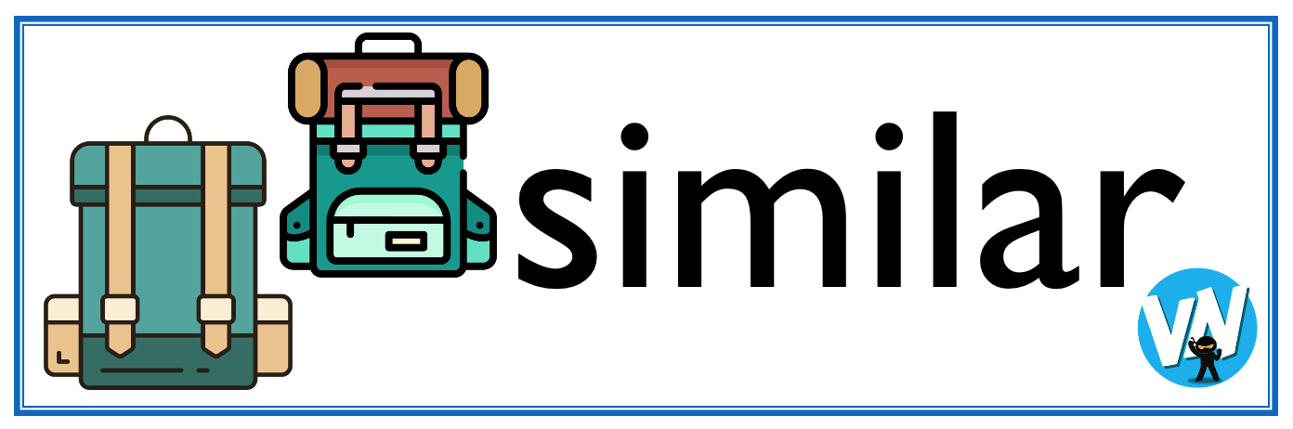




Display Slips
The following slides are for classroom display. As you teach each Word of the Day, words can be displayed in the classroom to enable pupils to use the taught vocabulary in an independent manner.

Slide 21
brush
serve

Slide 22
grow
feed

Slide 23
construct
habitat

Slide 24
routine
adjacent

Slide 25
retrieve
tentative

