Slide 1
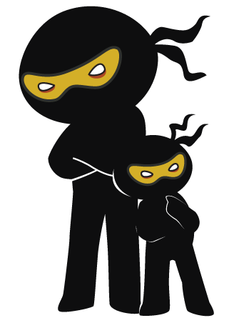



Word of the Day
Summer Term 2021
Week 27 – 12th April 2021
'Words unlock the doors to a world of understanding...'

Slide 2

This Week's Words
Grasshopper
Shinobi
river
confront
rattle
dawdle
snap
devious
feather
famished
terrible
relinquish

Slide 3
Grasshopper (Tier 1)
river
rattle
snap
feather
terrible

Slide 4
Shinobi (Tier 2)
confront
dawdle
devious
famished
relinquish

Slide 5


Grasshopper Word of the Day
river
Word Class
Word of the Day:
(noun)
(riv-er)
Pronunciation / Syllables
Definition:
A river is a large amount of fresh water flowing continuously in a long line across the land.
The river was full of fish and wildlife.
Phrases: | the deep river | flowing river
Synonym: | Antonym: | Rhyme: | Link Word:
stream |  | liver | flowing
 |  | shiver | deep

Slide 6

Grasshopper Word of the Day
rattle
Word Class
Word of the Day:
(verb)
(rat-tle)
Pronunciation / Syllables
Definition:
When something rattles or when you rattle it, it makes short sharp knocking sounds because it is being shaken or it keeps hitting against something hard.
The knives and forks rattled as the were put away.
Phrases: | loud rattling | didn’t stop rattling
Synonym: | Antonym: | Rhyme: | Link Word:
clatter |  | battle | metal
bang |  | cattle | noise

Slide 7
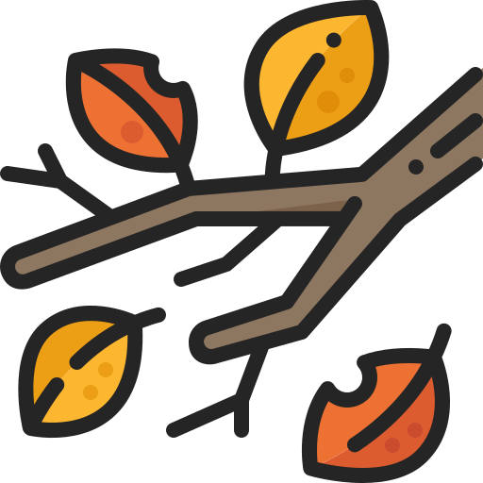
Grasshopper Word of the Day
snap
Word Class
Word of the Day:
(verb)
(snap)
Pronunciation / Syllables
Definition:
If something snaps or if you snap it, it breaks suddenly, usually with a sharp cracking noise.
The twig snapped as she stepped on it.
Phrases: | snapped easily | snap and crash
Synonym: | Antonym: | Rhyme: | Link Word:
break | hold | map | broken
splinter |  | gap | noise

Slide 8

Grasshopper Word of the Day
feather
Word Class
Word of the Day:
(noun)
(feath-er)
Pronunciation / Syllables
Definition:
A bird's feathers are the soft covering on its body. Each feather consists of a lot of smooth hairs on each side of a thin stiff centre.
The bird’s feathers were colourful.
Phrases: | beautiful feather | golden feathers
Synonym: | Antonym: | Rhyme: | Link Word:
plume |  | together | bird
quill |  | weather | hat

Slide 9
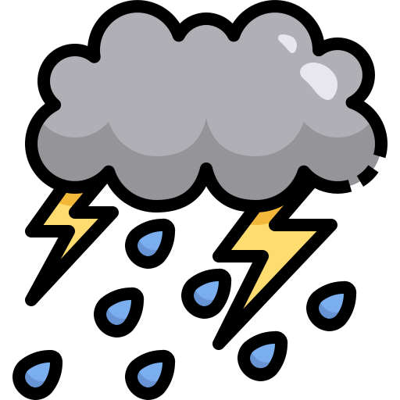
Grasshopper Word of the Day
terrible
Word Class
Word of the Day:
(adjective)
(ter-ri-ble)
Pronunciation / Syllables
Definition:
A terrible experience or situation is very serious or very unpleasant.
The weather was terrible outside.
Phrases: | the terrible storm | a terrible idea
Synonym: | Antonym: | Rhyme: | Link Word:
dreadful | slight | incredible | bad
awful | brilliant | edible | negative

Slide 10

Shinobi Word of the Day
confront
Word Class
Word of the Day:
(verb)
(con-front)
Pronunciation / Syllables
Definition:
If you are confronted with a problem, task, or difficulty, you have to deal with it.
Mrs Jones was confronted by a tricky maths question.
Phrases: | a brief confrontation | was confronted by
Synonym: | Antonym: | Prefix / Suffix: | Rhyme: | Link Word:
challenge | avoid | -ed | hunt | battle
tackle |  | -ation | blunt | problem

Slide 11

Shinobi Word of the Day
dawdle
Word Class
Word of the Day:
(verb)
(daw-dle)
Pronunciation / Syllables
Definition:
If you dawdle, you spend more time than is necessary going somewhere.
Adah dawdled across the playground after PE.
Phrases: | was always dawdling | dawdled and stumbled
Synonym: | Antonym: | Prefix / Suffix: | Rhyme: | Link Word:
linger | hurry | -ed |  | walk
dally |  | -ing |  | slow

Slide 12

Shinobi Word of the Day
devious
Word Class
Word of the Day:
(adjective)
(de-vi-ous)
Pronunciation / Syllables
Definition:
If you describe someone as devious you do not like them because you think they are dishonest and like to keep things secret, often in a complicated way.
Jeremy had a devious plan to score 10/10 on the test.
Phrases: | extremely devious | clever and devious
Synonym: | Antonym: | Prefix / Suffix: | Rhyme: | Link Word:
underhand | above board | -ness | previous | idea
dishonest |  | -ly |  | person

Slide 13

Shinobi Word of the Day
famished
Word Class
Word of the Day:
(adjective)
(fam-ished)
Pronunciation / Syllables
Definition:
If you are famished, you are very hungry.
It was still an hour until lunch and Alex was famished.
Phrases: | thirsty and famished | everyone was famished
Synonym: | Antonym: | Prefix / Suffix: | Rhyme: | Link Word:
ravenous | well fed |  | vanished | food
starving |  |  | banished | starve

Slide 14


Shinobi Word of the Day
relinquish
Word Class
Word of the Day:
(verb)
(re-lin-quish)
Pronunciation / Syllables
Definition:
If you relinquish something such as power or control, you give it up.
Alex relinquished her title as the times table champion.
Phrases: | wouldn’t relinquish | would never relinquish
Synonym: | Antonym: | Prefix / Suffix | Rhyme: | Link Word:
renounce | keep | -ing | extinguish | title
give up | retain | -ed | distinguish | power

Slide 15
Vocabulary Laboratory
Describe / Definition:
Use it in a sentence:
Focus Word (write below):
Word Class:
Synonyms: (words with same / similar meaning) | Antonyms: (words with opposite meaning)
Rhymes: (words that sound the same) | Link Words: (Example: football = pitch, team, player)
Draw your sentence:

Slide 16

Vocabulary Visualiser
Draw the Grasshopper words and bring them to life.
Word: river | Word: snap
Word: feather | Word: terrible

Slide 17

Vocabulary Visualiser
Draw the Shinobi words and bring them to life.
Word: confront | Word: dawdle
Word: devious | Word: famished

Slide 18
Matching Meanings
Draw lines from the Grasshopper words to their definitions.
Grasshopper Word
river
rattle
snap
feather
terrible
Grasshopper Definitions
When something *** or when you *** it, it makes short sharp knocking sounds because it is being shaken or it keeps hitting against something hard.
A *** experience or situation is very serious or very unpleasant.
A bird’s *** are the soft covering on its body. Each *** consists of a lot of smooth hairs on each side of a thin stiff centre.
A *** is a large amount of fresh water flowing continuously in a long line across the land.
If something *** or if you *** it, it breaks suddenly, usually with a sharp cracking noise.

Slide 19
Matching Meanings
Draw lines from the Shinobi words to their definitions.
Shinobi Word
confront
dawdle
devious
famished
relinquish
Shinobi Definitions
If you are *** with a problem, task, or difficulty, you have to deal with it.
If you are ***, you are very hungry.
If you *** something such as power or control, you give it up.
If you ***, you spend more time than is necessary going somewhere.
If you describe someone as *** you do not like them because you think they are dishonest and like to keep things secret, often in a complicated way.

Slide 20






Display Slips
The following slides are for classroom display. As you teach each Word of the Day, words can be displayed in the classroom to enable pupils to use the taught vocabulary in an independent manner.

Slide 21
river
rattle

Slide 22
snap
feather

Slide 23
terrible
confront

Slide 24
dawdle
devious

Slide 25
famished
relinquish

