Slide 1
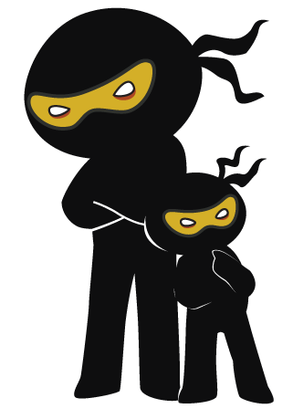



Word of the Day
Spring Term 2021
Week 22 – 22nd February 2021
'Words unlock the doors to a world of understanding...'

Slide 2

This Week's Words
Grasshopper
Shinobi
climb
reluctant
skip
effortless
blow
glare
bounce
tension
meet
unanimous

Slide 3
Grasshopper (Tier 1)
climb
skip
blow
bounce
meet

Slide 4
Shinobi (Tier 2)
reluctant
effortless
glare
tension
unanimous

Slide 5

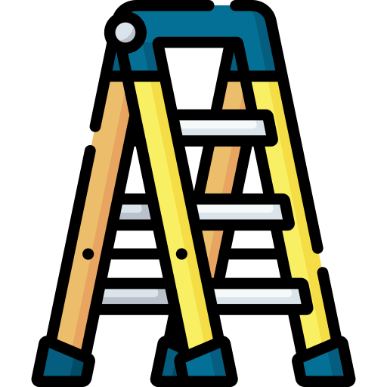
Grasshopper Word of the Day
climb
Word Class
Word of the Day:
(verb)
(climb)
Pronunciation / Syllables
Definition:
If you climb something such as a tree, mountain, or ladder, or climb up it, you move towards the top of it. If you climb down it, you move towards the bottom of it.
Mr. Robson climbed the ladder to get to the roof.
Phrases: | carefully climb | climbed up
Synonym: | Antonym: | Rhyme: | Link Word:
mount | descend | time | up
scale |  | crime | down

Slide 6
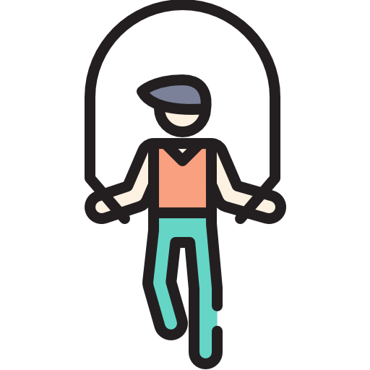
Grasshopper Word of the Day
skip
Word Class
Word of the Day:
(verb)
(skip)
Pronunciation / Syllables
Definition:
If you skip along, you move almost as if you are dancing, with a series of little jumps from one foot to the other.
Alice skipped around the playground in the sun.
Phrases: | skipped joyfully | skip together
Synonym: | Antonym: | Rhyme: | Link Word:
prance | trudge | ship | rope
bound |  | trip | along

Slide 7

Grasshopper Word of the Day
blow
Word Class
Word of the Day:
(verb)
(blow)
Pronunciation / Syllables
Definition:
If the wind blows something somewhere or if it blows there, the wind moves it there.
The wind was blowing very hard today.
Phrases: | blew over | blow out
Synonym: | Antonym: | Rhyme: | Link Word:
gust |  | show | wind
puff |  | low | over

Slide 8

Grasshopper Word of the Day
bounce
Word Class
Word of the Day:
(verb)
(bounce)
Pronunciation / Syllables
Definition:
When an object such as a ball bounces or when you bounce it, it moves upwards from a surface or away from it immediately after hitting it.
Gustav bounced the ball to Justine.
Phrases: | bounce over the | a powerful bounce
Synonym: | Antonym: | Rhyme: | Link Word:
rebound |  | pounce | ball
 |  | announce | through

Slide 9

Grasshopper Word of the Day
meet
Word Class
Word of the Day:
(verb)
(meet)
Pronunciation / Syllables
Definition:
If you meet someone, you happen to be in the same place as them and start talking to them. You may know the other person, but be surprised to see them, or you may not know them at all.
Gregor needed to meet Mrs Robson at break time.
Phrases: | meet up with | didn’t expect to meet
Synonym: | Antonym: | Rhyme: | Link Word:
encounter | avoid | feet | together
bump into |  | street | new

Slide 10
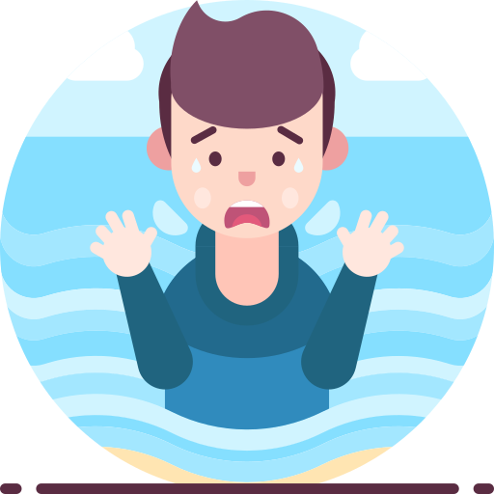
Shinobi Word of the Day
reluctant
Word Class
Word of the Day:
(adjective)
(re-luc-tant)
Pronunciation / Syllables
Definition:
If you are reluctant to do something, you are unwilling to do it and hesitate before doing it, or do it slowly and without enthusiasm.
Alonso was reluctant to get in the swimming pool.
Phrases: | very reluctant | afraid and reluctant
Synonym: | Antonym: | Prefix / Suffix: | Rhyme: | Link Word:
unwilling | willing | -ly |  | fear
fearful | eager | -ance |  | danger

Slide 11
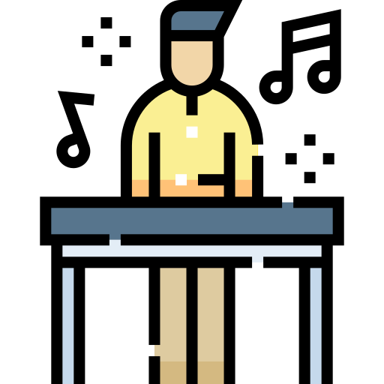
Shinobi Word of the Day
effortless
Word Class
Word of the Day:
(adjective)
(ef-fort-less)
Pronunciation / Syllables
Definition:
Something that is effortless is done easily and well.
Mr Jay made playing the piano look effortless.
Phrases: | truly effortless | natural and effortless
Synonym: | Antonym: | Prefix / Suffix: | Rhyme: | Link Word:
easy | difficult | -ly |  | move
simple |  |  |  | play

Slide 12

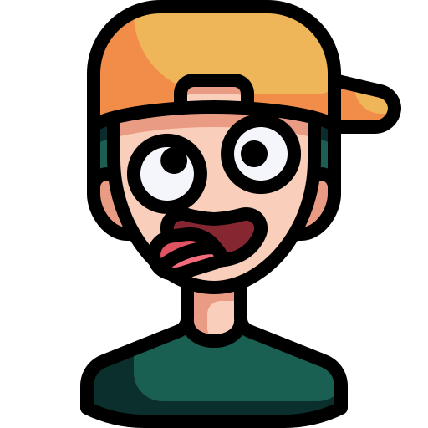
Shinobi Word of the Day
glare
Word Class
Word of the Day:
(noun / verb)
(glare)
Pronunciation / Syllables
Definition:
If you glare at someone, you look at them with an angry expression on your face.
Mr Jay glared at Ronnie while she played the piano.
Phrases: | glare angrily | a short glare
Synonym: | Antonym: | Prefix / Suffix: | Rhyme: | Link Word:
scowl | smile | -ed | where | naughty
glower |  | -ing | stare | angry

Slide 13
Shinobi Word of the Day
tension
Word Class
Word of the Day:
(noun)
(ten-sion)
Pronunciation / Syllables
Definition:
Tension is the feeling that is produced in a situation when people are anxious and do not trust each other.
You could feel the tension, as Mr Jay glared at Ronnie.
Phrases: | full of tension | feel the tension
Synonym: | Antonym: | Prefix / Suffix: | Rhyme: | Link Word:
friction | harmony | -s | mention | awkward
unease |  |  | attention | moment

Slide 14

Shinobi Word of the Day
unanimous
Word Class
Word of the Day:
(adjective)
(u-nan-i-mous)
Pronunciation / Syllables
Definition:
When a group of people are unanimous, they all agree about something or all vote for the same thing.
It was unanimous, everyone thought Ronnie had been rude.
Phrases: | a unanimous decision | overwhelmingly unanimous
Synonym: | Antonym: | Prefix / Suffix | Rhyme: | Link Word:
united | divided | -ly |  | decision
with one voice | at odds |  |  | opinion

Slide 15
Vocabulary Laboratory
Describe / Definition:
Use it in a sentence:
Focus Word (write below):
Word Class:
Synonyms: (words with same / similar meaning) | Antonyms: (words with opposite meaning)
Rhymes: (words that sound the same) | Link Words: (Example: football = pitch, team, player)
Draw your sentence:

Slide 16

Vocabulary Visualiser
Draw the Grasshopper words and bring them to life.
Word: climb | Word: skip
Word: bounce | Word: meet

Slide 17
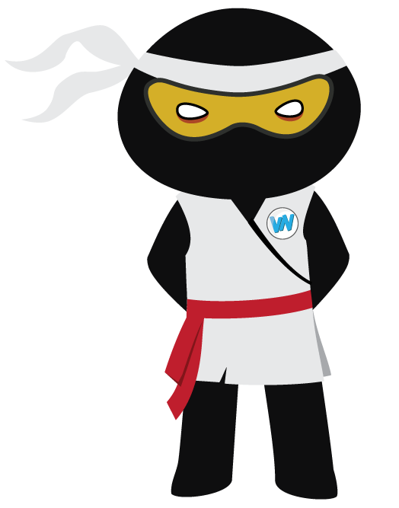
Vocabulary Visualiser
Draw the Shinobi words and bring them to life.
Word: effortless | Word: reluctant
Word: glare | Word: unanimous

Slide 18
Matching Meanings
Draw lines from the Grasshopper words to their definitions.
Grasshopper Word
climb
skip
blow
bounce
meet
Grasshopper Definitions
If you *** along, you move almost as if you are dancing, with a series of little jumps from one foot to the other.
When an object such as a ball *** or when you *** it, it moves upwards from a surface or away from it immediately after hitting it.
If you *** someone, you happen to be in the same place as them and start talking to them. You may know the other person, but be surprised to see them, or you may not know them at all.
If you *** something such as a tree, mountain, or ladder, or climb up it, you move towards the top of it. If you *** down it, you move towards the bottom of it.
If the wind *** something somewhere or if it *** there, the wind moves it there.

Slide 19
Matching Meanings
Draw lines from the Shinobi words to their definitions.
Shinobi Word
reluctant
effortless
glare
tension
unanimous
Shinobi Definitions
Something that is *** is done easily and well.
*** is the feeling that is produced in a situation when people are anxious and do not trust each other.
When a group of people are ***, they all agree about something or all vote for the same thing.
If you *** at someone, you look at them with an angry expression on your face.
If you are *** to do something, you are unwilling to do it and hesitate before doing it, or do it slowly and without enthusiasm.

Slide 20






Display Slips
The following slides are for classroom display. As you teach each Word of the Day, words can be displayed in the classroom to enable pupils to use the taught vocabulary in an independent manner.

Slide 21
climb
skip

Slide 22
blow
bounce

Slide 23
meet
reluctant

Slide 24
effortless
glare

Slide 25
tension
unanimous

