Slide 1
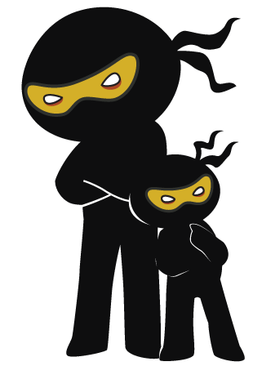



Word of the Day
Autumn Term 2020
Week – 2nd November 2020
'Words unlock the doors to a world of understanding...'

Slide 2

This Week's Words
Grasshopper
Shinobi
listen
responsible
downstairs
remarkable
attic
interrupt
thin
suspicious
dull
consequence

Slide 3
Grasshopper (Tier 1)
listen
downstairs
attic
thin
dull

Slide 4
Shinobi (Tier 2)
responsible
remarkable
interrupt
suspicious
consequence

Slide 5


Grasshopper Word of the Day
listen
Word Class
Word of the Day:
(noun / verb)
(lis-ten)
Pronunciation / Syllables
Definition:
If you listen to someone who is talking or to a sound, you give your attention to them or it.
Hamza listened to music on his computer.
Phrases: | listen to the | listen carefully
Synonym: | Antonym: | Rhyme: | Link Word:
hear | ignore | glisten | music
 |  | mission | words

Slide 6

Grasshopper Word of the Day
downstairs
Word Class
Word of the Day:
(noun / adjective)
(down-stairs)
Pronunciation / Syllables
Definition:
If something or someone is downstairs in a building, they are on the ground floor or on a lower floor than you.
I needed to move the the classroom downstairs.
Phrases: | move slowly downstairs | need to go downstairs
Synonym: | Antonym: | Rhyme: | Link Word:
 | upstairs | chairs | house
 |  | pairs | upstairs

Slide 7
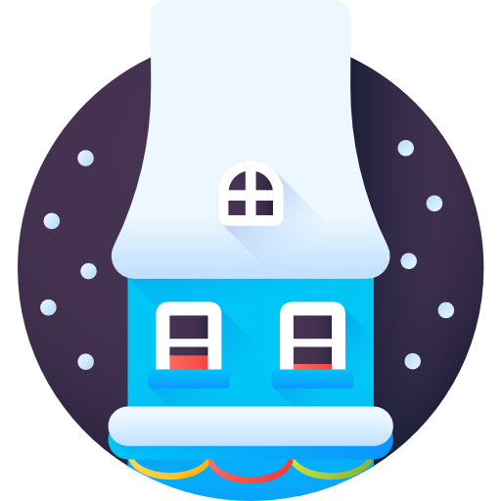
Grasshopper Word of the Day
attic
Word Class
Word of the Day:
(noun)
(at-tic)
Pronunciation / Syllables
Definition:
An attic is a room at the top of a house just below the roof.
The old clothes and decorations we placed in the attic.
Phrases: | put in the attic | the spooky attic
Synonym: | Antonym: | Rhyme: | Link Word:
loft |  | static | loft
 |  | dramatic | spooky

Slide 8
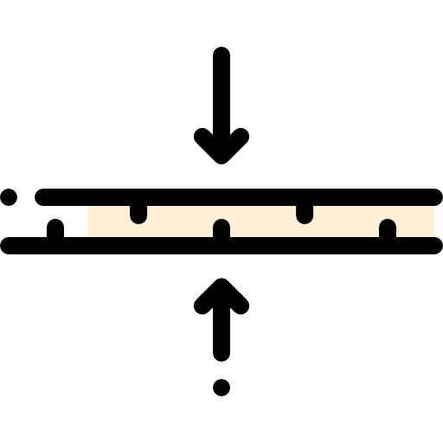
Grasshopper Word of the Day
thin
Word Class
Word of the Day:
(adjective)
(thin)
Pronunciation / Syllables
Definition:
Something that is thin is much narrower than it is long.
The children walked along the thin pavement.
Phrases: | long and thin | thick and thin
Synonym: | Antonym: | Rhyme: | Link Word:
narrow | thick | bin | person
fine |  | sin | object

Slide 9

Grasshopper Word of the Day
dull
Word Class
Word of the Day:
(adjective)
(dull)
Pronunciation / Syllables
Definition:
A dull colour or light is not bright.
The moon was dull in the sky because it was behind clouds.
Phrases: | the dull light | the colours were dull
Synonym: | Antonym: | Rhyme: | Link Word:
dark | bright | full | light
gloomy |  | pull | colour

Slide 10
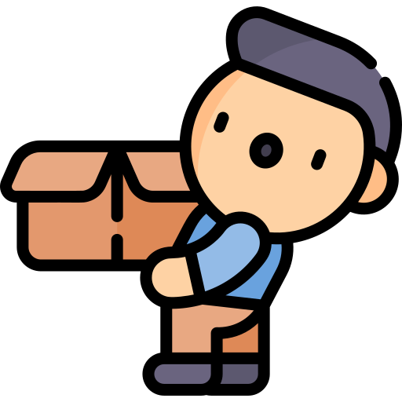
Shinobi Word of the Day
responsible
Word Class
Word of the Day:
(adjective)
(re-spon-si-ble)
Pronunciation / Syllables
Definition:
If someone or something is responsible for a particular event or situation, they are the cause of it or they can be blamed for it.
Alice was responsible for moving the box of plates.
Phrases: | responsible for | was responsible for
Synonym: | Antonym: | Prefix / Suffix: | Rhyme: | Link Word:
accountable |  | ir- |  | person
 |  | -ly |  | role

Slide 11

Shinobi Word of the Day
remarkable
Word Class
Word of the Day:
(adjective)
(re-mark-a-ble)
Pronunciation / Syllables
Definition:
Someone or something that is remarkable is unusual or special in a way that makes people notice them and be surprised or impressed.
Ismail’s report on WW2 was remarkable.
Phrases: | it was a remarkable | remarkable and special
Synonym: | Antonym: | Prefix / Suffix: | Rhyme: | Link Word:
astonishing | ordinary | un- | chargeable | work
extraordinary |  | -ly |  | skill

Slide 12

Shinobi Word of the Day
interrupt
Word Class
Word of the Day:
(verb)
(in-ter-rupt)
Pronunciation / Syllables
Definition:
If you interrupt someone who is speaking, you say or do something that causes them to stop.
John interrupted the teacher while she was talking.
Phrases: | interrupted the conversation | interrupted which was rude
Synonym: | Antonym: | Prefix / Suffix: | Rhyme: | Link Word:
heckle | continue | -tion | erupt | conversation
cancel |  | -ing | abrupt | game

Slide 13
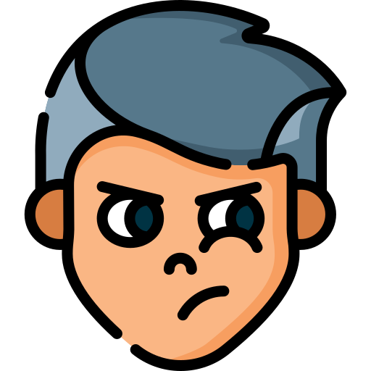
Shinobi Word of the Day
suspicious
Word Class
Word of the Day:
(adjective)
(sus-pi-cious)
Pronunciation / Syllables
Definition:
If you are suspicious of someone or something, you do not trust them, and are careful when dealing with them.
I was suspicious of the twins, who went back inside.
Phrases: | was suspicious of | was acting suspiciously
Synonym: | Antonym: | Prefix / Suffix: | Rhyme: | Link Word:
wary | trusting | -ly | vicious | behaviour
dubious |  |  | delicious | sounds

Slide 14


Shinobi Word of the Day
consequence
Word Class
Word of the Day:
(noun)
(con-se-quence)
Pronunciation / Syllables
Definition:
The consequences of something are the results or effects of it.
Callum needed a consequence for being rude.
Phrases: | there would be a consequence | the consequence was
Synonym: | Antonym: | Prefix / Suffix | Rhyme: | Link Word:
result | cause | -tly | fence | naughty
effect |  | in- | deliverance | rules

Slide 15
listen
downstairs

Slide 16
attic
thin

Slide 17
dull
responsible

Slide 18
remarkable
interrupt

Slide 19
suspicious
consequence

