Slide 1




Word of the Day
Autumn Term 2020
Week – 16th November 2020
'Words unlock the doors to a world of understanding...'

Slide 2

This Week's Words
Grasshopper
Shinobi
truth
vile
lie
betray
exit
haul
wish
wreckage
pile
limp

Slide 3
Grasshopper (Tier 1)
truth
lie
exit
wish
pile

Slide 4
Shinobi (Tier 2)
vile
betray
haul
wreckage
limp

Slide 5


Grasshopper Word of the Day
truth
Word Class
Word of the Day:
(noun)
(truth)
Pronunciation / Syllables
Definition:
The truth about something is all the facts about it, rather than things that are imagined or invented.
It was important to always tell the truth.
Phrases: | told the truth | must tell the truth
Synonym: | Antonym: | Rhyme: | Link Word:
fact | false | youth | words
 |  | tooth | lie

Slide 6

Grasshopper Word of the Day
lie
Word Class
Word of the Day:
(noun/verb)
(lie)
Pronunciation / Syllables
Definition:
A lie is something that someone says or writes which they know is untrue.
Julie told a lie about doing her homework.
Phrases: | mustn’t lie | shouldn’t lie to
Synonym: | Antonym: | Rhyme: | Link Word:
fib | truth | pie | people
 | fact | die | trick

Slide 7

Grasshopper Word of the Day
exit
Word Class
Word of the Day:
(noun/verb)
(ex-it)
Pronunciation / Syllables
Definition:
The exit is the door through which you can leave a public building.
The children moved to the exit, ready for lunch.
Phrases: | ran to the exit | used the exit
Synonym: | Antonym: | Rhyme: | Link Word:
way out | entrance |  | building
door |  |  | fire

Slide 8

Grasshopper Word of the Day
wish
Word Class
Word of the Day:
(noun/verb)
(wish)
Pronunciation / Syllables
Definition:
A wish is a desire or strong feeling that you want to have something or do something.
Everyone wished things would quickly get back to normal.
Phrases: | wished for | hoped and wished
Synonym: | Antonym: | Rhyme: | Link Word:
crave |  | fish | light
hope |  | dish | colour

Slide 9

Grasshopper Word of the Day
pile
Word Class
Word of the Day:
(noun/verb)
(pile)
Pronunciation / Syllables
Definition:
A pile of things is a mass of them that is high in the middle and has sloping sides.
Mr. Watson had a huge pile of books to mark.
Phrases: | an enormous pile | piled up high
Synonym: | Antonym: | Rhyme: | Link Word:
heap |  | file | books
stack |  | mile | leaves

Slide 10

Shinobi Word of the Day
vile
Word Class
Word of the Day:
(adjective)
(vile)
Pronunciation / Syllables
Definition:
If you say that someone or something is vile, you mean that they are very unpleasant.
The witch created a vile looking and smelling potion.
Phrases: | vile and disgusting | a vile person
Synonym: | Antonym: | Prefix / Suffix: | Rhyme: | Link Word:
foul | pleasant |  | style | person
vulgar |  |  | smile | behaviour

Slide 11



Shinobi Word of the Day
betray
Word Class
Word of the Day:
(verb)
(be-tray)
Pronunciation / Syllables
Definition:
If you betray someone who loves or trusts you, your actions hurt and disappoint them.
Alex betrayed his team by going to another team to play.
Phrases: | had betrayed us | your betrayal
Synonym: | Antonym: | Prefix / Suffix: | Rhyme: | Link Word:
let down | be loyal | -al | today | friend
fail |  | -ed | display | team

Slide 12


Shinobi Word of the Day
haul
Word Class
Word of the Day:
(verb/noun)
(haul)
Pronunciation / Syllables
Definition:
If you haul something which is heavy or difficult to move, you move it using a lot of effort.
The science club had a large haul of butterflies.
Phrases: | a significant haul | hauled the _____ into the
Synonym: | Antonym: | Prefix / Suffix: | Rhyme: | Link Word:
drag | push | -ed | hall | sport
pull |  | -ing | ball | fishing

Slide 13

Shinobi Word of the Day
wreckage
Word Class
Word of the Day:
(noun)
(wreck-age)
Pronunciation / Syllables
Definition:
When something such as a plane, car, or building has been destroyed, you can refer to what remains as wreckage or the wreckage.
The wreckage of the ship was covered in history.
Phrases: | an ancient wreckage | the wreckage of
Synonym: | Antonym: | Prefix / Suffix: | Rhyme: | Link Word:
wreck |  | -s | message | ship
debris |  |  |  | aeroplane

Slide 14
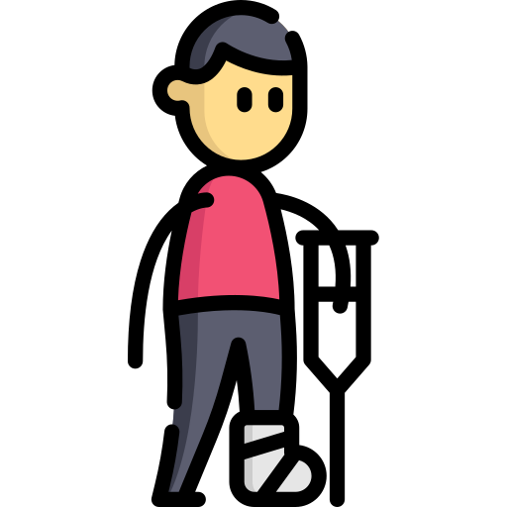
Shinobi Word of the Day
limp
Word Class
Word of the Day:
(verb/noun)
(limp)
Pronunciation / Syllables
Definition:
If a person or animal limps, they walk with difficulty or in an uneven way because one of their legs or feet is hurt.
Greg was limping after he was kicked during football.
Phrases: | limped in pain | limped away from
Synonym: | Antonym: | Prefix / Suffix | Rhyme: | Link Word:
hobble |  | -ed | shrimp | walk
shuffle |  | -ing | wimp | injury

Slide 15
truth
lie

Slide 16
exit
wish

Slide 17
pile
vile

Slide 18
betray
haul

Slide 19
wreckage
limp

