Slide 1




Word of the Day
Autumn Term 2020
Week – 30th November 2020
'Words unlock the doors to a world of understanding...'

Slide 2

This Week's Words
Grasshopper
Shinobi
guess
ablaze
slimy
brazen
nibble
sublime
gulp
absurd
millionaire
squander

Slide 3
Grasshopper (Tier 1)
guess
slimy
nibble
gulp
millionaire

Slide 4
Shinobi (Tier 2)
ablaze
brazen
sublime
absurd
squander

Slide 5


Grasshopper Word of the Day
guess
Word Class
Word of the Day:
(verb/noun)
(guess)
Pronunciation / Syllables
Definition:
If you guess something, you give an answer or provide an opinion which may not be true because you do not have definite knowledge about the matter concerned.
Could the children guess the mystery number?
Phrases: | a good guess | couldn’t guess
Synonym: | Antonym: | Rhyme: | Link Word:
estimate |  | dress | question
think |  | bless | answer

Slide 6

Grasshopper Word of the Day
slimy
Word Class
Word of the Day:
(adjective)
(slim-y)
Pronunciation / Syllables
Definition:
Slimy substances are thick, wet, and unpleasant. Slimy objects are covered in a slimy substance.
The snail was beautiful and left a slimy trail.
Phrases: | slippery and slimy | covered in slime
Synonym: | Antonym: | Rhyme: | Link Word:
gooey |  | grimy | insect
slippy |  |  | gunk

Slide 7

Grasshopper Word of the Day
nibble
Word Class
Word of the Day:
(verb/noun)
(nib-ble)
Pronunciation / Syllables
Definition:
If you nibble food, you eat it by biting very small pieces of it, for example because you are not very hungry.
Mr Jones nibbled at the doughnut during lunchtime.
Phrases: | slowly nibbled | nibbled and gnawed
Synonym: | Antonym: | Rhyme: | Link Word:
peck | guzzle | scribble | food
bite |  | dribble | nail

Slide 8
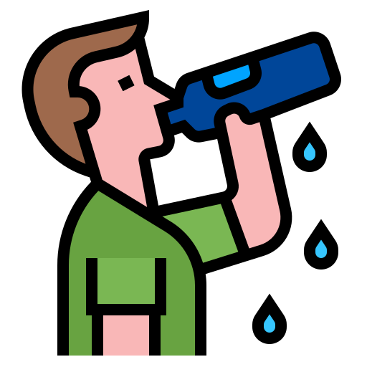
Grasshopper Word of the Day
gulp
Word Class
Word of the Day:
(verb/noun)
(gulp)
Pronunciation / Syllables
Definition:
If you gulp something, you eat or drink it very quickly by swallowing large quantities of it at once.
Rahim gulped his water after PE.
Phrases: | a huge gulp of | gasped and gulped
Synonym: | Antonym: | Rhyme: | Link Word:
guzzle | sip | pulp | air
swig |  |  | liquid

Slide 9

Grasshopper Word of the Day
millionaire
Word Class
Word of the Day:
(noun)
(mil-lion-aire)
Pronunciation / Syllables
Definition:
A millionaire is a very rich person who has money or property worth at least a million pounds or dollars.
The millionaire visited the school with the charity.
Phrases: | generous millionaire | unknown millionaire
Synonym: | Antonym: | Rhyme: | Link Word:
 |  | care | money
 |  | hair | rich

Slide 10

Shinobi Word of the Day
ablaze
Word Class
Word of the Day:
(adjective)
(a-blaze)
Pronunciation / Syllables
Definition:
Something that is ablaze is burning very fiercely. If a place is ablaze with lights or colours, it is very bright because of them.
Jeff’s eyes were ablaze with excitement..
Phrases: | ablaze with | ablaze from
Synonym: | Antonym: | Prefix / Suffix: | Rhyme: | Link Word:
alight | dark |  | amaze | fire
aglow | extinguished |  | craze | eyes

Slide 11

Shinobi Word of the Day
brazen
Word Class
Word of the Day:
(adjective/verb)
(bra-zen)
Pronunciation / Syllables
Definition:
If you describe a person or their behaviour as brazen, you mean that they are very bold and do not care what other people think about them or their behaviour.
Jen walked brazenly into the classroom ten minutes late.
Phrases: | bold and brazen | his brazen actions
Synonym: | Antonym: | Prefix / Suffix: | Rhyme: | Link Word:
bold | shy | -ly | raisin | behaviour
insolent | timid |  |  | action

Slide 12

Shinobi Word of the Day
sublime
Word Class
Word of the Day:
(adjective/verb)
(sub-lime)
Pronunciation / Syllables
Definition:
If you describe something as sublime, you mean that it has a wonderful quality that affects you deeply.
Today’s pudding was absolutely sublime.
Phrases: | just sublime | sublime and delicious
Synonym: | Antonym: | Prefix / Suffix: | Rhyme: | Link Word:
first-class | poor | -ly | time | food
heavenly | ordinary |  | crime | clothing

Slide 13

Shinobi Word of the Day
absurd
Word Class
Word of the Day:
(adjective/noun)
(ab-surd)
Pronunciation / Syllables
Definition:
If you say that something is absurd, you are criticizing it because you think that it is ridiculous or that it does not make sense.
Dad thought the price of the trainers was absurd.
Phrases: | rather absurd | completely absurd
Synonym: | Antonym: | Prefix / Suffix: | Rhyme: | Link Word:
ridiculous | sensible | -ly | heard | cost
laughable |  |  | occurred | behaviour

Slide 14

Shinobi Word of the Day
squander
Word Class
Word of the Day:
(verb)
(squan-der)
Pronunciation / Syllables
Definition:
If you squander money, resources, or opportunities, you waste them.
Shahib didn’t want to squander his time playing games.
Phrases: | had squandered | don’t squander
Synonym: | Antonym: | Prefix / Suffix | Rhyme: | Link Word:
waste | save | -ing | wander | money
throw away |  | -ed | ponder | time

Slide 15
guess
slimy

Slide 16
nibble
gulp

Slide 17
millionaire
ablaze

Slide 18
brazen
sublime

Slide 19
absurd
squander

