Slide 1




Word of the Day
Autumn Term 2020
Week – 23rd November 2020
'Words unlock the doors to a world of understanding...'

Slide 2

This Week's Words
Grasshopper
Shinobi
build
warning
roots
judge
history
intend
village
descend
memories
slavery

Slide 3
Grasshopper (Tier 1)
build
roots
history
village
memories

Slide 4
Shinobi (Tier 2)
warning
judge
intend
descend
slavery

Slide 5


Grasshopper Word of the Day
build
Word Class
Word of the Day:
(verb)
(build)
Pronunciation / Syllables
Definition:
If you build something, you make it by joining things together.
The children were building model boats.
Phrases: | create and build | build with
Synonym: | Antonym: | Rhyme: | Link Word:
construct | demolish | skilled | create
make |  | filled | home

Slide 6

Grasshopper Word of the Day
roots
Word Class
Word of the Day:
(noun)
(roots)
Pronunciation / Syllables
Definition:
You can refer to the place or culture that a person or their family comes from as their roots.
Emily’s roots were important to her.
Phrases: | my roots are | roots were important to
Synonym: | Antonym: | Rhyme: | Link Word:
family |  | fruits | family
origins |  | boots | history

Slide 7

Grasshopper Word of the Day
history
Word Class
Word of the Day:
(noun)
(his-to-ry)
Pronunciation / Syllables
Definition:
A history is an account of events that have happened in the past.
Understanding our history is important.
Phrases: | our history | the history of
Synonym: | Antonym: | Rhyme: | Link Word:
the past | future | mystery | war
 |  |  | learning

Slide 8

Grasshopper Word of the Day
village
Word Class
Word of the Day:
(noun)
(vil-lage)
Pronunciation / Syllables
Definition:
A village consists of a group of houses, together with other buildings such as a church and a school, in a country area.
The village was calm, peaceful and full of nature.
Phrases: | the beautiful village | village close to the
Synonym: | Antonym: | Rhyme: | Link Word:
 |  | pillage | town
 |  | spillage | community

Slide 9

Grasshopper Word of the Day
memories
Word Class
Word of the Day:
(noun)
(mem-o-ries)
Pronunciation / Syllables
Definition:
A memory is something that you remember from the past.
We looked at the wonderful memories in the photo album.
Phrases: | fond memories of | my memories of
Synonym: | Antonym: | Rhyme: | Link Word:
 |  | treasury | videos
 |  | remedy | pictures

Slide 10

Shinobi Word of the Day
warning
Word Class
Word of the Day:
(noun)
(warn-ing)
Pronunciation / Syllables
Definition:
A warning is something which is said or written to tell people of a possible danger, problem, or other unpleasant thing that might happen.
Without warning, the fire alarm began to sound.
Phrases: | without warning | was a warning for
Synonym: | Antonym: | Prefix / Suffix: | Rhyme: | Link Word:
caution |  |  | mourning | danger
alert |  |  | scorning | change

Slide 11

Shinobi Word of the Day
judge
Word Class
Word of the Day:
(verb)
(judge)
Pronunciation / Syllables
Definition:
If you judge something or someone, you form an opinion about them after you have examined the evidence or thought carefully about them.
Evie was judging who would be chosen for the role.
Phrases: | was judging her | judged the performance
Synonym: | Antonym: | Prefix / Suffix: | Rhyme: | Link Word:
decide |  | -ing | fudge | people
deem |  | -ed | budge | performance

Slide 12

Shinobi Word of the Day
intend
Word Class
Word of the Day:
(verb)
(in-tend)
Pronunciation / Syllables
Definition:
If you intend to do something, you have decided or planned to do it.
Fatima intended to visit her gran after school.
Phrases: | had always intended to | was my intention to
Synonym: | Antonym: | Prefix / Suffix: | Rhyme: | Link Word:
plan |  | -tion | defend | decide
mean |  | -ing | pretend | plan

Slide 13
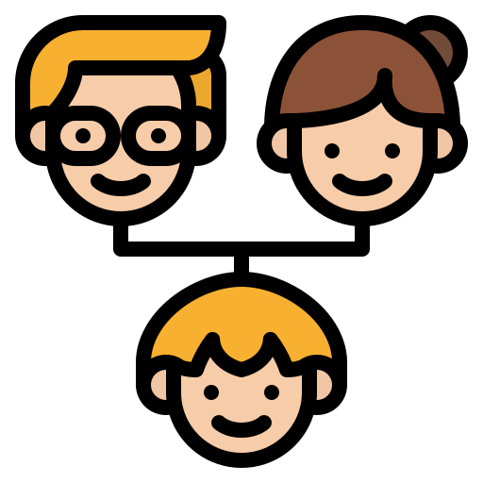
Shinobi Word of the Day
descend
Word Class
Word of the Day:
(verb)
(de-scend)
Pronunciation / Syllables
Definition:
Connected by a blood relationship to another person.
Who do you descend from?
Phrases: | descended from | I descended from
Synonym: | Antonym: | Prefix / Suffix: | Rhyme: | Link Word:
come from |  | -ant | ascend | ancestor
 |  | -ing | friend | history

Slide 14
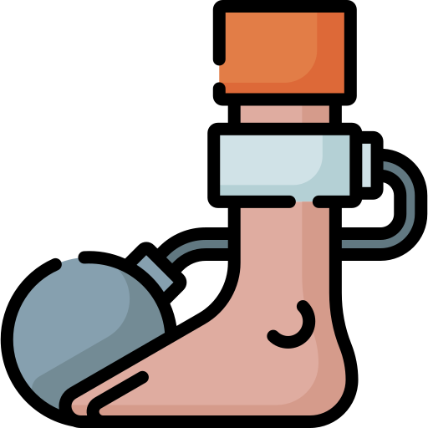
Shinobi Word of the Day
slavery
Word Class
Word of the Day:
(noun)
(slav-er-y)
Pronunciation / Syllables
Definition:
The subjection of a person to another person, especially in being forced into work. Total control over.
Slavery is a terrible thing.
Phrases: | was a slave to | was a form of slavery
Synonym: | Antonym: | Prefix / Suffix | Rhyme: | Link Word:
captivity | freedom |  | bravery | Europe
shackles |  |  |  | Africa

Slide 15
build
roots

Slide 16
history
village

Slide 17
memories
warning

Slide 18
judge
intend

Slide 19
descend
slavery

