Slide 1
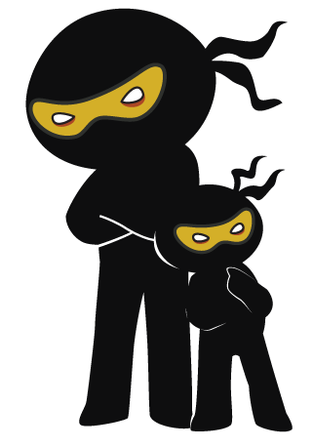



Word of the Day
Autumn Term 2020
Week 15 – 14th December 2020
'Words unlock the doors to a world of understanding...'

Slide 2

This Week's Words
Grasshopper
Shinobi
gift
anticipation
midnight
lavish
peace
nostalgia
tinsel
yuletide
bauble
eve

Slide 3
Grasshopper (Tier 1)
gift
midnight
peace
tinsel
bauble

Slide 4
Shinobi (Tier 2)
anticipation
lavish
nostalgia
yuletide
eve

Slide 5


Grasshopper Word of the Day
gift
Word Class
Word of the Day:
(noun)
(gift)
Pronunciation / Syllables
Definition:
A gift is something that you give someone as a present.
Mrs Rasul gave every child a book as a gift.
Phrases: | a secret gift | a gift wrapped in
Synonym: | Antonym: | Rhyme: | Link Word:
present |  | shift | birthday
offering |  | lift | Christmas

Slide 6


Grasshopper Word of the Day
midnight
Word Class
Word of the Day:
(noun)
(mid-night)
Pronunciation / Syllables
Definition:
Midnight is twelve o'clock in the middle of the night.
It was 11:59pm. One minute until midnight.
Phrases: | just before midnight | midnight was coming
Synonym: | Antonym: | Rhyme: | Link Word:
 |  | might | night
 |  | flight | day

Slide 7

Grasshopper Word of the Day
peace
Word Class
Word of the Day:
(noun)
(peace)
Pronunciation / Syllables
Definition:
If you have a feeling of peace, you feel contented and calm and not at all worried. You can also say that you are at peace.
Mr Smith relaxed in his chair and felt at peace.
Phrases: | Ah…peace at last | it was peaceful
Synonym: | Antonym: | Rhyme: | Link Word:
calm | noise | police | relaxed
 | irritation | cease | calm

Slide 8
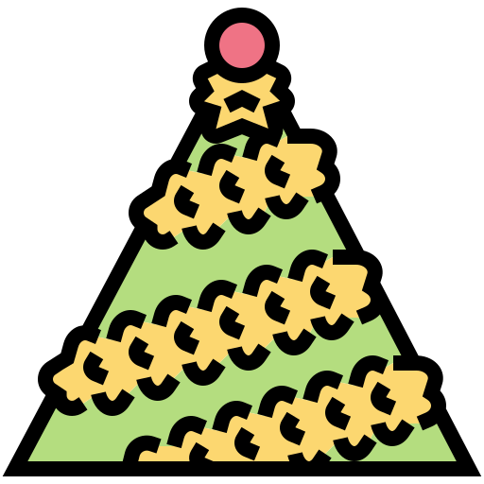
Grasshopper Word of the Day
tinsel
Word Class
Word of the Day:
(noun)
(tin-sel)
Pronunciation / Syllables
Definition:
Tinsel consists of small strips of shiny paper attached to long pieces of thread. People use tinsel as a decoration at Christmas.
The tinsel was wrapped around the tree.
Phrases: | sparkling tinsel was | covered in tinsel
Synonym: | Antonym: | Rhyme: | Link Word:
spangle |  |  | tree
glitter |  |  | angel

Slide 9

Grasshopper Word of the Day
bauble
Word Class
Word of the Day:
(noun)
(bau-ble)
Pronunciation / Syllables
Definition:
A bauble is a small, cheap ornament or piece of jewellery, normally hung on a Christmas tree.
Baubles of every colour were on the tree.
Phrases: | baubles hung from the | baubles of every size and shape
Synonym: | Antonym: | Rhyme: | Link Word:
ornament |  |  | tree
toy |  |  | decoration

Slide 10

Shinobi Word of the Day
anticipation
Word Class
Word of the Day:
(noun)
(an-tic-pa-tion)
Pronunciation / Syllables
Definition:
Anticipation is a feeling of excitement about something pleasant or exciting that you know is going to happen.
Everyone was full of anticipation for Christmas.
Phrases: | was anticipating getting a | didn’t anticipate that
Synonym: | Antonym: | Prefix / Suffix: | Rhyme: | Link Word:
excitement |  | -tion | education | excited
hope |  |  | situation | present

Slide 11
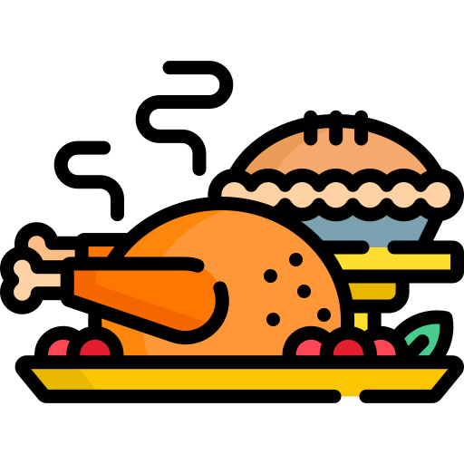
Shinobi Word of the Day
lavish
Word Class
Word of the Day:
(adjective)
(lav-ish)
Pronunciation / Syllables
Definition:
If you describe something as lavish, you mean that it is very elaborate and impressive and a lot of money has been spent on it.
The dinner staff had prepared a lavish Christmas dinner.
Phrases: | such a lavish | a lavish and bold gift
Synonym: | Antonym: | Prefix / Suffix: | Rhyme: | Link Word:
luxurious | meagre | -ly | wish | expensive
sumptuous |  | -ing | ravish | meal

Slide 12


Shinobi Word of the Day
nostalgia
Word Class
Word of the Day:
(noun)
(nos-tal-gia)
Pronunciation / Syllables
Definition:
Nostalgia is an affectionate feeling you have for the past, especially for a particularly happy time.
Julie felt nostalgic as the Christmas songs played.
Phrases: | she felt nostalgic | nostalgia filled the room
Synonym: | Antonym: | Prefix / Suffix: | Rhyme: | Link Word:
remembrance |  | -ic |  | memory
reminiscence |  |  |  | feeling

Slide 13

Shinobi Word of the Day
Yuletide
Word Class
Word of the Day:
(noun)
(yule-tide)
Pronunciation / Syllables
Definition:
Yuletide is the period of several days around and including Christmas Day.
The magical grotto had symbols of a Yuletide theme.
Phrases: | Yuletide greetings | full of Yuletide spirit
Synonym: | Antonym: | Prefix / Suffix: | Rhyme: | Link Word:
Christmas |  |  | ride | symbol
 |  |  | bride | period

Slide 14

Shinobi Word of the Day
eve
Word Class
Word of the Day:
(noun)
(eve)
Pronunciation / Syllables
Definition:
The eve of a particular event or occasion is the day before it, or the period of time just before it.
Alex loved Christmas. He said it was Christmas Eve Eve!
Phrases: | It was Christmas Eve | the on the eve of Christmas
Synonym: | Antonym: | Prefix / Suffix | Rhyme: | Link Word:
 |  |  | leave | day
 |  |  | heave | before

Slide 15
gift
midnight

Slide 16
peace
tinsel

Slide 17
bauble
anticipation

Slide 18
lavish
nostalgia

Slide 19
Yuletide
eve

