Slide 1
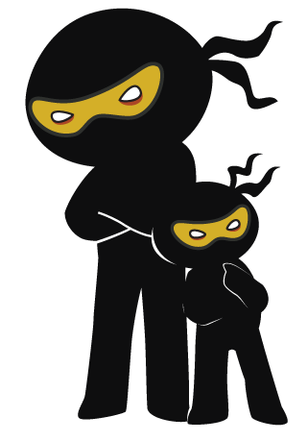



Word of the Day
Spring Term 2021
Week 17 – 11th January 2021
'Words unlock the doors to a world of understanding...'

Slide 2

This Week's Words
Grasshopper
Shinobi
whisper
fatigue
tiptoe
adore
spy
bitter
hairy
quirky
sprint
neglect

Slide 3
Grasshopper (Tier 1)
whisper
tiptoe
spy
hairy
sprint

Slide 4
Shinobi (Tier 2)
fatigue
adore
bitter
quirky
neglect

Slide 5


Grasshopper Word of the Day
whisper
Word Class
Word of the Day:
(verb)
(whis-per)
Pronunciation / Syllables
Definition:
When you whisper, you say something very quietly, using your breath rather than your throat, so that only one person can hear you.
Shanza whispered to her best friend in the lesson.
Phrases: | whisper quietly | stop whispering
Synonym: | Antonym: | Rhyme: | Link Word:
murmur | shout | crisper | talk
mutter |  | whisker | sound

Slide 6
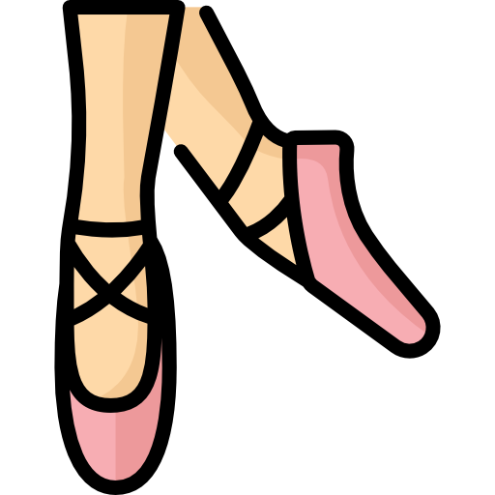
Grasshopper Word of the Day
tiptoe
Word Class
Word of the Day:
(verb)
(tip-toe)
Pronunciation / Syllables
Definition:
If you tiptoe somewhere, you walk there very quietly without putting your heels on the floor when you walk.
The dancer tiptoed across the dance floor.
Phrases: | tiptoed across the | tiptoed carefully towards
Synonym: | Antonym: | Rhyme: | Link Word:
sneak |  | crypto | dance
 |  |  | walk

Slide 7


Grasshopper Word of the Day
spy
Word Class
Word of the Day:
(verb)
(spy)
Pronunciation / Syllables
Definition:
If you spy on someone, you watch them secretly.
Jenny spied on Adriana from behind the slide.
Phrases: | the hidden spy was | spied from the shadows
Synonym: | Antonym: | Rhyme: | Link Word:
watch |  | sky | enemy
follow |  | dry | hide

Slide 8

Grasshopper Word of the Day
hairy
Word Class
Word of the Day:
(adjective)
(hair-y)
Pronunciation / Syllables
Definition:
Someone or something that is hairy is covered with hairs.
The hairy spider crawled up the wall.
Phrases: | dirty and hairy | thick, hairy fur
Synonym: | Antonym: | Rhyme: | Link Word:
furry | hairless | library | animal
bushy |  | dairy | clothes

Slide 9
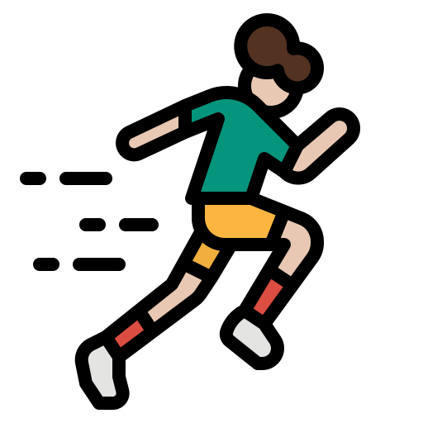
Grasshopper Word of the Day
sprint
Word Class
Word of the Day:
(verb)
(sprint)
Pronunciation / Syllables
Definition:
If you sprint, you run or ride as fast as you can over a short distance.
Fatima sprinted to use the swings first.
Phrases: | sprinted to the | sprinted away from
Synonym: | Antonym: | Rhyme: | Link Word:
race | walk | print | sport
dart |  | hint | running

Slide 10

Shinobi Word of the Day
fatigue
Word Class
Word of the Day:
(noun)
(fa-tigue)
Pronunciation / Syllables
Definition:
Fatigue is a feeling of extreme physical or mental tiredness.
The long days staring at the screen were fatiguing.
Phrases: | could fatigue in | I’m fatigued from
Synonym: | Antonym: | Prefix / Suffix: | Rhyme: | Link Word:
tiredness | energy | -ed | league | work
exhaustion | vigour | -ing | intrigue | energy

Slide 11


Shinobi Word of the Day
adore
Word Class
Word of the Day:
(verb)
(a-dore)
Pronunciation / Syllables
Definition:
If you adore something, you like it very much.
Ramesh adored every type of fruit.
Phrases: | was full of adoration for | just adored
Synonym: | Antonym: | Prefix / Suffix: | Rhyme: | Link Word:
love | hate | -ation | before | food
cherish | loathe | -ed | floor | feelings

Slide 12

Shinobi Word of the Day
bitter
Word Class
Word of the Day:
(adjective)
(bit-ter)
Pronunciation / Syllables
Definition:
If someone is bitter after a disappointing experience or after being treated unfairly, they continue to feel angry about it.
Ollie was bitter after finishing third in the race.
Phrases: | bitter and jealous | a bitter, old
Synonym: | Antonym: | Prefix / Suffix: | Rhyme: | Link Word:
resentful | content | -ly | litter | attitude
disgruntled | magnanimous | -ness | glitter | person

Slide 13

Shinobi Word of the Day
quirky
Word Class
Word of the Day:
(adjective)
(quirk-y)
Pronunciation / Syllables
Definition:
Something or someone that is quirky is rather odd or unpredictable in their appearance, character, or behaviour.
The new girl in school had a quirky accent.
Phrases: | unique and quirky | unusually quirky
Synonym: | Antonym: | Prefix / Suffix: | Rhyme: | Link Word:
eccentric | conventional | -ier | turkey | clothes
unusual | normal | -iness | murky | voice

Slide 14
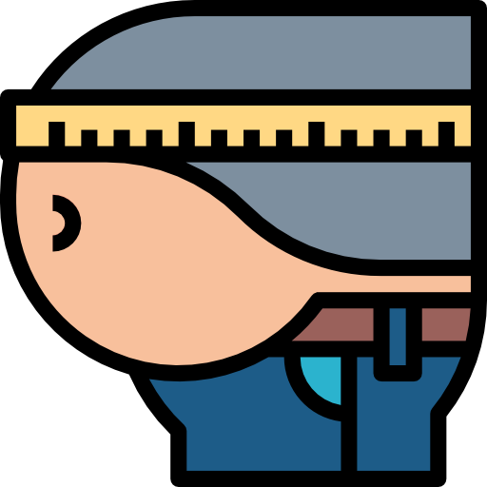
Shinobi Word of the Day
neglect
Word Class
Word of the Day:
(verb)
(ne-glect)
Pronunciation / Syllables
Definition:
If you neglect someone or something, you fail to look after them properly.
John neglected himself in 2020, so he started to exercise every day.
Phrases: | had neglected | suffered from terrible neglect
Synonym: | Antonym: | Prefix / Suffix | Rhyme: | Link Word:
abandon | look after | -ful | subject | children
forsake | cherish | -ing | respect | animals

Slide 15
Vocabulary Laboratory
Describe / Definition:
Use it in a sentence:
Focus Word (write below):
Word Class:
Synonyms: (words with same / similar meaning) | Antonyms: (words with opposite meaning)
Rhymes: (words that sound the same) | Link Words: (Example: football = pitch, team, player)
Draw your sentence:

Slide 16
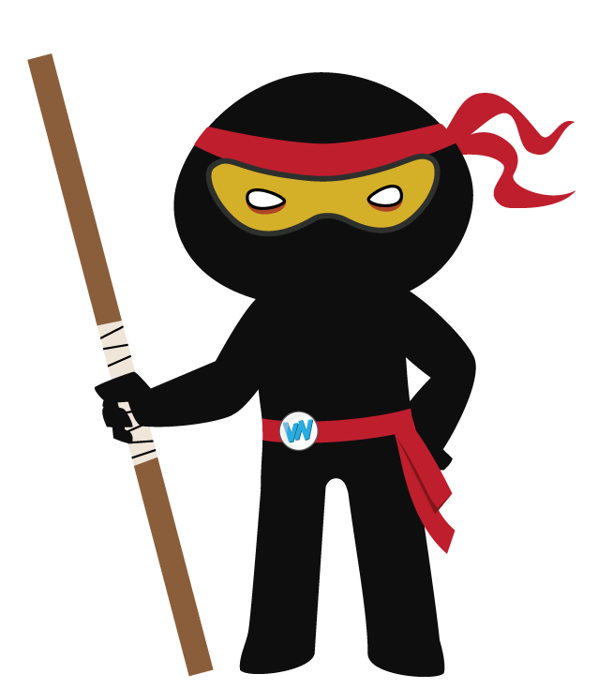
Vocabulary Visualiser
Draw the Grasshopper words and bring them to life.
Word: whisper | Word: tiptoe
Word: spy | Word: hairy

Slide 17
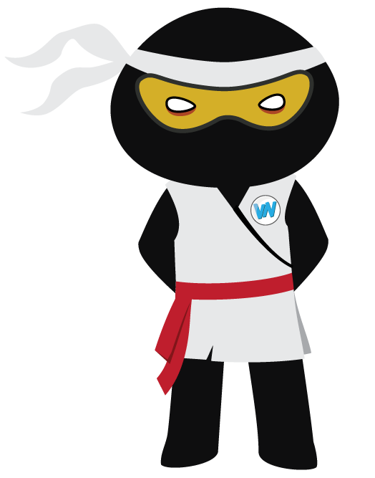
Vocabulary Visualiser
Draw the Shinobi words and bring them to life.
Word: adore | Word: bitter
Word: quirky | Word: neglect

Slide 18
Matching Meanings
Draw lines from the Grasshopper words to their definitions.
Grasshopper Word
whisper
tiptoe
spy
hairy
sprint
Grasshopper Definitions
If you **** on someone, you watch them secretly.
Someone or something that is **** is covered with hairs.
When you ****, you say something very quietly, using your breath rather than your throat, so that only one person can hear you.
If you ****, you run or ride as fast as you can over a short distance.
If you **** somewhere, you walk there very quietly without putting your heels on the floor when you walk.

Slide 19
Matching Meanings
Draw lines from the Shinobi words to their definitions.
Shinobi Word
fatigue
adore
bitter
quirky
neglect
Shinobi Definitions
If you **** something, you like it very much.
Something or someone that is **** is rather odd or unpredictable in their appearance, character, or behaviour.
If you **** someone or something, you fail to look after them properly.
**** is a feeling of extreme physical or mental tiredness.
If someone is **** after a disappointing experience or after being treated unfairly, they continue to feel angry about it.

Slide 20
whisper
tiptoe

Slide 21
spy
hairy

Slide 22
sprint
fatigue

Slide 23
adore
bitter

Slide 24
quirky
neglect

