Slide 1




Word of the Day
Spring Term 2021
Week 16 – 4th January 2021
'Words unlock the doors to a world of understanding...'

Slide 2

This Week's Words
Grasshopper
Shinobi
dirty
compassionate
equal
infinite
fuzzy
fallible
juicy
optimistic
swollen
lousy

Slide 3
Grasshopper (Tier 1)
dirty
equal
fuzzy
juicy
swollen

Slide 4
Shinobi (Tier 2)
compassionate
infinite
fallible
optimistic
lousy

Slide 5


Grasshopper Word of the Day
dirty
Word Class
Word of the Day:
(adjective)
(dirt-y)
Pronunciation / Syllables
Definition:
If something is dirty, it is marked or covered with stains, spots, or mud, and needs to be cleaned.
Rahul’s t-shirt was dirty after playing in the mud.
Phrases: | a very dirty | dirty and smelly
Synonym: | Antonym: | Rhyme: | Link Word:
mucky | clean | thirty | clothes
grimy |  |  | stain

Slide 6

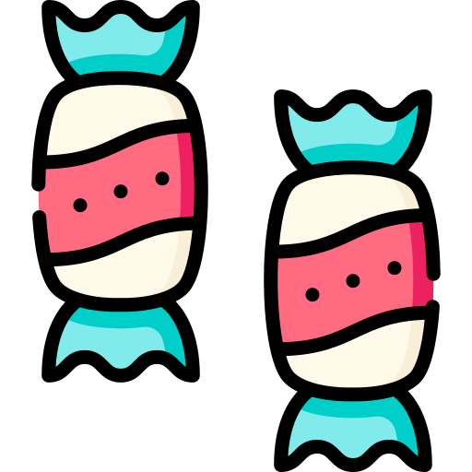
Grasshopper Word of the Day
equal
Word Class
Word of the Day:
(adjective)
(e-qual)
Pronunciation / Syllables
Definition:
If two things are equal or if one thing is equal to another, they are the same in size, number, standard, or value.
The twins had an equal amount of sweets.
Phrases: | it was equal to | had an equal amount of
Synonym: | Antonym: | Rhyme: | Link Word:
even | uneven | sequel | fair
balanced | unequal | treacle | balance

Slide 7

Grasshopper Word of the Day
fuzzy
Word Class
Word of the Day:
(adjective)
(fuzz-y)
Pronunciation / Syllables
Definition:
If something is fuzzy, it has a covering that feels soft and like fur. A fuzzy picture, image, or sound is unclear and hard to see or hear.
The new puppy’s fur was brown and fuzzy.
Phrases: | a fuzzy memory | fuzzy and soft
Synonym: | Antonym: | Rhyme: | Link Word:
frizzy | clear | buzzy | sight
blurry | sharp |  | feeling

Slide 8

Grasshopper Word of the Day
juicy
Word Class
Word of the Day:
(adjective)
(juic-y)
Pronunciation / Syllables
Definition:
If food is juicy, it has a lot of juice in it and is very enjoyable to eat.
The oranges for lunch were very juicy.
Phrases: | soft and juicy | juicy and delicious
Synonym: | Antonym: | Rhyme: | Link Word:
moist | dry |  | drink
ripe |  |  | fruit

Slide 9
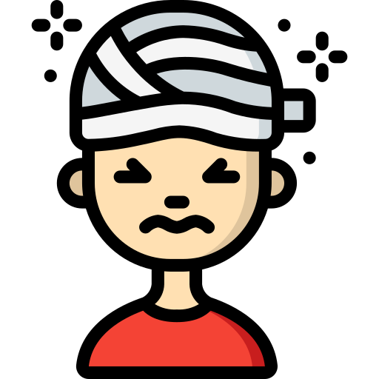
Grasshopper Word of the Day
swollen
Word Class
Word of the Day:
(adjective)
(swol-len)
Pronunciation / Syllables
Definition:
If a part of your body is swollen, it is larger and rounder than normal, usually as a result of injury or illness.
My head was swollen where I bumped it.
Phrases: | swollen and sore | bleeding and swollen
Synonym: | Antonym: | Rhyme: | Link Word:
expand | shrink | stolen | body part
bulge |  |  | feeling

Slide 10

Shinobi Word of the Day
compassionate
Word Class
Word of the Day:
(adjective)
(com-pas-sion-ate)
Pronunciation / Syllables
Definition:
If you describe someone or something as compassionate, you mean that they feel or show pity, sympathy, and understanding for people who are suffering.
She showed compassion by helping up Jen up.
Phrases: | a compassionate person | very compassionate
Synonym: | Antonym: | Prefix / Suffix: | Rhyme: | Link Word:
caring | heartless | -ly | passionate | act
warm |  | un- |  | person

Slide 11

Shinobi Word of the Day
infinite
Word Class
Word of the Day:
(adjective)
(in-fi-nite)
Pronunciation / Syllables
Definition:
If you describe something as infinite, you are emphasizing that it is extremely great in amount or degree.
His love for playing hockey was infinite.
Phrases: | an infinite amount of | had infinite love for
Synonym: | Antonym: | Prefix / Suffix: | Rhyme: | Link Word:
limitless | limited | -ly |  | never-ending
unlimited | small

Slide 12

Shinobi Word of the Day
fallible
Word Class
Word of the Day:
(adjective)
(fal-li-ble)
Pronunciation / Syllables
Definition:
If you say that someone or something is fallible, you mean that they are not perfect and are likely to make mistakes or to fail in what they are doing.
Ollie was fallible, but continued to train and work hard.
Phrases: | fallible and weak | fallible and could fail
Synonym: | Antonym: | Prefix / Suffix: | Rhyme: | Link Word:
flawed | infallible | -in | valuable | failure
imperfect |  |  | compatible | stop

Slide 13

Shinobi Word of the Day
optimistic
Word Class
Word of the Day:
(adjective)
(op-ti-mis-tic)
Pronunciation / Syllables
Definition:
Someone who is optimistic is hopeful about the future or the success of something in particular.
Harriet was optimistic about 2021.
Phrases: | very optimistic about | positive and optimistic
Synonym: | Antonym: | Prefix / Suffix: | Rhyme: | Link Word:
confident | pessimistic | over- | realistic | attitude
positive | negative | -ally | artistic | outlook

Slide 14

Shinobi Word of the Day
lousy
Word Class
Word of the Day:
(adjective)
(lous-y)
Pronunciation / Syllables
Definition:
If you describe something as lousy, you mean that it is of very bad quality or that you do not like it.
2020 had been a lousy year, but 2021 would be better.
Phrases: | lousy and forgettable | such a lousy
Synonym: | Antonym: | Prefix / Suffix | Rhyme: | Link Word:
awful | good |  | drowsy | time
terrible | great |  |  | behaviour

Slide 15
dirty
equal

Slide 16
fuzzy
juicy

Slide 17
swollen
compassionate

Slide 18
infinite
fallible

Slide 19
optimistic
lousy

