Slide 1
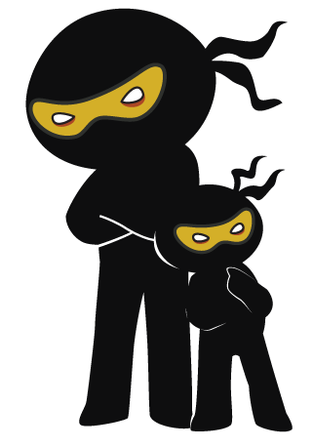



Word of the Day
Spring Term 2021
Week 19 – 25th January 2021
'Words unlock the doors to a world of understanding...'

Slide 2

This Week's Words
Grasshopper
Shinobi
sway
swoop
rhyme
stumble
rule
average
stomp
slumber
gust
selection

Slide 3
Grasshopper (Tier 1)
sway
rhyme
rule
stomp
gust

Slide 4
Shinobi (Tier 2)
swoop
stumble
average
slumber
selection

Slide 5


Grasshopper Word of the Day
sway
Word Class
Word of the Day:
(verb)
(sway)
Pronunciation / Syllables
Definition:
When people or things sway, they lean or swing slowly from one side to the other.
The trees on the playground swayed in the wind.
Phrases: | bent and swayed | swayed back and forth
Synonym: | Antonym: | Rhyme: | Link Word:
swing |  | they | people
shake |  | way | plants

Slide 6

Grasshopper Word of the Day
rhyme
Word Class
Word of the Day:
(verb / noun)
(rhyme)
Pronunciation / Syllables
Definition:
If one word rhymes with another or if two words rhyme, they have a very similar sound. Words that rhyme with each other are often used in poems.
Class 5 loved poems that rhymed.
Phrases: | rhyming is fun | time to rhyme
Synonym: | Antonym: | Rhyme: | Link Word:
 |  | time | words
 |  | crime | poems

Slide 7

Grasshopper Word of the Day
rule
Word Class
Word of the Day:
(noun)
(rule)
Pronunciation / Syllables
Definition:
Rules are instructions that tell you what you are allowed to do and what you are not allowed to do.
In order to be safe, we must follow the school rules.
Phrases: | the rules were clear | don’t break the rules
Synonym: | Antonym: | Rhyme: | Link Word:
regulation |  | school | follow
order |  | cool | break

Slide 8


Grasshopper Word of the Day
stomp
Word Class
Word of the Day:
(verb)
(stomp)
Pronunciation / Syllables
Definition:
If you stomp somewhere, you walk there with very heavy steps, often because you are angry.
Mr Robson stomped across the hall in his muddy boots.
Phrases: | stomped across | stomped moodily
Synonym: | Antonym: | Rhyme: | Link Word:
stamp | tip-toe | swamp | mud
 |  | comp | crush

Slide 9

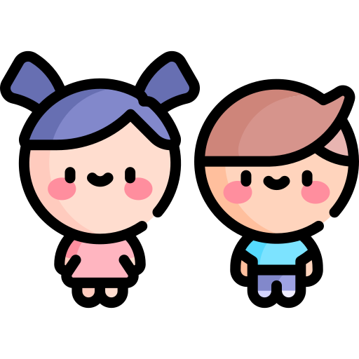
Grasshopper Word of the Day
gust
Word Class
Word of the Day:
(verb / noun)
(gust)
Pronunciation / Syllables
Definition:
A gust is a short, strong, sudden rush of wind.
A gust of wind nearly knocked the reception children over.
Phrases: | a huge gust | gusts and gales
Synonym: | Antonym: | Rhyme: | Link Word:
blast | breeze | just | storm
gale |  | dust | air

Slide 10


Shinobi Word of the Day
swoop
Word Class
Word of the Day:
(verb)
(swoop)
Pronunciation / Syllables
Definition:
When a bird or aeroplane swoops, it suddenly moves downwards through the air in a smooth curving movement.
A seagull swooped down and pinched my pork pie.
Phrases: | swooped speedily | stealthily swooped
Synonym: | Antonym: | Prefix / Suffix: | Rhyme: | Link Word:
dive |  | -ed | loop | bird
pounce |  | -ing | scoop | aeroplane

Slide 11
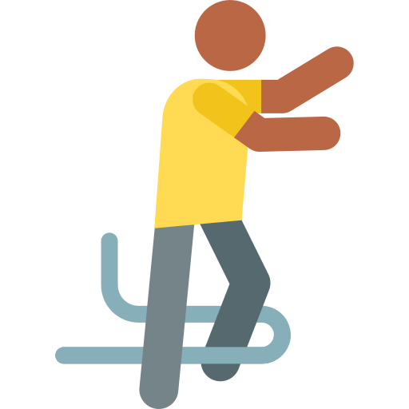
Shinobi Word of the Day
stumble
Word Class
Word of the Day:
(verb)
(stum-ble)
Pronunciation / Syllables
Definition:
If you stumble, you put your foot down awkwardly while you are walking or running and nearly fall over.
John stumbled on the coats that were on the floor.
Phrases: | unknowingly stumbled | stumble and trip
Synonym: | Antonym: | Prefix / Suffix: | Rhyme: | Link Word:
trip |  | -ed | tumble | injure
stagger |  | -ing | crumble | balance

Slide 12


Shinobi Word of the Day
average
Word Class
Word of the Day:
(adjective)
(av-er-age)
Pronunciation / Syllables
Definition:
An average person or thing is typical or normal.
This week’s spelling scores were rather average.
Phrases: | an average score | the average was
Synonym: | Antonym: | Prefix / Suffix: | Rhyme: | Link Word:
ordinary | outstanding | -ed | beverage | ok
standard | exceptional | -ing | leverage | acceptable

Slide 13

Shinobi Word of the Day
slumber
Word Class
Word of the Day:
(noun / verb)
(slum-ber)
Pronunciation / Syllables
Definition:
Slumber or sleep is the natural state of rest in which your eyes are closed, your body is inactive, and your mind does not think.
Mr Jones fell into a deep slumber at his desk.
Phrases: | quickly slumbered | a peaceful slumber
Synonym: | Antonym: | Prefix / Suffix: | Rhyme: | Link Word:
snooze | wake-up | -ed | number | lazy
doze |  |  | lumber | tired

Slide 14

Shinobi Word of the Day
selection
Word Class
Word of the Day:
(noun)
(se-lec-tion)
Pronunciation / Syllables
Definition:
A selection of people or things is a set of them that have been selected from a larger group.
There was a fabulous selection of fruit to choose from.
Phrases: | a magnificent selection of | a limited selection of
Synonym: | Antonym: | Prefix / Suffix | Rhyme: | Link Word:
range |  | -s | collection | clothes
variety |  |  | direction | shoes

Slide 15
Vocabulary Laboratory
Describe / Definition:
Use it in a sentence:
Focus Word (write below):
Word Class:
Synonyms: (words with same / similar meaning) | Antonyms: (words with opposite meaning)
Rhymes: (words that sound the same) | Link Words: (Example: football = pitch, team, player)
Draw your sentence:

Slide 16

Vocabulary Visualiser
Draw the Grasshopper words and bring them to life.
Word: sway | Word: rule
Word: stomp | Word: gust

Slide 17

Vocabulary Visualiser
Draw the Shinobi words and bring them to life.
Word: swoop | Word: stumble
Word: slumber | Word: selection

Slide 18
Matching Meanings
Draw lines from the Grasshopper words to their definitions.
Grasshopper Word
sway
rhyme
rule
stomp
gust
Grasshopper Definitions
If one word *** with another or if two words ***, they have a very similar sound. Words that *** with each other are often used in poems.
If you *** somewhere, you walk there with very heavy steps, often because you are angry.
When people or things ***, they lean or swing slowly from one side to the other.
A *** is a short, strong, sudden rush of wind.
*** are instructions that tell you what you are allowed to do and what you are not allowed to do.

Slide 19
Matching Meanings
Draw lines from the Shinobi words to their definitions.
Shinobi Word
swoop
stumble
average
slumber
selection
Shinobi Definitions
If you ***, you put your foot down awkwardly while you are walking or running and nearly fall over.
A *** of people or things is a set of them that have been selected from a larger group.
When a bird or aeroplane ***, it suddenly moves downwards through the air in a smooth curving movement.
*** or sleep is the natural state of rest in which your eyes are closed, your body is inactive, and your mind does not think.
An *** person or thing is typical or normal.

Slide 20
sway
rhyme

Slide 21
rule
stomp

Slide 22
gust
swoop

Slide 23
stumble
average

Slide 24
slumber
selection

