Slide 1




Word of the Day
Autumn Term 2020
Week 4 – 21st September 2020
'Words unlock the doors to a world of understanding...'

Slide 2

This Week's Words
Grasshopper
Shinobi
voice
forbidden
mirror
appearance
crowd
arrogant
petal
refuge
meal
collapse

Slide 3
Grasshopper (Tier 1)
voice
mirror
crowd
petal
meal

Slide 4
Shinobi (Tier 2)
forbidden
appearance
arrogant
refuge
collapse

Slide 5


Grasshopper Word of the Day
voice
Word Class
Word of the Day:
(noun)
(voice)
Pronunciation / Syllables
Definition:
When someone speaks or sings, you hear their voice.
Hamza has a beautiful singing voice.
Phrases: | beautiful voice | loud voice
Synonym: | Antonym: | Rhyme: | Link Word:
 |  | choice | loud
 |  |  | quiet

Slide 6

Grasshopper Word of the Day
mirror
Word Class
Word of the Day:
(noun / verb)
(mir-ror)
Pronunciation / Syllables
Definition:
A mirror is a flat piece of glass which reflects light, so that when you look at it you can see yourself reflected in it.
I can see myself in the mirror.
Phrases: | my reflection the the | the mirror reflected
Synonym: | Antonym: | Rhyme: | Link Word:
 |  |  | large
 |  |  | old

Slide 7

Grasshopper Word of the Day
crowd
Word Class
Word of the Day:
(noun / verb)
(crowd)
Pronunciation / Syllables
Definition:
A crowd is a large group of people who have gathered together, for example to watch or listen to something interesting, or to protest about something.
The crowd came along for the school play.
Phrases: | large and noisy crowd | a growing crowd
Synonym: | Antonym: | Rhyme: | Link Word:
mob |  | loud | large
army |  | cloud | growing

Slide 8

Grasshopper Word of the Day
petal
Word Class
Word of the Day:
(noun)
(pet-al)
Pronunciation / Syllables
Definition:
The petals of a flower are the thin coloured or white parts which together form the flower.
The petals of the flower were pink and red.
Phrases: | petals fell to the | the glowing petals
Synonym: | Antonym: | Rhyme: | Link Word:
 |  | metal | colourful
 |  | settle | flower

Slide 9

Grasshopper Word of the Day
meal
Word Class
Word of the Day:
(noun)
(meal)
Pronunciation / Syllables
Definition:
A meal is an occasion when people sit down and eat, usually at a regular time.
Everyone ate a yummy meal for lunch.
Phrases: | the meal smelt | a delicious meal
Synonym: | Antonym: | Rhyme: | Link Word:
snack |  | feel | tasty
bite |  | real | warm

Slide 10


Shinobi Word of the Day
forbidden
Word Class
Word of the Day:
(adjective)
(for-bid-den)
Pronunciation / Syllables
Definition:
If something is forbidden, you are not allowed to do it or have it.
Football was forbidden on the school playground.
Phrases: | were forbidden from | was forbidden
Synonym: | Antonym: | Prefix / Suffix: | Rhyme: | Link Word:
illegal | legal |  | hidden | always
outlawed | permitted |  | given | law

Slide 11

Shinobi Word of the Day
appearance
Word Class
Word of the Day:
(noun)
(ap-pear-ance)
Pronunciation / Syllables
Definition:
Someone's or something's appearance is the way that they look.
Jennifer’s appearance was smart and strong.
Phrases: | appearance of a | a __________ appearance
Synonym: | Antonym: | Prefix / Suffix: | Rhyme: | Link Word:
image |  | -s | interference | scruffy
facade |  |  | clearance | beautiful

Slide 12

Shinobi Word of the Day
arrogant
Word Class
Word of the Day:
(adjective)
(ar-ro-gant)
Pronunciation / Syllables
Definition:
Someone who is arrogant behaves in a proud, unpleasant way towards other people because they believe that they are more important than others.
Felix could be quite arrogant in maths lessons.
Phrases: | extremely arrogant | an arrogant person
Synonym: | Antonym: | Prefix / Suffix: | Rhyme: | Link Word:
smug | humble | -ance | elegant | person
snobby | modest | -ly | experiment | actions

Slide 13

Shinobi Word of the Day
refuge
Word Class
Word of the Day:
(noun)
(ref-uge)
Pronunciation / Syllables
Definition:
If you take refuge somewhere, you try to protect yourself from physical harm by going there.
The family took refuge in the Anderson shelter.
Phrases: | took refuge | found refuge
Synonym: | Antonym: | Prefix / Suffix: | Rhyme: | Link Word:
shelter |  |  | deluge | hide
sanctuary |  |  | refuse | safety

Slide 14
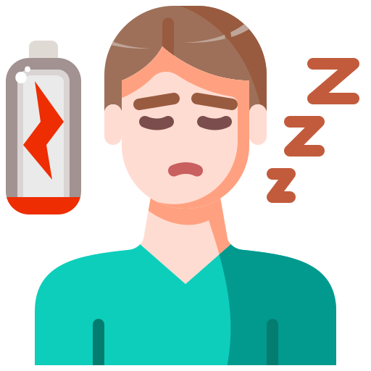
Shinobi Word of the Day
collapse
Word Class
Word of the Day:
(verb)
(col-lapse)
Pronunciation / Syllables
Definition:
If you collapse, you suddenly faint or fall down because you are very ill or weak.
Mrs. Jones collapsed onto her desk at home time.
Phrases: | suddenly collapsed | collapsed dangerously
Synonym: | Antonym: | Prefix / Suffix | Rhyme: | Link Word:
slump | Hold up | -ing | perhaps | exhausted
fall down |  | -ed | traps | tired

