Slide 1
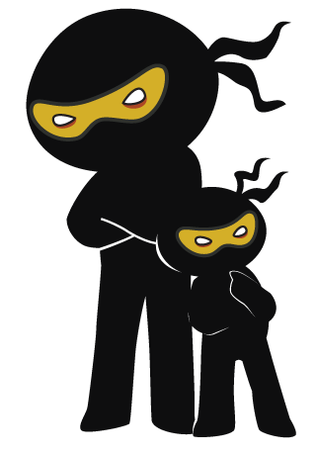



Word of the Day
Autumn Term 2020
Week 6 – 5th October 2020
'Words unlock the doors to a world of understanding...'

Slide 2

This Week's Words
Grasshopper
Shinobi
tired
monstrosity
surprised
scarce
hunger
barren
bored
miscreant
disgust
obscene

Slide 3
Grasshopper (Tier 1)
tired
surprised
hunger
bored
disgust

Slide 4
Shinobi (Tier 2)
monstrosity
scarce
barren
miscreant
obscene

Slide 5

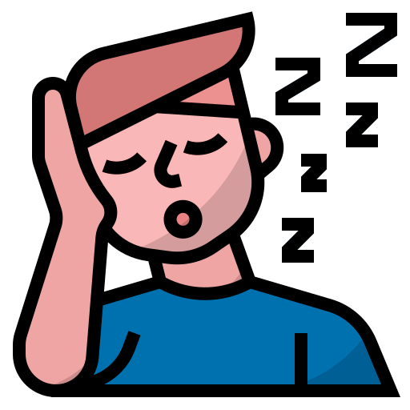
Grasshopper Word of the Day
tired
Word Class
Word of the Day:
(adjective)
(tired)
Pronunciation / Syllables
Definition:
If you are tired, you feel that you want to rest or sleep.
Tony looked tired and needed a rest or a sleep.
Phrases: | extremely tired | tired of it all
Synonym: | Antonym: | Rhyme: | Link Word:
weary | fresh | fired | sleep
worn out |  | wired | rest

Slide 6

Grasshopper Word of the Day
surprised
Word Class
Word of the Day:
(adjective)
(sur-prised)
Pronunciation / Syllables
Definition:
If you are surprised at something, you have a feeling of surprise, because it is unexpected or unusual.
Everyone was surprised when the head teacher came in.
Phrases: | very surprised | surprised and shocked
Synonym: | Antonym: | Rhyme: | Link Word:
astonished | unsurprising | sized | face
shocked |  | advised | look

Slide 7

Grasshopper Word of the Day
hunger
Word Class
Word of the Day:
(noun)
(hun-ger)
Pronunciation / Syllables
Definition:
Hunger is the feeling of weakness or discomfort that you get when you need something to eat.
Everyone was hungry and ready for lunch.
Phrases: | hungry and thirsty | full of hunger
Synonym: | Antonym: | Rhyme: | Link Word:
famine |  | younger | thirst
 |  |  | food

Slide 8

Grasshopper Word of the Day
bored
Word Class
Word of the Day:
(adjective)
(bored)
Pronunciation / Syllables
Definition:
If you are bored, you feel tired and impatient because you have lost interest in something or because you have nothing to do.
Hamza was bored at home and wanted to go to school.
Phrases: | just bored of it | bored, sick and tired
Synonym: | Antonym: | Rhyme: | Link Word:
tedious | interest | sword | fun
 |  | snored | tired

Slide 9

Grasshopper Word of the Day
disgust
Word Class
Word of the Day:
(noun)
(dis-gust)
Pronunciation / Syllables
Definition:
Disgust is a feeling of very strong dislike or disapproval.
Zang felt disgust when he saw all the wasted food.
Phrases: | a disgusting taste | disgusting to see
Synonym: | Antonym: | Rhyme: | Link Word:
loath | relish | just | feeling
 |  | trust | food

Slide 10

Shinobi Word of the Day
monstrosity
Word Class
Word of the Day:
(noun)
(mon-stros-i-ty)
Pronunciation / Syllables
Definition:
If you describe something, especially something large, as a monstrosity, you mean that you think it is extremely ugly.
The new school uniform was a monstrosity.
Phrases: | such a monstrosity to see | what a monstrosity
Synonym: | Antonym: | Prefix / Suffix: | Rhyme: | Link Word:
eyesore |  |  | curiosity | monster
freak |  |  | velocity | sight

Slide 11

Shinobi Word of the Day
scarce
Word Class
Word of the Day:
(adjective)
(scarce)
Pronunciation / Syllables
Definition:
If something is scarce, there is not enough of it.
Glue sticks had become scarce in the year 4 class.
Phrases: | had become scarce | were now scarce
Synonym: | Antonym: | Prefix / Suffix: | Rhyme: | Link Word:
sparse | plentiful | -ly |  | food
meagre |  |  |  | clothing

Slide 12

Shinobi Word of the Day
barren
Word Class
Word of the Day:
(adjective)
(bar-ren)
Pronunciation / Syllables
Definition:
If you describe a room or a place as barren, you do not like it because it has almost no furniture or other objects in it.
The hall was barren, all the equipment had been removed.
Phrases: | barren and silent | barren, empty and eerie
Synonym: | Antonym: | Prefix / Suffix: | Rhyme: | Link Word:
desert | fertile |  |  | room
waste | productive |  |  | land

Slide 13

Shinobi Word of the Day
miscreant
Word Class
Word of the Day:
(noun)
(mis-cre-ant)
Pronunciation / Syllables
Definition:
A miscreant is someone who has done something illegal or behaved badly.
The character in the book was a miscreant.
Phrases: | a foul miscreant | a vile miscreant
Synonym: | Antonym: | Prefix / Suffix: | Rhyme: | Link Word:
rascal |  |  |  | crime
villain |  |  |  | behaviour

Slide 14

Shinobi Word of the Day
obscene
Word Class
Word of the Day:
(adjective)
(ob-scene)
Pronunciation / Syllables
Definition:
If you describe something as obscene, you disapprove of it very strongly and consider it to be terribly wrong.
The behaviour of the children had been obscene.
Phrases: | shockingly obscene | obscene, yet required
Synonym: | Antonym: | Prefix / Suffix | Rhyme: | Link Word:
vile | pure | -ly | between | behaviour
outrageous | decent |  | machine | rude

