Slide 1
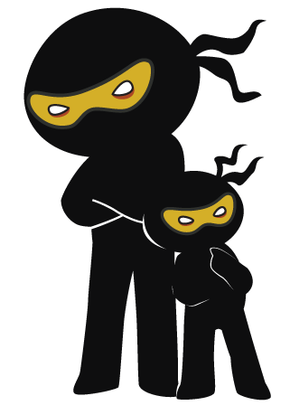



Word of the Day
Autumn Term 2020
Week 8 – 19th October 2020
'Words unlock the doors to a world of understanding...'

Slide 2

This Week's Words
Grasshopper
Shinobi
vote
steal
taste
symbol
vanish
adapt
duvet
maximum
fur
consistent

Slide 3
Grasshopper (Tier 1)
vote
taste
vanish
duvet
fur

Slide 4
Shinobi (Tier 2)
steal
symbol
adapt
maximum
consistent

Slide 5


Grasshopper Word of the Day
vote
Word Class
Word of the Day:
(noun / verb)
(vote)
Pronunciation / Syllables
Definition:
A vote is an occasion when a group of people make a decision by each person indicating his or her choice. The choice that most people support is accepted.
The class voted for Courtney to be the playground buddy.
Phrases: | choose to vote | voted for
Synonym: | Antonym: | Rhyme: | Link Word:
select |  | coat | person
choose |  | note | choose

Slide 6

Grasshopper Word of the Day
taste
Word Class
Word of the Day:
(noun / verb)
(taste)
Pronunciation / Syllables
Definition:
Taste is one of the five senses that people have. When you have food or drink in your mouth, your sense of taste makes it possible for you to know what it is.
I could taste the cheese inside the pie.
Phrases: | tasted the | I could taste
Synonym: | Antonym: | Rhyme: | Link Word:
flavour |  | placed | food
mouthful |  | traced | tongue

Slide 7

Grasshopper Word of the Day
vanish
Word Class
Word of the Day:
(verb)
(van-ish)
Pronunciation / Syllables
Definition:
If someone or something vanishes, they disappear suddenly or in a way that cannot be explained.
Ezra’s coat had vanished from the peg.
Phrases: | vanished from sight | had vanished from
Synonym: | Antonym: | Rhyme: | Link Word:
disappear | appear | banish | magic
fade |  | lavish | object

Slide 8

Grasshopper Word of the Day
duvet
Word Class
Word of the Day:
(noun)
(du-vet)
Pronunciation / Syllables
Definition:
A duvet is a large cover filled with feathers or similar material which you put over yourself in bed instead of a sheet and blankets.
The thick duvet kept me warm at night.
Phrases: | warm duvet | under the duvet
Synonym: | Antonym: | Rhyme: | Link Word:
quilt |  |  | furniture
 |  |  | clothing

Slide 9
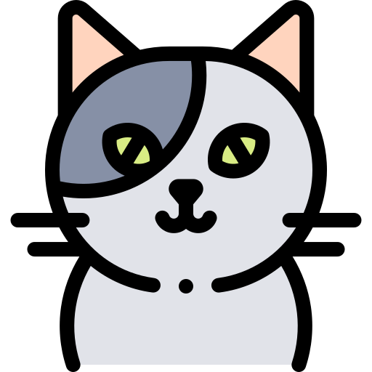
Grasshopper Word of the Day
fur
Word Class
Word of the Day:
(noun)
(fur)
Pronunciation / Syllables
Definition:
Fur is the thick and usually soft hair that grows on the bodies of many mammals.
The cat had soft and smooth grey fur.
Phrases: | thick, warm fur | filthy, fur
Synonym: | Antonym: | Rhyme: | Link Word:
pelt |  | purr | animal
mane |  | slur | warmth

Slide 10
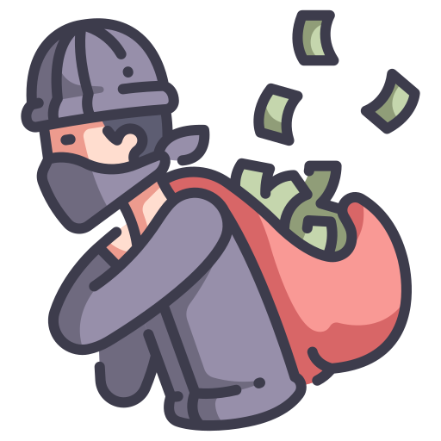
Shinobi Word of the Day
steal
Word Class
Word of the Day:
(verb)
(steal)
Pronunciation / Syllables
Definition:
If you steal something from someone, you take it away from them without their permission and without intending to return it.
Jeremy stole Ismail’s pencil from his table.
Phrases: | chose to steal | had stolen the
Synonym: | Antonym: | Prefix / Suffix: | Rhyme: | Link Word:
pinch |  | -s | reveal | thief
shoplift |  |  | ideal | decision

Slide 11

Shinobi Word of the Day
symbol
Word Class
Word of the Day:
(noun)
(sym-bol)
Pronunciation / Syllables
Definition:
A symbol of something such as an idea is a shape or design that is used to represent it.
The symbol for peace was known across the world.
Phrases: | was a symbol of | she was a symbol of
Synonym: | Antonym: | Prefix / Suffix: | Rhyme: | Link Word:
emblem |  | -s | nimble | power
insignia |  | -ic | thimble | bravery

Slide 12

Shinobi Word of the Day
adapt
Word Class
Word of the Day:
(verb)
(a-dapt)
Pronunciation / Syllables
Definition:
If you adapt to a new situation or adapt yourself to it, you change your ideas or behaviour in order to deal with it successfully.
Everyone needed to adapt and begin to wear facemasks.
Phrases: | had to adapt to | must adapt, or
Synonym: | Antonym: | Prefix / Suffix: | Rhyme: | Link Word:
modify | preserve | -ation | wrapped | change
alter | keep | -ing | trapped | switch

Slide 13

Shinobi Word of the Day
maximum
Word Class
Word of the Day:
(adjective)
(max-i-mum)
Pronunciation / Syllables
Definition:
You use maximum to describe an amount which is the largest that is possible, allowed, or required.
The maximum entry height was 200cm.
Phrases: | be aware of the maximum | exceeded the maximum
Synonym: | Antonym: | Prefix / Suffix: | Rhyme: | Link Word:
utmost | minimum | sub- |  | capacity
greatest |  |  |  | number

Slide 14

Shinobi Word of the Day
consistent
Word Class
Word of the Day:
(adjective)
(con-sist-ent)
Pronunciation / Syllables
Definition:
Someone who is consistent always behaves in the same way, has the same attitudes towards people or things, or achieves the same level of success in something.
Miss Cavill was consistent with her daily classroom routine.
Phrases: | always consistent | more consistent
Synonym: | Antonym: | Prefix / Suffix | Rhyme: | Link Word:
reliable | inconsistent | -ly | distant | routine
unwavering |  | in- | persistent | rules

Slide 15
vote
taste

Slide 16
vanish
duvet

Slide 17
fur
steal

Slide 18
symbol
adapt

Slide 19
maximum
consistent

