Slide 1
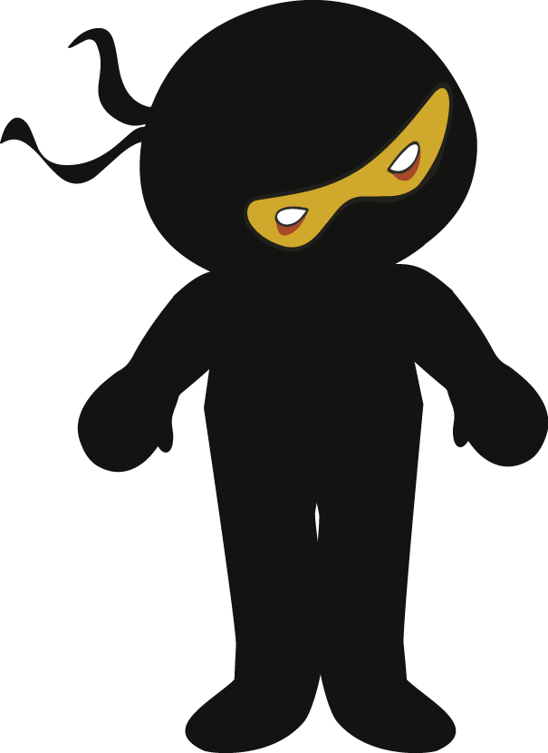
Character
Description
Writing
Prompt

Slide 2

Character Description Writing Prompt
 | What are they wearing? Keep it simple. Names and colours? Link to the weather or where they are. | Height? Build? Muscular? Thin? Rotund? | Clothing? Smart? Scruffy? Why are they dressed this way? Items. | Can you use a simile to describe the formality of their appearance? | Use personification to create a mental image of the clothes on the character’s body.
Describe the eyes and hair- skin, use a simile here. | Use a simile to describe the eye or hair colour? | How do other people feel around this character? What’s the vibe? Why? | Describe the character’s facial features? Is there a feature that can infer something about an event in the character’s past? E.g. a scar, broken nose, burn etc. |  | How is the weather affecting the character? The sun, wind, rain etc
Use an oxymoron to compare or contrast the character. | What equipment does the character have with them? Why? | Describe the character from afar and from up close. | Personality Confident? Shy? Anxious? Elated? | Create a rumour about the character – ‘Rumour has it…..’ | Explain one thing that is known for certain about this character. ‘One thing was for certain…’
Character Description Writing Prompt
 | What are they wearing? Keep it simple. Names and colours? Link to the weather or where they are. | Height? Build? Muscular? Thin? Rotund? | Clothing? Smart? Scruffy? Why are they dressed this way? Items. | Can you use a simile to describe the formality of their appearance? | Use personification to create a mental image of the clothes on the character’s body.
Describe the eyes and hair – skin, use a simile here. | Use a simile to describe the eye or hair colour? | How do other people feel around this character? What’s the vibe? Why? | Describe the character’s facial features? Is there a feature that can infer something about an event in the character’s past? E.g. a scar, broken nose, burn etc. |  | How is the weather affecting the character? The sun, wind, rain etc
Use an oxymoron to compare or contrast the character. | What equipment does the character have with them? Why? | Describe the character from afar and from up close. | Personality Confident? Shy? Anxious? Elated? | Create a rumour about the character – ‘Rumour has it…..’ | Explain one thing that is known for certain about this character. ‘One thing was for certain…’

Slide 3
Character Description Writing Prompt
 | What are they wearing? Keep it simple. Names and colours? Link to the weather or where they are. | Height? Build? Muscular? Thin? Rotund? | Clothing? Smart? Scruffy? Why are they dressed this way? Items. | Can you use a simile to describe the formality of their appearance? | Use personification to create a mental image of the clothes on the character’s body.
Describe the eyes and hair? | Use a simile to describe the eye or hair colour? | How do other people feel around this character? What’s the vibe? Why? | Describe the character’s facial features? Is there a feature that can infer something about an event in the character’s past? E.g. a scar, broken nose, burn etc. |  | How is the weather affecting the character? The sun, wind, rain etc
Use an oxymoron to compare or contrast the character. | What equipment does the character have with them? Why? | Describe the character from afar and from up close. | Personality Confident? Shy? Anxious? Elated? | Create a rumour about the character – ‘Rumour has it…..’ | Explain one thing that is known for certain about this character. ‘One thing was for certain…’

