Slide 1

VOCABULARY LABORATORY
Explain meaning / Definition:
Use in a sentence (add picture):
Target Word
Modifications:
Word Class:
Modify to past tense, present, plural singular, add prefix or suffix etc.
Prefixes
Suffixes
Synonyms
Antonyms
Morphology (Morphemes and Syllables)
Vocabulary Ninja
'Words unlock the doors to a world of understanding...'

Slide 2
VOCABULARY LABORATORY
Explain meaning / Definition:
Use in a sentence (add picture too):
Modifications:
Word Class:
Modify to past tense, present, plural singular, add prefix or suffix etc.
Synonyms
Antonyms
VocabularyNinja
'Words unlock the doors to a world of understanding...'

Slide 3
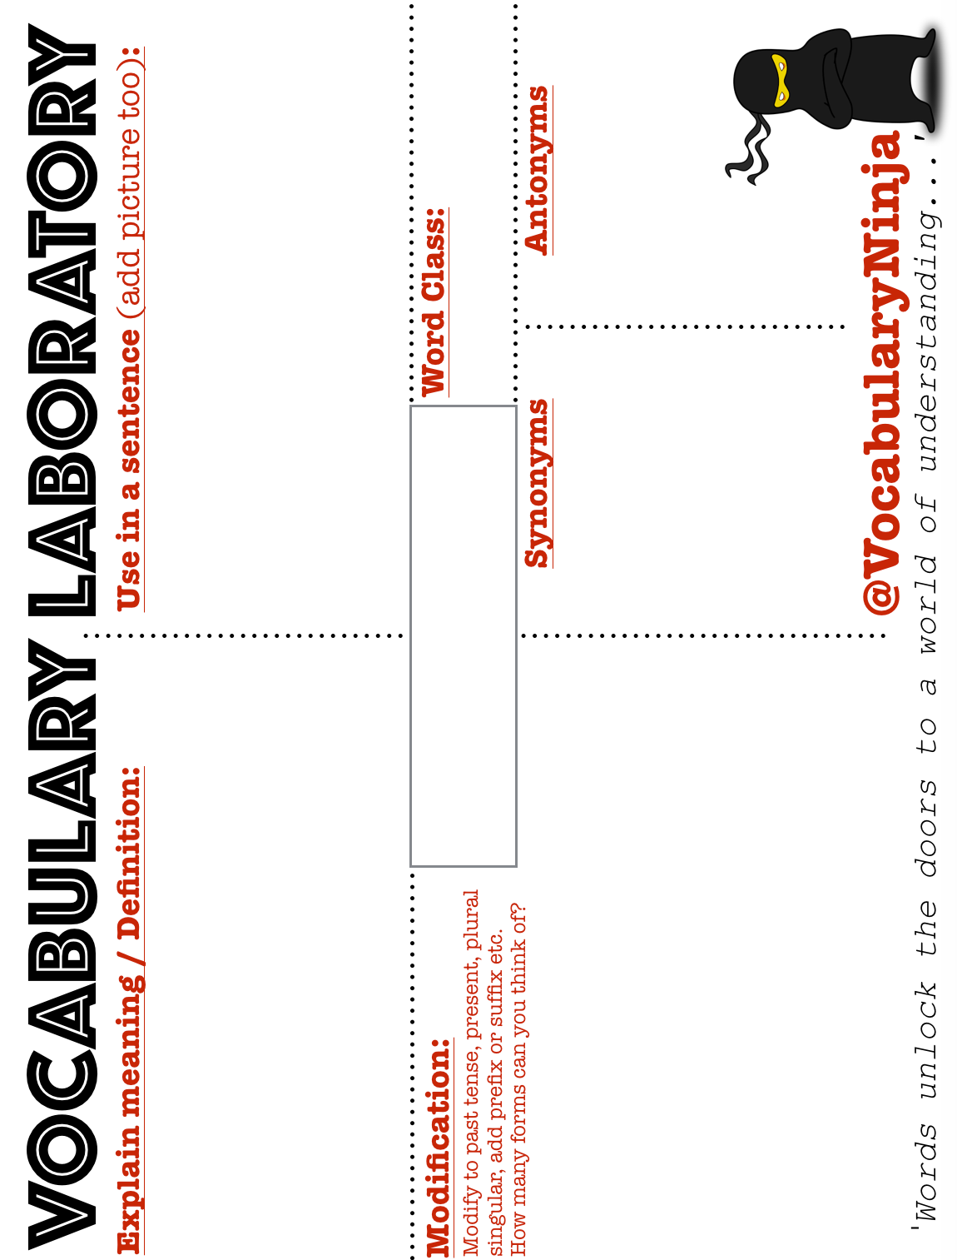

Slide 4
VOCABULARY LABORATORY
Explain meaning / Definition:
Use in a sentence (add picture too):
Modifications:
Word Class:
Modify to past tense, present, plural singular, add prefix or suffix etc.
How many forms can you think of?
Word Class:
Synonyms
Antonyms
@VocabularyNinja
'Words unlock the doors to a world of understanding...'

Slide 5
VOCABULARY LABORATORY
Explain meaning / Definition:
Use in a sentence:
Picture:
@VocabularyNinja
'Words unlock the doors to a world of understanding...'

Slide 6
VOCABULARY LABORATORY
Explain meaning / Definition:
Use in a sentence:
Picture:
Vocabulary Ninja
'Words unlock the doors to a world of understanding...'

