Slide 1

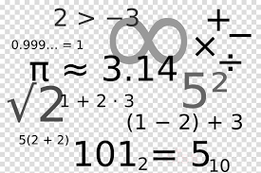
The
Tough
Ten
Sample

Slide 2

Vocabulary Ninja’s Whole School Maths Starter System or the ‘Tough Ten’ is here! An amazing and totally comprehensive whole school maths starter system. Consistency is the key here. Vocabulary Ninja loves resources that offer marginal gains learning opportunities, little and often. Whether you are a class teacher looking for impact and routines in your classroom, or a subject leader looking to embed strong systems in school….This resource is for you!
The Tough Ten, is so simple but so powerful. Ten questions everyday, no effort, no workload, 100% impact. Plus, pupils love it, Vocabulary Ninja has used the system successfully with Y6 students over the past three years with huge success! So let’s get the whole school involved.
The Tough Ten offers 10 questions everyday linked to the National Curriculum and mathematical expectations for each year group to help pupils develop confidence answers fluency-based maths questions that links closely to success in arithmetic and ultimately success in reasoning.
Mathematical fluency is the foundation of a pupil’s ability to reason and problem solve. The Tough Ten offers a simple whole school solution which offers impact, consistency from year group to year group and progression as pupils move through school from Year 1 to Year 6.
Each termly pack offers a set of ten questions for everyday, which is neatly copied between 8 and 10 times on one page, so that as a class teacher, you only need to print 2 or 3 pages, then trim and stick. Save time, save money and supercharge the impact in the classroom.

Slide 3
Autumn
Year 6

Slide 4
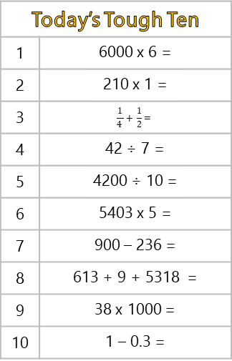
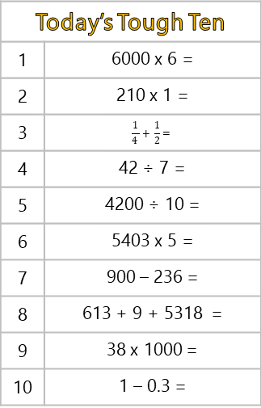
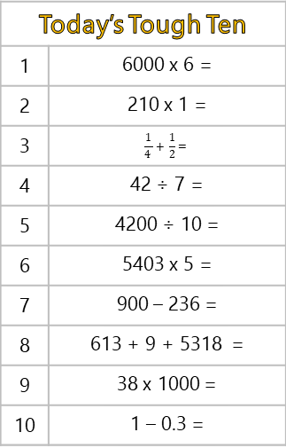
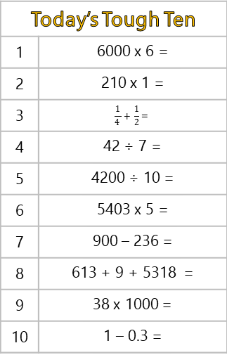
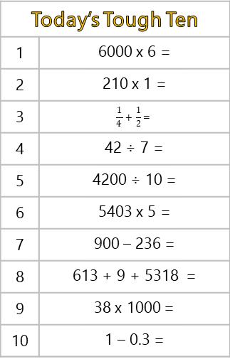
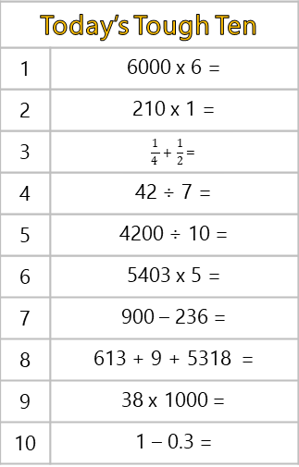
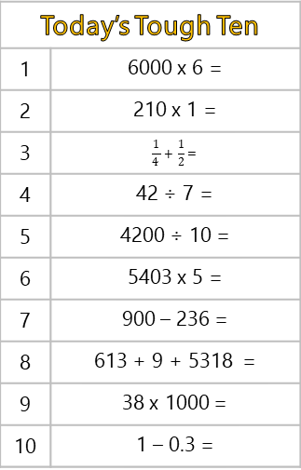
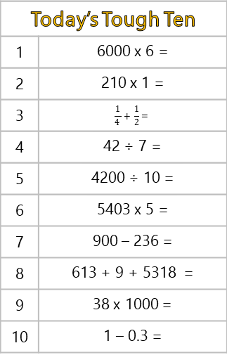
Today’s Tough Ten
1 | 6000 x 6 =
2 | 210 x 1 =
3 | $$\frac{1}{4 }+ \frac{1}{2}=$$
4 | 42 ÷ 7 =
5 | 4200 ÷ 10 =
6 | 5403 x 5 =
7 | 900 – 236 =
8 | 613 + 9 + 5318 =
9 | 38 x 1000 =
10 | 1 – 0.3 =
Today’s Tough Ten
1 | 6000 x 6 =
2 | 210 x 1 =
3 | $$\frac{1}{4 }+ \frac{1}{2}=$$
4 | 42 ÷ 7 =
5 | 4200 ÷ 10 =
6 | 5403 x 5 =
7 | 900 – 236 =
8 | 613 + 9 + 5318 =
9 | 38 x 1000 =
10 | 1 – 0.3 =
Today’s Tough Ten
1 | 6000 x 6 =
2 | 210 x 1 =
3 | $$\frac{1}{4 }+ \frac{1}{2}=$$
4 | 42 ÷ 7 =
5 | 4200 ÷ 10 =
6 | 5403 x 5 =
7 | 900 – 236 =
8 | 613 + 9 + 5318 =
9 | 38 x 1000 =
10 | 1 – 0.3 =
Today’s Tough Ten
1 | 6000 x 6 =
2 | 210 x 1 =
3 | $$\frac{1}{4 }+ \frac{1}{2}=$$
4 | 42 ÷ 7 =
5 | 4200 ÷ 10 =
6 | 5403 x 5 =
7 | 900 – 236 =
8 | 613 + 9 + 5318 =
9 | 38 x 1000 =
10 | 1 – 0.3 =
Today’s Tough Ten
1 | 6000 x 6 =
2 | 210 x 1 =
3 | $$\frac{1}{4 }+ \frac{1}{2}=$$
4 | 42 ÷ 7 =
5 | 4200 ÷ 10 =
6 | 5403 x 5 =
7 | 900 – 236 =
8 | 613 + 9 + 5318 =
9 | 38 x 1000 =
10 | 1 – 0.3 =
Today’s Tough Ten
1 | 6000 x 6 =
2 | 210 x 1 =
3 | $$\frac{1}{4 }+ \frac{1}{2}=$$
4 | 42 ÷ 7 =
5 | 4200 ÷ 10 =
6 | 5403 x 5 =
7 | 900 – 236 =
8 | 613 + 9 + 5318 =
9 | 38 x 1000 =
10 | 1 – 0.3 =
Today’s Tough Ten
1 | 6000 x 6 =
2 | 210 x 1 =
3 | $$\frac{1}{4 }+ \frac{1}{2}=$$
4 | 42 ÷ 7 =
5 | 4200 ÷ 10 =
6 | 5403 x 5 =
7 | 900 – 236 =
8 | 613 + 9 + 5318 =
9 | 38 x 1000 =
10 | 1 – 0.3 =
Today’s Tough Ten
1 | 6000 x 6 =
2 | 210 x 1 =
3 | $$\frac{1}{4 }+ \frac{1}{2}=$$
4 | 42 ÷ 7 =
5 | 4200 ÷ 10 =
6 | 5403 x 5 =
7 | 900 – 236 =
8 | 613 + 9 + 5318 =
9 | 38 x 1000 =
10 | 1 – 0.3 =

Slide 5
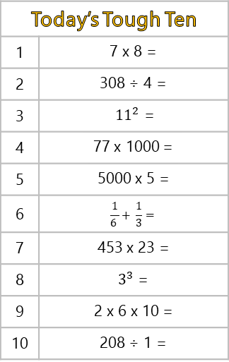
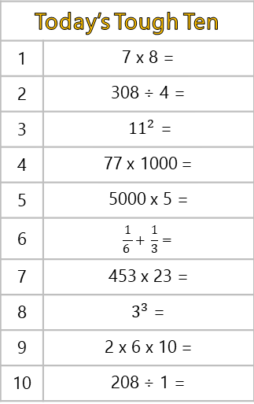
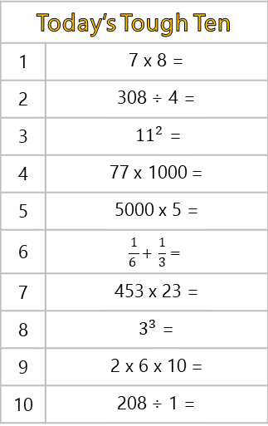
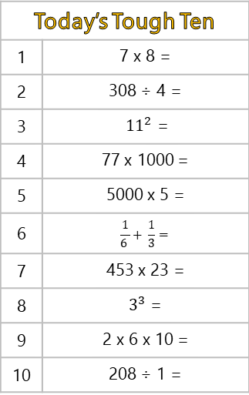
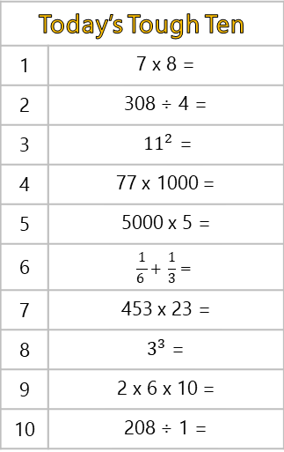
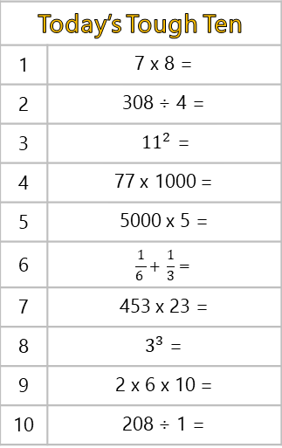
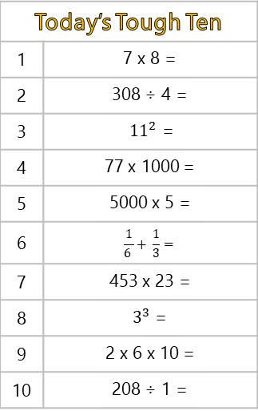
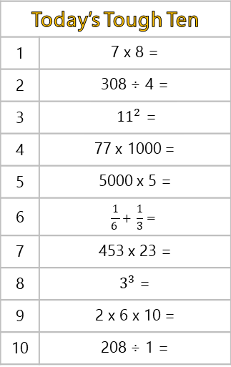
Today’s Tough Ten
1 | 7 x 8 =
2 | 308 ÷ 4 =
3 | ${11}^{2}$ =
4 | 77 x 1000 =
5 | 5000 x 5 =
6 | $$\frac{1}{6 }+ \frac{1}{3}=$$
7 | 453 x 23 =
8 | $3^{3}$ =
9 | 2 x 6 x 10 =
10 | 208 ÷ 1 =
Today’s Tough Ten
1 | 7 x 8 =
2 | 308 ÷ 4 =
3 | ${11}^{2}$ =
4 | 77 x 1000 =
5 | 5000 x 5 =
6 | $$\frac{1}{6 }+ \frac{1}{3}=$$
7 | 453 x 23 =
8 | $3^{3}$ =
9 | 2 x 6 x 10 =
10 | 208 ÷ 1 =
Today’s Tough Ten
1 | 7 x 8 =
2 | 308 ÷ 4 =
3 | ${11}^{2}$ =
4 | 77 x 1000 =
5 | 5000 x 5 =
6 | $$\frac{1}{6 }+ \frac{1}{3}=$$
7 | 453 x 23 =
8 | $3^{3}$ =
9 | 2 x 6 x 10 =
10 | 208 ÷ 1 =
Today’s Tough Ten
1 | 7 x 8 =
2 | 308 ÷ 4 =
3 | ${11}^{2}$ =
4 | 77 x 1000 =
5 | 5000 x 5 =
6 | $$\frac{1}{6 }+ \frac{1}{3}=$$
7 | 453 x 23 =
8 | $3^{3}$ =
9 | 2 x 6 x 10 =
10 | 208 ÷ 1 =
Today’s Tough Ten
1 | 7 x 8 =
2 | 308 ÷ 4 =
3 | ${11}^{2}$ =
4 | 77 x 1000 =
5 | 5000 x 5 =
6 | $$\frac{1}{6 }+ \frac{1}{3}=$$
7 | 453 x 23 =
8 | $3^{3}$ =
9 | 2 x 6 x 10 =
10 | 208 ÷ 1 =
Today’s Tough Ten
1 | 7 x 8 =
2 | 308 ÷ 4 =
3 | ${11}^{2}$ =
4 | 77 x 1000 =
5 | 5000 x 5 =
6 | $$\frac{1}{6 }+ \frac{1}{3}=$$
7 | 453 x 23 =
8 | $3^{3}$ =
9 | 2 x 6 x 10 =
10 | 208 ÷ 1 =
Today’s Tough Ten
1 | 7 x 8 =
2 | 308 ÷ 4 =
3 | ${11}^{2}$ =
4 | 77 x 1000 =
5 | 5000 x 5 =
6 | $$\frac{1}{6 }+ \frac{1}{3}=$$
7 | 453 x 23 =
8 | $3^{3}$ =
9 | 2 x 6 x 10 =
10 | 208 ÷ 1 =
Today’s Tough Ten
1 | 7 x 8 =
2 | 308 ÷ 4 =
3 | ${11}^{2}$ =
4 | 77 x 1000 =
5 | 5000 x 5 =
6 | $$\frac{1}{6 }+ \frac{1}{3}=$$
7 | 453 x 23 =
8 | $3^{3}$ =
9 | 2 x 6 x 10 =
10 | 208 ÷ 1 =

Slide 6
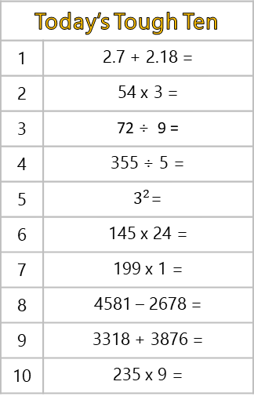


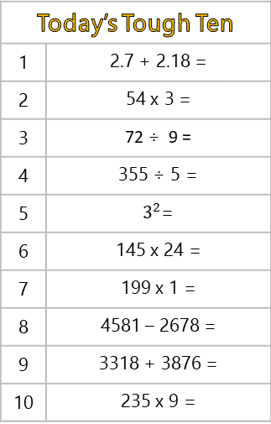
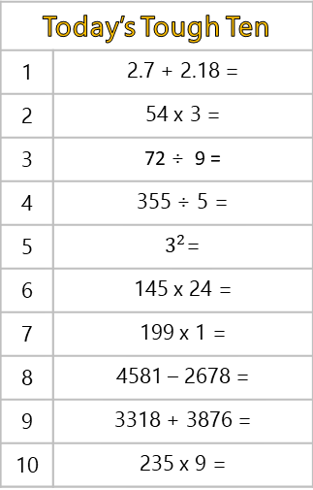
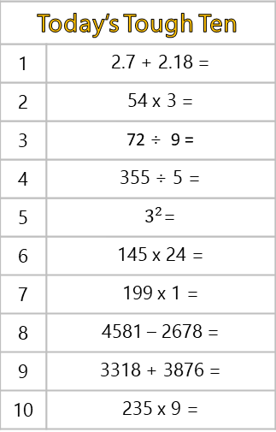


Today’s Tough Ten
1 | 2.7 + 2.18 =
2 | 54 x 3 =
3 | 72 ÷ 9 =
4 | 355 ÷ 5 =
5 | $3^{2}$=
6 | 145 x 24 =
7 | 199 x 1 =
8 | 4581 – 2678 =
9 | 3318 + 3876 =
10 | 235 x 9 =
Today’s Tough Ten
1 | 2.7 + 2.18 =
2 | 54 x 3 =
3 | 72 ÷ 9 =
4 | 355 ÷ 5 =
5 | $3^{2}$=
6 | 145 x 24 =
7 | 199 x 1 =
8 | 4581 – 2678 =
9 | 3318 + 3876 =
10 | 235 x 9 =
Today’s Tough Ten
1 | 2.7 + 2.18 =
2 | 54 x 3 =
3 | 72 ÷ 9 =
4 | 355 ÷ 5 =
5 | $3^{2}$=
6 | 145 x 24 =
7 | 199 x 1 =
8 | 4581 – 2678 =
9 | 3318 + 3876 =
10 | 235 x 9 =
Today’s Tough Ten
1 | 2.7 + 2.18 =
2 | 54 x 3 =
3 | 72 ÷ 9 =
4 | 355 ÷ 5 =
5 | $3^{2}$=
6 | 145 x 24 =
7 | 199 x 1 =
8 | 4581 – 2678 =
9 | 3318 + 3876 =
10 | 235 x 9 =
Today’s Tough Ten
1 | 2.7 + 2.18 =
2 | 54 x 3 =
3 | 72 ÷ 9 =
4 | 355 ÷ 5 =
5 | $3^{2}$=
6 | 145 x 24 =
7 | 199 x 1 =
8 | 4581 – 2678 =
9 | 3318 + 3876 =
10 | 235 x 9 =
Today’s Tough Ten
1 | 2.7 + 2.18 =
2 | 54 x 3 =
3 | 72 ÷ 9 =
4 | 355 ÷ 5 =
5 | $3^{2}$=
6 | 145 x 24 =
7 | 199 x 1 =
8 | 4581 – 2678 =
9 | 3318 + 3876 =
10 | 235 x 9 =
Today’s Tough Ten
1 | 2.7 + 2.18 =
2 | 54 x 3 =
3 | 72 ÷ 9 =
4 | 355 ÷ 5 =
5 | $3^{2}$=
6 | 145 x 24 =
7 | 199 x 1 =
8 | 4581 – 2678 =
9 | 3318 + 3876 =
10 | 235 x 9 =
Today’s Tough Ten
1 | 2.7 + 2.18 =
2 | 54 x 3 =
3 | 72 ÷ 9 =
4 | 355 ÷ 5 =
5 | $3^{2}$=
6 | 145 x 24 =
7 | 199 x 1 =
8 | 4581 – 2678 =
9 | 3318 + 3876 =
10 | 235 x 9 =

Slide 7
Spring
Year 6

Slide 8
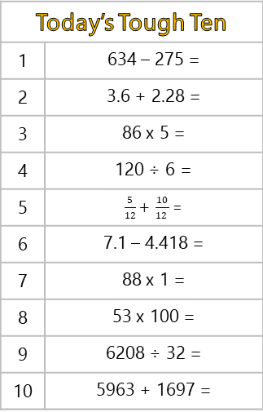
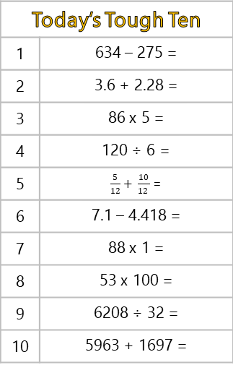
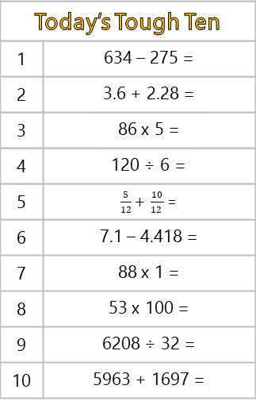
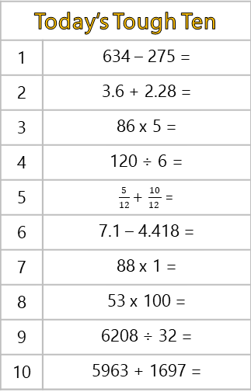


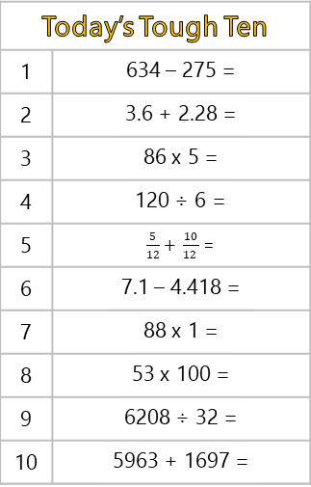

Today’s Tough Ten
1 | 634 – 275 =
2 | 3.6 + 2.28 =
3 | 86 x 5 =
4 | 120 ÷ 6 =
5 | $\frac{5}{12}+ \frac{10}{12 }$ =
6 | 7.1 – 4.418 =
7 | 88 x 1 =
8 | 53 x 100 =
9 | 6208 ÷ 32 =
10 | 5963 + 1697 =
Today’s Tough Ten
1 | 634 – 275 =
2 | 3.6 + 2.28 =
3 | 86 x 5 =
4 | 120 ÷ 6 =
5 | $\frac{5}{12}+ \frac{10}{12 }$ =
6 | 7.1 – 4.418 =
7 | 88 x 1 =
8 | 53 x 100 =
9 | 6208 ÷ 32 =
10 | 5963 + 1697 =
Today’s Tough Ten
1 | 634 – 275 =
2 | 3.6 + 2.28 =
3 | 86 x 5 =
4 | 120 ÷ 6 =
5 | $\frac{5}{12}+ \frac{10}{12 }$ =
6 | 7.1 – 4.418 =
7 | 88 x 1 =
8 | 53 x 100 =
9 | 6208 ÷ 32 =
10 | 5963 + 1697 =
Today’s Tough Ten
1 | 634 – 275 =
2 | 3.6 + 2.28 =
3 | 86 x 5 =
4 | 120 ÷ 6 =
5 | $\frac{5}{12}+ \frac{10}{12 }$ =
6 | 7.1 – 4.418 =
7 | 88 x 1 =
8 | 53 x 100 =
9 | 6208 ÷ 32 =
10 | 5963 + 1697 =
Today’s Tough Ten
1 | 634 – 275 =
2 | 3.6 + 2.28 =
3 | 86 x 5 =
4 | 120 ÷ 6 =
5 | $\frac{5}{12}+ \frac{10}{12 }$ =
6 | 7.1 – 4.418 =
7 | 88 x 1 =
8 | 53 x 100 =
9 | 6208 ÷ 32 =
10 | 5963 + 1697 =
Today’s Tough Ten
1 | 634 – 275 =
2 | 3.6 + 2.28 =
3 | 86 x 5 =
4 | 120 ÷ 6 =
5 | $\frac{5}{12}+ \frac{10}{12 }$ =
6 | 7.1 – 4.418 =
7 | 88 x 1 =
8 | 53 x 100 =
9 | 6208 ÷ 32 =
10 | 5963 + 1697 =
Today’s Tough Ten
1 | 634 – 275 =
2 | 3.6 + 2.28 =
3 | 86 x 5 =
4 | 120 ÷ 6 =
5 | $\frac{5}{12}+ \frac{10}{12 }$ =
6 | 7.1 – 4.418 =
7 | 88 x 1 =
8 | 53 x 100 =
9 | 6208 ÷ 32 =
10 | 5963 + 1697 =
Today’s Tough Ten
1 | 634 – 275 =
2 | 3.6 + 2.28 =
3 | 86 x 5 =
4 | 120 ÷ 6 =
5 | $\frac{5}{12}+ \frac{10}{12 }$ =
6 | 7.1 – 4.418 =
7 | 88 x 1 =
8 | 53 x 100 =
9 | 6208 ÷ 32 =
10 | 5963 + 1697 =

Slide 9
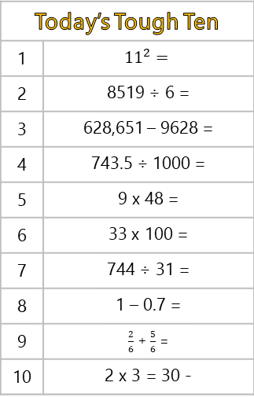
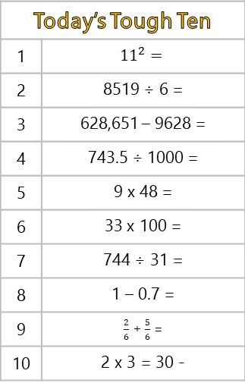
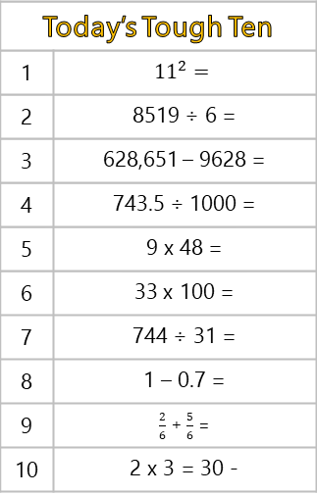
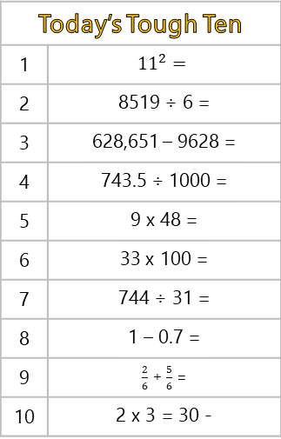


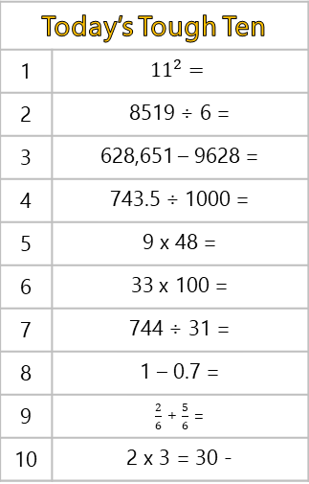

Today’s Tough Ten
1 | $${11}^{2}=$$
2 | 8519 ÷ 6 =
3 | 628,651 – 9628 =
4 | 743.5 ÷ 1000 =
5 | 9 x 48 =
6 | 33 x 100 =
7 | 744 ÷ 31 =
8 | 1 – 0.7 =
9 | $\frac{2}{6}$ + $\frac{5}{6}$ =
10 | 2 x 3 = 30 -
Today’s Tough Ten
1 | $${11}^{2}=$$
2 | 8519 ÷ 6 =
3 | 628,651 – 9628 =
4 | 743.5 ÷ 1000 =
5 | 9 x 48 =
6 | 33 x 100 =
7 | 744 ÷ 31 =
8 | 1 – 0.7 =
9 | $\frac{2}{6}$ + $\frac{5}{6}$ =
10 | 2 x 3 = 30 -
Today’s Tough Ten
1 | $${11}^{2}=$$
2 | 8519 ÷ 6 =
3 | 628,651 – 9628 =
4 | 743.5 ÷ 1000 =
5 | 9 x 48 =
6 | 33 x 100 =
7 | 744 ÷ 31 =
8 | 1 – 0.7 =
9 | $\frac{2}{6}$ + $\frac{5}{6}$ =
10 | 2 x 3 = 30 -
Today’s Tough Ten
1 | $${11}^{2}=$$
2 | 8519 ÷ 6 =
3 | 628,651 – 9628 =
4 | 743.5 ÷ 1000 =
5 | 9 x 48 =
6 | 33 x 100 =
7 | 744 ÷ 31 =
8 | 1 – 0.7 =
9 | $\frac{2}{6}$ + $\frac{5}{6}$ =
10 | 2 x 3 = 30 -
Today’s Tough Ten
1 | $${11}^{2}=$$
2 | 8519 ÷ 6 =
3 | 628,651 – 9628 =
4 | 743.5 ÷ 1000 =
5 | 9 x 48 =
6 | 33 x 100 =
7 | 744 ÷ 31 =
8 | 1 – 0.7 =
9 | $\frac{2}{6}$ + $\frac{5}{6}$ =
10 | 2 x 3 = 30 -
Today’s Tough Ten
1 | $${11}^{2}=$$
2 | 8519 ÷ 6 =
3 | 628,651 – 9628 =
4 | 743.5 ÷ 1000 =
5 | 9 x 48 =
6 | 33 x 100 =
7 | 744 ÷ 31 =
8 | 1 – 0.7 =
9 | $\frac{2}{6}$ + $\frac{5}{6}$ =
10 | 2 x 3 = 30 -
Today’s Tough Ten
1 | $${11}^{2}=$$
2 | 8519 ÷ 6 =
3 | 628,651 – 9628 =
4 | 743.5 ÷ 1000 =
5 | 9 x 48 =
6 | 33 x 100 =
7 | 744 ÷ 31 =
8 | 1 – 0.7 =
9 | $\frac{2}{6}$ + $\frac{5}{6}$ =
10 | 2 x 3 = 30 -
Today’s Tough Ten
1 | $${11}^{2}=$$
2 | 8519 ÷ 6 =
3 | 628,651 – 9628 =
4 | 743.5 ÷ 1000 =
5 | 9 x 48 =
6 | 33 x 100 =
7 | 744 ÷ 31 =
8 | 1 – 0.7 =
9 | $\frac{2}{6}$ + $\frac{5}{6}$ =
10 | 2 x 3 = 30 -

Slide 10
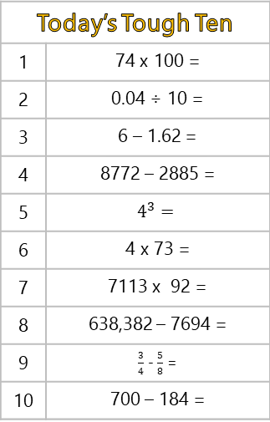
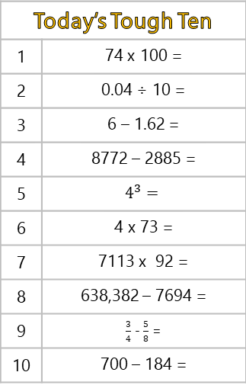
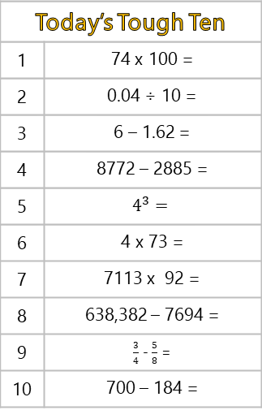
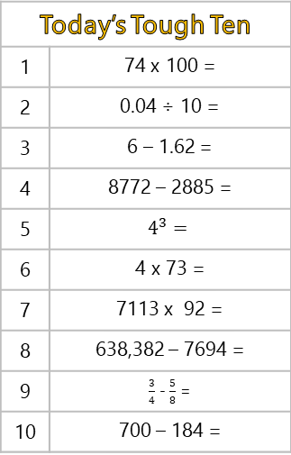




Today’s Tough Ten
1 | 74 x 100 =
2 | 0.04 ÷ 10 =
3 | 6 – 1.62 =
4 | 8772 – 2885 =
5 | $$4^{3}=$$
6 | 4 x 73 =
7 | 7113 x 92 =
8 | 638,382 – 7694 =
9 | $\frac{3}{4}$ - $\frac{5}{8}$ =
10 | 700 – 184 =
Today’s Tough Ten
1 | 74 x 100 =
2 | 0.04 ÷ 10 =
3 | 6 – 1.62 =
4 | 8772 – 2885 =
5 | $$4^{3}=$$
6 | 4 x 73 =
7 | 7113 x 92 =
8 | 638,382 – 7694 =
9 | $\frac{3}{4}$ - $\frac{5}{8}$ =
10 | 700 – 184 =
Today’s Tough Ten
1 | 74 x 100 =
2 | 0.04 ÷ 10 =
3 | 6 – 1.62 =
4 | 8772 – 2885 =
5 | $$4^{3}=$$
6 | 4 x 73 =
7 | 7113 x 92 =
8 | 638,382 – 7694 =
9 | $\frac{3}{4}$ - $\frac{5}{8}$ =
10 | 700 – 184 =
Today’s Tough Ten
1 | 74 x 100 =
2 | 0.04 ÷ 10 =
3 | 6 – 1.62 =
4 | 8772 – 2885 =
5 | $$4^{3}=$$
6 | 4 x 73 =
7 | 7113 x 92 =
8 | 638,382 – 7694 =
9 | $\frac{3}{4}$ - $\frac{5}{8}$ =
10 | 700 – 184 =
Today’s Tough Ten
1 | 74 x 100 =
2 | 0.04 ÷ 10 =
3 | 6 – 1.62 =
4 | 8772 – 2885 =
5 | $$4^{3}=$$
6 | 4 x 73 =
7 | 7113 x 92 =
8 | 638,382 – 7694 =
9 | $\frac{3}{4}$ - $\frac{5}{8}$ =
10 | 700 – 184 =
Today’s Tough Ten
1 | 74 x 100 =
2 | 0.04 ÷ 10 =
3 | 6 – 1.62 =
4 | 8772 – 2885 =
5 | $$4^{3}=$$
6 | 4 x 73 =
7 | 7113 x 92 =
8 | 638,382 – 7694 =
9 | $\frac{3}{4}$ - $\frac{5}{8}$ =
10 | 700 – 184 =
Today’s Tough Ten
1 | 74 x 100 =
2 | 0.04 ÷ 10 =
3 | 6 – 1.62 =
4 | 8772 – 2885 =
5 | $$4^{3}=$$
6 | 4 x 73 =
7 | 7113 x 92 =
8 | 638,382 – 7694 =
9 | $\frac{3}{4}$ - $\frac{5}{8}$ =
10 | 700 – 184 =
Today’s Tough Ten
1 | 74 x 100 =
2 | 0.04 ÷ 10 =
3 | 6 – 1.62 =
4 | 8772 – 2885 =
5 | $$4^{3}=$$
6 | 4 x 73 =
7 | 7113 x 92 =
8 | 638,382 – 7694 =
9 | $\frac{3}{4}$ - $\frac{5}{8}$ =
10 | 700 – 184 =

Slide 11
Summer
Year 6

Slide 12







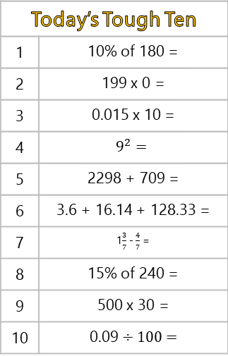
Today’s Tough Ten
1 | 10% of 180 =
2 | 199 x 0 =
3 | 0.015 x 10 =
4 | $$9^{2}=$$
5 | 2298 + 709 =
6 | 3.6 + 16.14 + 128.33 =
7 | 1$\frac{3}{7}$ - $\frac{4}{7}$ =
8 | 15% of 240 =
9 | 500 x 30 =
10 | 0.09 ÷ 100 =
Today’s Tough Ten
1 | 10% of 180 =
2 | 199 x 0 =
3 | 0.015 x 10 =
4 | $$9^{2}=$$
5 | 2298 + 709 =
6 | 3.6 + 16.14 + 128.33 =
7 | 1$\frac{3}{7}$ - $\frac{4}{7}$ =
8 | 15% of 240 =
9 | 500 x 30 =
10 | 0.09 ÷ 100 =
Today’s Tough Ten
1 | 10% of 180 =
2 | 199 x 0 =
3 | 0.015 x 10 =
4 | $$9^{2}=$$
5 | 2298 + 709 =
6 | 3.6 + 16.14 + 128.33 =
7 | 1$\frac{3}{7}$ - $\frac{4}{7}$ =
8 | 15% of 240 =
9 | 500 x 30 =
10 | 0.09 ÷ 100 =
Today’s Tough Ten
1 | 10% of 180 =
2 | 199 x 0 =
3 | 0.015 x 10 =
4 | $$9^{2}=$$
5 | 2298 + 709 =
6 | 3.6 + 16.14 + 128.33 =
7 | 1$\frac{3}{7}$ - $\frac{4}{7}$ =
8 | 15% of 240 =
9 | 500 x 30 =
10 | 0.09 ÷ 100 =
Today’s Tough Ten
1 | 10% of 180 =
2 | 199 x 0 =
3 | 0.015 x 10 =
4 | $$9^{2}=$$
5 | 2298 + 709 =
6 | 3.6 + 16.14 + 128.33 =
7 | 1$\frac{3}{7}$ - $\frac{4}{7}$ =
8 | 15% of 240 =
9 | 500 x 30 =
10 | 0.09 ÷ 100 =
Today’s Tough Ten
1 | 10% of 180 =
2 | 199 x 0 =
3 | 0.015 x 10 =
4 | $$9^{2}=$$
5 | 2298 + 709 =
6 | 3.6 + 16.14 + 128.33 =
7 | 1$\frac{3}{7}$ - $\frac{4}{7}$ =
8 | 15% of 240 =
9 | 500 x 30 =
10 | 0.09 ÷ 100 =
Today’s Tough Ten
1 | 10% of 180 =
2 | 199 x 0 =
3 | 0.015 x 10 =
4 | $$9^{2}=$$
5 | 2298 + 709 =
6 | 3.6 + 16.14 + 128.33 =
7 | 1$\frac{3}{7}$ - $\frac{4}{7}$ =
8 | 15% of 240 =
9 | 500 x 30 =
10 | 0.09 ÷ 100 =
Today’s Tough Ten
1 | 10% of 180 =
2 | 199 x 0 =
3 | 0.015 x 10 =
4 | $$9^{2}=$$
5 | 2298 + 709 =
6 | 3.6 + 16.14 + 128.33 =
7 | 1$\frac{3}{7}$ - $\frac{4}{7}$ =
8 | 15% of 240 =
9 | 500 x 30 =
10 | 0.09 ÷ 100 =

Slide 13








Today’s Tough Ten
1 | 10 x 1 x 9 =
2 | 40 – (63 ÷ 9) =
3 | 4108 – 3017 =
4 | 9078 + 174 =
5 | 1 $\frac{4}{9} − \frac{8}{9}=$
6 | 934 – 509 =
7 | $\frac{6}{9}$ + $\frac{7}{9}$ =
8 | 16.73 + 34.879 =
9 | 53 x 9 =
10 | 4 x 1370 =
Today’s Tough Ten
1 | 10 x 1 x 9 =
2 | 40 – (63 ÷ 9) =
3 | 4108 – 3017 =
4 | 9078 + 174 =
5 | 1 $\frac{4}{9} − \frac{8}{9}=$
6 | 934 – 509 =
7 | $\frac{6}{9}$ + $\frac{7}{9}$ =
8 | 16.73 + 34.879 =
9 | 53 x 9 =
10 | 4 x 1370 =
Today’s Tough Ten
1 | 10 x 1 x 9 =
2 | 40 – (63 ÷ 9) =
3 | 4108 – 3017 =
4 | 9078 + 174 =
5 | 1 $\frac{4}{9} − \frac{8}{9}=$
6 | 934 – 509 =
7 | $\frac{6}{9}$ + $\frac{7}{9}$ =
8 | 16.73 + 34.879 =
9 | 53 x 9 =
10 | 4 x 1370 =
Today’s Tough Ten
1 | 10 x 1 x 9 =
2 | 40 – (63 ÷ 9) =
3 | 4108 – 3017 =
4 | 9078 + 174 =
5 | 1 $\frac{4}{9} − \frac{8}{9}=$
6 | 934 – 509 =
7 | $\frac{6}{9}$ + $\frac{7}{9}$ =
8 | 16.73 + 34.879 =
9 | 53 x 9 =
10 | 4 x 1370 =
Today’s Tough Ten
1 | 10 x 1 x 9 =
2 | 40 – (63 ÷ 9) =
3 | 4108 – 3017 =
4 | 9078 + 174 =
5 | 1 $\frac{4}{9} − \frac{8}{9}=$
6 | 934 – 509 =
7 | $\frac{6}{9}$ + $\frac{7}{9}$ =
8 | 16.73 + 34.879 =
9 | 53 x 9 =
10 | 4 x 1370 =
Today’s Tough Ten
1 | 10 x 1 x 9 =
2 | 40 – (63 ÷ 9) =
3 | 4108 – 3017 =
4 | 9078 + 174 =
5 | 1 $\frac{4}{9} − \frac{8}{9}=$
6 | 934 – 509 =
7 | $\frac{6}{9}$ + $\frac{7}{9}$ =
8 | 16.73 + 34.879 =
9 | 53 x 9 =
10 | 4 x 1370 =
Today’s Tough Ten
1 | 10 x 1 x 9 =
2 | 40 – (63 ÷ 9) =
3 | 4108 – 3017 =
4 | 9078 + 174 =
5 | 1 $\frac{4}{9} − \frac{8}{9}=$
6 | 934 – 509 =
7 | $\frac{6}{9}$ + $\frac{7}{9}$ =
8 | 16.73 + 34.879 =
9 | 53 x 9 =
10 | 4 x 1370 =
Today’s Tough Ten
1 | 10 x 1 x 9 =
2 | 40 – (63 ÷ 9) =
3 | 4108 – 3017 =
4 | 9078 + 174 =
5 | 1 $\frac{4}{9} − \frac{8}{9}=$
6 | 934 – 509 =
7 | $\frac{6}{9}$ + $\frac{7}{9}$ =
8 | 16.73 + 34.879 =
9 | 53 x 9 =
10 | 4 x 1370 =

Slide 14
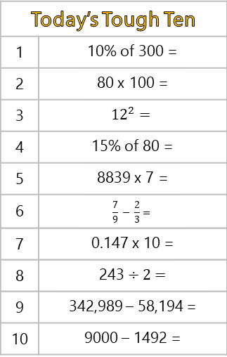
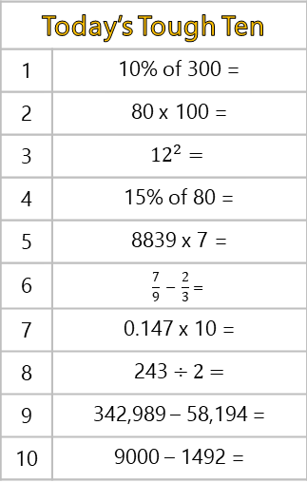
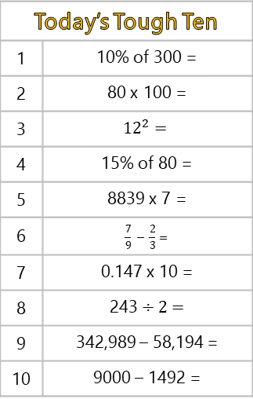
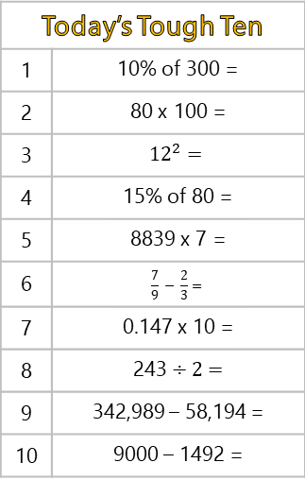
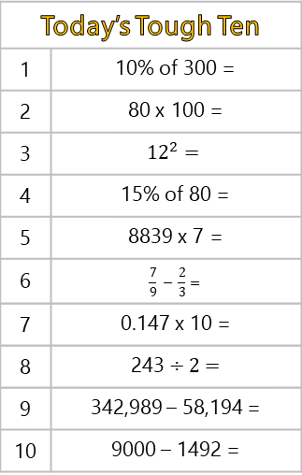
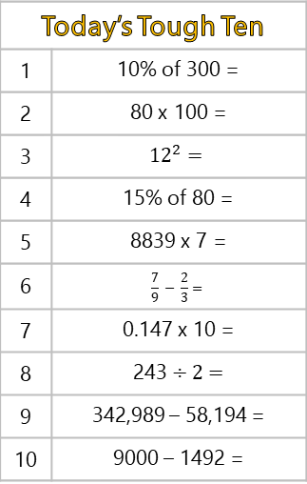
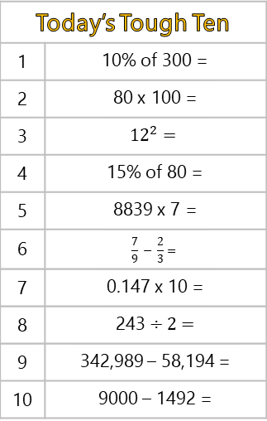
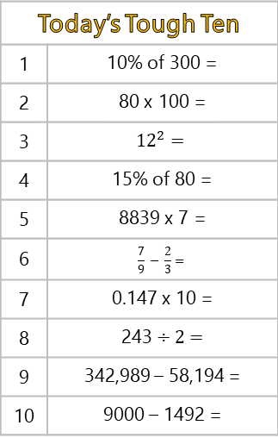
Today’s Tough Ten
1 | 10% of 300 =
2 | 80 x 100 =
3 | $${12}^{2}=$$
4 | 15% of 80 =
5 | 8839 x 7 =
6 | $$\frac{7}{9} − \frac{2}{3}=$$
7 | 0.147 x 10 =
8 | 243 ÷ 2 =
9 | 342,989 – 58,194 =
10 | 9000 – 1492 =
Today’s Tough Ten
1 | 10% of 300 =
2 | 80 x 100 =
3 | $${12}^{2}=$$
4 | 15% of 80 =
5 | 8839 x 7 =
6 | $$\frac{7}{9} − \frac{2}{3}=$$
7 | 0.147 x 10 =
8 | 243 ÷ 2 =
9 | 342,989 – 58,194 =
10 | 9000 – 1492 =
Today’s Tough Ten
1 | 10% of 300 =
2 | 80 x 100 =
3 | $${12}^{2}=$$
4 | 15% of 80 =
5 | 8839 x 7 =
6 | $$\frac{7}{9} − \frac{2}{3}=$$
7 | 0.147 x 10 =
8 | 243 ÷ 2 =
9 | 342,989 – 58,194 =
10 | 9000 – 1492 =
Today’s Tough Ten
1 | 10% of 300 =
2 | 80 x 100 =
3 | $${12}^{2}=$$
4 | 15% of 80 =
5 | 8839 x 7 =
6 | $$\frac{7}{9} − \frac{2}{3}=$$
7 | 0.147 x 10 =
8 | 243 ÷ 2 =
9 | 342,989 – 58,194 =
10 | 9000 – 1492 =
Today’s Tough Ten
1 | 10% of 300 =
2 | 80 x 100 =
3 | $${12}^{2}=$$
4 | 15% of 80 =
5 | 8839 x 7 =
6 | $$\frac{7}{9} − \frac{2}{3}=$$
7 | 0.147 x 10 =
8 | 243 ÷ 2 =
9 | 342,989 – 58,194 =
10 | 9000 – 1492 =
Today’s Tough Ten
1 | 10% of 300 =
2 | 80 x 100 =
3 | $${12}^{2}=$$
4 | 15% of 80 =
5 | 8839 x 7 =
6 | $$\frac{7}{9} − \frac{2}{3}=$$
7 | 0.147 x 10 =
8 | 243 ÷ 2 =
9 | 342,989 – 58,194 =
10 | 9000 – 1492 =
Today’s Tough Ten
1 | 10% of 300 =
2 | 80 x 100 =
3 | $${12}^{2}=$$
4 | 15% of 80 =
5 | 8839 x 7 =
6 | $$\frac{7}{9} − \frac{2}{3}=$$
7 | 0.147 x 10 =
8 | 243 ÷ 2 =
9 | 342,989 – 58,194 =
10 | 9000 – 1492 =
Today’s Tough Ten
1 | 10% of 300 =
2 | 80 x 100 =
3 | $${12}^{2}=$$
4 | 15% of 80 =
5 | 8839 x 7 =
6 | $$\frac{7}{9} − \frac{2}{3}=$$
7 | 0.147 x 10 =
8 | 243 ÷ 2 =
9 | 342,989 – 58,194 =
10 | 9000 – 1492 =

Slide 15
Autumn
Year 2

Slide 16
Today’s Tough Ten
1 | 12 – 9 =
2 | 18 – 2 =
3 | = 7 + 8
4 | 14 – 10 =
5 | 16 – 5 =
6 | = 13 + 5
7 | 20 – 12 =
8 | = 18 – 7
9 | 19 – 10 =
10 | 20 – 17 =
Today’s Tough Ten
1 | 12 – 9 =
2 | 18 – 2 =
3 | = 7 + 8
4 | 14 – 10 =
5 | 16 – 5 =
6 | = 13 + 5
7 | 20 – 12 =
8 | = 18 – 7
9 | 19 – 10 =
10 | 20 – 17 =
Today’s Tough Ten
1 | 12 – 9 =
2 | 18 – 2 =
3 | = 7 + 8
4 | 14 – 10 =
5 | 16 – 5 =
6 | = 13 + 5
7 | 20 – 12 =
8 | = 18 – 7
9 | 19 – 10 =
10 | 20 – 17 =
Today’s Tough Ten
1 | 12 – 9 =
2 | 18 – 2 =
3 | = 7 + 8
4 | 14 – 10 =
5 | 16 – 5 =
6 | = 13 + 5
7 | 20 – 12 =
8 | = 18 – 7
9 | 19 – 10 =
10 | 20 – 17 =
Today’s Tough Ten
1 | 12 – 9 =
2 | 18 – 2 =
3 | = 7 + 8
4 | 14 – 10 =
5 | 16 – 5 =
6 | = 13 + 5
7 | 20 – 12 =
8 | = 18 – 7
9 | 19 – 10 =
10 | 20 – 17 =
Today’s Tough Ten
1 | 12 – 9 =
2 | 18 – 2 =
3 | = 7 + 8
4 | 14 – 10 =
5 | 16 – 5 =
6 | = 13 + 5
7 | 20 – 12 =
8 | = 18 – 7
9 | 19 – 10 =
10 | 20 – 17 =
Today’s Tough Ten
1 | 12 – 9 =
2 | 18 – 2 =
3 | = 7 + 8
4 | 14 – 10 =
5 | 16 – 5 =
6 | = 13 + 5
7 | 20 – 12 =
8 | = 18 – 7
9 | 19 – 10 =
10 | 20 – 17 =
Today’s Tough Ten
1 | 12 – 9 =
2 | 18 – 2 =
3 | = 7 + 8
4 | 14 – 10 =
5 | 16 – 5 =
6 | = 13 + 5
7 | 20 – 12 =
8 | = 18 – 7
9 | 19 – 10 =
10 | 20 – 17 =

Slide 17
Today’s Tough Ten
1 | 20 – 17 =
2 | 12 + 9 =
3 | 14 – 10 =
4 | 9 + 9 =
5 | 8 + 9 =
6 | 19 – 1 =
7 | = 20 – 13
8 | = 20 – 10
9 | 10 + 10 =
10 | 18 – 6 =
Today’s Tough Ten
1 | 20 – 17 =
2 | 12 + 9 =
3 | 14 – 10 =
4 | 9 + 9 =
5 | 8 + 9 =
6 | 19 – 1 =
7 | = 20 – 13
8 | = 20 – 10
9 | 10 + 10 =
10 | 18 – 6 =
Today’s Tough Ten
1 | 20 – 17 =
2 | 12 + 9 =
3 | 14 – 10 =
4 | 9 + 9 =
5 | 8 + 9 =
6 | 19 – 1 =
7 | = 20 – 13
8 | = 20 – 10
9 | 10 + 10 =
10 | 18 – 6 =
Today’s Tough Ten
1 | 20 – 17 =
2 | 12 + 9 =
3 | 14 – 10 =
4 | 9 + 9 =
5 | 8 + 9 =
6 | 19 – 1 =
7 | = 20 – 13
8 | = 20 – 10
9 | 10 + 10 =
10 | 18 – 6 =
Today’s Tough Ten
1 | 20 – 17 =
2 | 12 + 9 =
3 | 14 – 10 =
4 | 9 + 9 =
5 | 8 + 9 =
6 | 19 – 1 =
7 | = 20 – 13
8 | = 20 – 10
9 | 10 + 10 =
10 | 18 – 6 =
Today’s Tough Ten
1 | 20 – 17 =
2 | 12 + 9 =
3 | 14 – 10 =
4 | 9 + 9 =
5 | 8 + 9 =
6 | 19 – 1 =
7 | = 20 – 13
8 | = 20 – 10
9 | 10 + 10 =
10 | 18 – 6 =
Today’s Tough Ten
1 | 20 – 17 =
2 | 12 + 9 =
3 | 14 – 10 =
4 | 9 + 9 =
5 | 8 + 9 =
6 | 19 – 1 =
7 | = 20 – 13
8 | = 20 – 10
9 | 10 + 10 =
10 | 18 – 6 =
Today’s Tough Ten
1 | 20 – 17 =
2 | 12 + 9 =
3 | 14 – 10 =
4 | 9 + 9 =
5 | 8 + 9 =
6 | 19 – 1 =
7 | = 20 – 13
8 | = 20 – 10
9 | 10 + 10 =
10 | 18 – 6 =

Slide 18
Today’s Tough Ten
1 | = 10 – 9
2 | 0 + 0 =
3 | 12 + 6 =
4 | = 10 – 7
5 | = 17 – 9
6 | 14 – 0 =
7 | 5 + 9 =
8 | 1 + 17 =
9 | 20 – 17 =
10 | 20 – 4 =
Today’s Tough Ten
1 | = 10 – 9
2 | 0 + 0 =
3 | 12 + 6 =
4 | = 10 – 7
5 | = 17 – 9
6 | 14 – 0 =
7 | 5 + 9 =
8 | 1 + 17 =
9 | 20 – 17 =
10 | 20 – 4 =
Today’s Tough Ten
1 | = 10 – 9
2 | 0 + 0 =
3 | 12 + 6 =
4 | = 10 – 7
5 | = 17 – 9
6 | 14 – 0 =
7 | 5 + 9 =
8 | 1 + 17 =
9 | 20 – 17 =
10 | 20 – 4 =
Today’s Tough Ten
1 | = 10 – 9
2 | 0 + 0 =
3 | 12 + 6 =
4 | = 10 – 7
5 | = 17 – 9
6 | 14 – 0 =
7 | 5 + 9 =
8 | 1 + 17 =
9 | 20 – 17 =
10 | 20 – 4 =
Today’s Tough Ten
1 | = 10 – 9
2 | 0 + 0 =
3 | 12 + 6 =
4 | = 10 – 7
5 | = 17 – 9
6 | 14 – 0 =
7 | 5 + 9 =
8 | 1 + 17 =
9 | 20 – 17 =
10 | 20 – 4 =
Today’s Tough Ten
1 | = 10 – 9
2 | 0 + 0 =
3 | 12 + 6 =
4 | = 10 – 7
5 | = 17 – 9
6 | 14 – 0 =
7 | 5 + 9 =
8 | 1 + 17 =
9 | 20 – 17 =
10 | 20 – 4 =
Today’s Tough Ten
1 | = 10 – 9
2 | 0 + 0 =
3 | 12 + 6 =
4 | = 10 – 7
5 | = 17 – 9
6 | 14 – 0 =
7 | 5 + 9 =
8 | 1 + 17 =
9 | 20 – 17 =
10 | 20 – 4 =
Today’s Tough Ten
1 | = 10 – 9
2 | 0 + 0 =
3 | 12 + 6 =
4 | = 10 – 7
5 | = 17 – 9
6 | 14 – 0 =
7 | 5 + 9 =
8 | 1 + 17 =
9 | 20 – 17 =
10 | 20 – 4 =

Slide 19
Spring
Year 2

Slide 20
Today’s Tough Ten
1 | 2 + 18 =
2 | 12 – 7 =
3 | 18 – 9 =
4 | = 10 + 50
5 | 11 = 16 -
6 | 3 x 10 =
7 | 69 – 8 =
8 | 22 + 7 =
9 | = 20 ÷ 10
10 | 30 – 20 =
Today’s Tough Ten
1 | 2 + 18 =
2 | 12 – 7 =
3 | 18 – 9 =
4 | = 10 + 50
5 | 11 = 16 -
6 | 3 x 10 =
7 | 69 – 8 =
8 | 22 + 7 =
9 | = 20 ÷ 10
10 | 30 – 20 =
Today’s Tough Ten
1 | 2 + 18 =
2 | 12 – 7 =
3 | 18 – 9 =
4 | = 10 + 50
5 | 11 = 16 -
6 | 3 x 10 =
7 | 69 – 8 =
8 | 22 + 7 =
9 | = 20 ÷ 10
10 | 30 – 20 =
Today’s Tough Ten
1 | 2 + 18 =
2 | 12 – 7 =
3 | 18 – 9 =
4 | = 10 + 50
5 | 11 = 16 -
6 | 3 x 10 =
7 | 69 – 8 =
8 | 22 + 7 =
9 | = 20 ÷ 10
10 | 30 – 20 =
Today’s Tough Ten
1 | 2 + 18 =
2 | 12 – 7 =
3 | 18 – 9 =
4 | = 10 + 50
5 | 11 = 16 -
6 | 3 x 10 =
7 | 69 – 8 =
8 | 22 + 7 =
9 | = 20 ÷ 10
10 | 30 – 20 =
Today’s Tough Ten
1 | 2 + 18 =
2 | 12 – 7 =
3 | 18 – 9 =
4 | = 10 + 50
5 | 11 = 16 -
6 | 3 x 10 =
7 | 69 – 8 =
8 | 22 + 7 =
9 | = 20 ÷ 10
10 | 30 – 20 =
Today’s Tough Ten
1 | 2 + 18 =
2 | 12 – 7 =
3 | 18 – 9 =
4 | = 10 + 50
5 | 11 = 16 -
6 | 3 x 10 =
7 | 69 – 8 =
8 | 22 + 7 =
9 | = 20 ÷ 10
10 | 30 – 20 =
Today’s Tough Ten
1 | 2 + 18 =
2 | 12 – 7 =
3 | 18 – 9 =
4 | = 10 + 50
5 | 11 = 16 -
6 | 3 x 10 =
7 | 69 – 8 =
8 | 22 + 7 =
9 | = 20 ÷ 10
10 | 30 – 20 =

Slide 21
Today’s Tough Ten
1 | 40 – 30 =
2 | 9 + 8 =
3 | 19 – 11 =
4 | 10 + 30 =
5 | 100 ÷ 10 =
6 | 65 – 4 =
7 | 48 = 41 +
8 | 3 + 23 =
9 | 1 x 10 =
10 | 100 – 40 =
Today’s Tough Ten
1 | 40 – 30 =
2 | 9 + 8 =
3 | 19 – 11 =
4 | 10 + 30 =
5 | 100 ÷ 10 =
6 | 65 – 4 =
7 | 48 = 41 +
8 | 3 + 23 =
9 | 1 x 10 =
10 | 100 – 40 =
Today’s Tough Ten
1 | 40 – 30 =
2 | 9 + 8 =
3 | 19 – 11 =
4 | 10 + 30 =
5 | 100 ÷ 10 =
6 | 65 – 4 =
7 | 48 = 41 +
8 | 3 + 23 =
9 | 1 x 10 =
10 | 100 – 40 =
Today’s Tough Ten
1 | 40 – 30 =
2 | 9 + 8 =
3 | 19 – 11 =
4 | 10 + 30 =
5 | 100 ÷ 10 =
6 | 65 – 4 =
7 | 48 = 41 +
8 | 3 + 23 =
9 | 1 x 10 =
10 | 100 – 40 =
Today’s Tough Ten
1 | 40 – 30 =
2 | 9 + 8 =
3 | 19 – 11 =
4 | 10 + 30 =
5 | 100 ÷ 10 =
6 | 65 – 4 =
7 | 48 = 41 +
8 | 3 + 23 =
9 | 1 x 10 =
10 | 100 – 40 =
Today’s Tough Ten
1 | 40 – 30 =
2 | 9 + 8 =
3 | 19 – 11 =
4 | 10 + 30 =
5 | 100 ÷ 10 =
6 | 65 – 4 =
7 | 48 = 41 +
8 | 3 + 23 =
9 | 1 x 10 =
10 | 100 – 40 =
Today’s Tough Ten
1 | 40 – 30 =
2 | 9 + 8 =
3 | 19 – 11 =
4 | 10 + 30 =
5 | 100 ÷ 10 =
6 | 65 – 4 =
7 | 48 = 41 +
8 | 3 + 23 =
9 | 1 x 10 =
10 | 100 – 40 =
Today’s Tough Ten
1 | 40 – 30 =
2 | 9 + 8 =
3 | 19 – 11 =
4 | 10 + 30 =
5 | 100 ÷ 10 =
6 | 65 – 4 =
7 | 48 = 41 +
8 | 3 + 23 =
9 | 1 x 10 =
10 | 100 – 40 =

Slide 22
Today’s Tough Ten
1 | 50 – 30 =
2 | 17 – 9 =
3 | = 9 + 9
4 | 16 – 12 =
5 | 13 = 17 -
6 | = 3 x 10
7 | 42 + 7 =
8 | 100 – 90 =
9 | 3 x 10 =
10 | 2 + 27 =
Today’s Tough Ten
1 | 50 – 30 =
2 | 17 – 9 =
3 | = 9 + 9
4 | 16 – 12 =
5 | 13 = 17 -
6 | = 3 x 10
7 | 42 + 7 =
8 | 100 – 90 =
9 | 3 x 10 =
10 | 2 + 27 =
Today’s Tough Ten
1 | 50 – 30 =
2 | 17 – 9 =
3 | = 9 + 9
4 | 16 – 12 =
5 | 13 = 17 -
6 | = 3 x 10
7 | 42 + 7 =
8 | 100 – 90 =
9 | 3 x 10 =
10 | 2 + 27 =
Today’s Tough Ten
1 | 50 – 30 =
2 | 17 – 9 =
3 | = 9 + 9
4 | 16 – 12 =
5 | 13 = 17 -
6 | = 3 x 10
7 | 42 + 7 =
8 | 100 – 90 =
9 | 3 x 10 =
10 | 2 + 27 =
Today’s Tough Ten
1 | 50 – 30 =
2 | 17 – 9 =
3 | = 9 + 9
4 | 16 – 12 =
5 | 13 = 17 -
6 | = 3 x 10
7 | 42 + 7 =
8 | 100 – 90 =
9 | 3 x 10 =
10 | 2 + 27 =
Today’s Tough Ten
1 | 50 – 30 =
2 | 17 – 9 =
3 | = 9 + 9
4 | 16 – 12 =
5 | 13 = 17 -
6 | = 3 x 10
7 | 42 + 7 =
8 | 100 – 90 =
9 | 3 x 10 =
10 | 2 + 27 =
Today’s Tough Ten
1 | 50 – 30 =
2 | 17 – 9 =
3 | = 9 + 9
4 | 16 – 12 =
5 | 13 = 17 -
6 | = 3 x 10
7 | 42 + 7 =
8 | 100 – 90 =
9 | 3 x 10 =
10 | 2 + 27 =
Today’s Tough Ten
1 | 50 – 30 =
2 | 17 – 9 =
3 | = 9 + 9
4 | 16 – 12 =
5 | 13 = 17 -
6 | = 3 x 10
7 | 42 + 7 =
8 | 100 – 90 =
9 | 3 x 10 =
10 | 2 + 27 =

Slide 23
Summer
Year 2

Slide 24
Today’s Tough Ten
1 | 7 x 5 =
2 | 6 x 2 =
3 | = 8 + 7
4 | 90 – 40 =
5 | 47 – 8 =
6 | = 5 x 5
7 | 34 + 24 =
8 | 40 ÷ 5 =
9 | 100 – 80 =
10 | 40 + 30 =
Today’s Tough Ten
1 | 7 x 5 =
2 | 6 x 2 =
3 | = 8 + 7
4 | 90 – 40 =
5 | 47 – 8 =
6 | = 5 x 5
7 | 34 + 24 =
8 | 40 ÷ 5 =
9 | 100 – 80 =
10 | 40 + 30 =
Today’s Tough Ten
1 | 7 x 5 =
2 | 6 x 2 =
3 | = 8 + 7
4 | 90 – 40 =
5 | 47 – 8 =
6 | = 5 x 5
7 | 34 + 24 =
8 | 40 ÷ 5 =
9 | 100 – 80 =
10 | 40 + 30 =
Today’s Tough Ten
1 | 7 x 5 =
2 | 6 x 2 =
3 | = 8 + 7
4 | 90 – 40 =
5 | 47 – 8 =
6 | = 5 x 5
7 | 34 + 24 =
8 | 40 ÷ 5 =
9 | 100 – 80 =
10 | 40 + 30 =
Today’s Tough Ten
1 | 7 x 5 =
2 | 6 x 2 =
3 | = 8 + 7
4 | 90 – 40 =
5 | 47 – 8 =
6 | = 5 x 5
7 | 34 + 24 =
8 | 40 ÷ 5 =
9 | 100 – 80 =
10 | 40 + 30 =
Today’s Tough Ten
1 | 7 x 5 =
2 | 6 x 2 =
3 | = 8 + 7
4 | 90 – 40 =
5 | 47 – 8 =
6 | = 5 x 5
7 | 34 + 24 =
8 | 40 ÷ 5 =
9 | 100 – 80 =
10 | 40 + 30 =
Today’s Tough Ten
1 | 7 x 5 =
2 | 6 x 2 =
3 | = 8 + 7
4 | 90 – 40 =
5 | 47 – 8 =
6 | = 5 x 5
7 | 34 + 24 =
8 | 40 ÷ 5 =
9 | 100 – 80 =
10 | 40 + 30 =
Today’s Tough Ten
1 | 7 x 5 =
2 | 6 x 2 =
3 | = 8 + 7
4 | 90 – 40 =
5 | 47 – 8 =
6 | = 5 x 5
7 | 34 + 24 =
8 | 40 ÷ 5 =
9 | 100 – 80 =
10 | 40 + 30 =

Slide 25
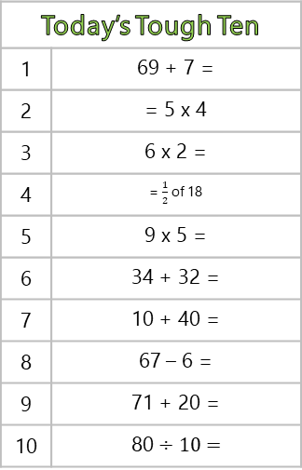
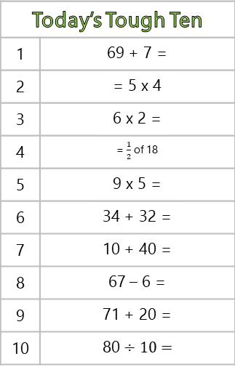
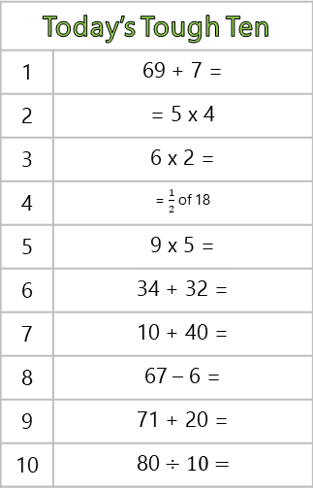
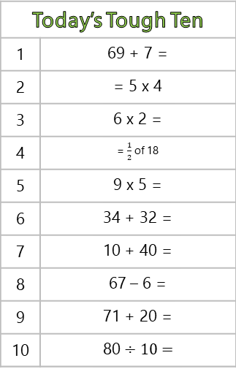
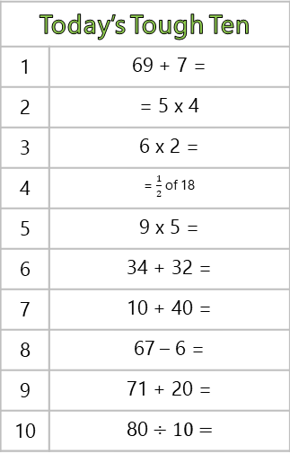
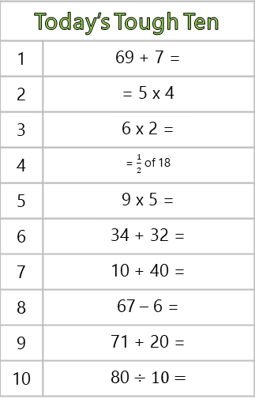


Today’s Tough Ten
1 | 69 + 7 =
2 | = 5 x 4
3 | 6 x 2 =
4 | = $\frac{1}{2}$ of 18
5 | 9 x 5 =
6 | 34 + 32 =
7 | 10 + 40 =
8 | 67 – 6 =
9 | 71 + 20 =
10 | 80 ÷ 10 =
Today’s Tough Ten
1 | 69 + 7 =
2 | = 5 x 4
3 | 6 x 2 =
4 | = $\frac{1}{2}$ of 18
5 | 9 x 5 =
6 | 34 + 32 =
7 | 10 + 40 =
8 | 67 – 6 =
9 | 71 + 20 =
10 | 80 ÷ 10 =
Today’s Tough Ten
1 | 69 + 7 =
2 | = 5 x 4
3 | 6 x 2 =
4 | = $\frac{1}{2}$ of 18
5 | 9 x 5 =
6 | 34 + 32 =
7 | 10 + 40 =
8 | 67 – 6 =
9 | 71 + 20 =
10 | 80 ÷ 10 =
Today’s Tough Ten
1 | 69 + 7 =
2 | = 5 x 4
3 | 6 x 2 =
4 | = $\frac{1}{2}$ of 18
5 | 9 x 5 =
6 | 34 + 32 =
7 | 10 + 40 =
8 | 67 – 6 =
9 | 71 + 20 =
10 | 80 ÷ 10 =
Today’s Tough Ten
1 | 69 + 7 =
2 | = 5 x 4
3 | 6 x 2 =
4 | = $\frac{1}{2}$ of 18
5 | 9 x 5 =
6 | 34 + 32 =
7 | 10 + 40 =
8 | 67 – 6 =
9 | 71 + 20 =
10 | 80 ÷ 10 =
Today’s Tough Ten
1 | 69 + 7 =
2 | = 5 x 4
3 | 6 x 2 =
4 | = $\frac{1}{2}$ of 18
5 | 9 x 5 =
6 | 34 + 32 =
7 | 10 + 40 =
8 | 67 – 6 =
9 | 71 + 20 =
10 | 80 ÷ 10 =
Today’s Tough Ten
1 | 69 + 7 =
2 | = 5 x 4
3 | 6 x 2 =
4 | = $\frac{1}{2}$ of 18
5 | 9 x 5 =
6 | 34 + 32 =
7 | 10 + 40 =
8 | 67 – 6 =
9 | 71 + 20 =
10 | 80 ÷ 10 =
Today’s Tough Ten
1 | 69 + 7 =
2 | = 5 x 4
3 | 6 x 2 =
4 | = $\frac{1}{2}$ of 18
5 | 9 x 5 =
6 | 34 + 32 =
7 | 10 + 40 =
8 | 67 – 6 =
9 | 71 + 20 =
10 | 80 ÷ 10 =

Slide 26
Today’s Tough Ten
1 | 30 + 60 =
2 | 79 – 7 =
3 | 8 x 10 =
4 | = 7 x 2
5 | 36 + 21 =
6 | 27 + 30 =
7 | 10 + 40 =
8 | 40 ÷ 10 =
9 | = 2 x 10
10 | 100 – 70 =
Today’s Tough Ten
1 | 30 + 60 =
2 | 79 – 7 =
3 | 8 x 10 =
4 | = 7 x 2
5 | 36 + 21 =
6 | 27 + 30 =
7 | 10 + 40 =
8 | 40 ÷ 10 =
9 | = 2 x 10
10 | 100 – 70 =
Today’s Tough Ten
1 | 30 + 60 =
2 | 79 – 7 =
3 | 8 x 10 =
4 | = 7 x 2
5 | 36 + 21 =
6 | 27 + 30 =
7 | 10 + 40 =
8 | 40 ÷ 10 =
9 | = 2 x 10
10 | 100 – 70 =
Today’s Tough Ten
1 | 30 + 60 =
2 | 79 – 7 =
3 | 8 x 10 =
4 | = 7 x 2
5 | 36 + 21 =
6 | 27 + 30 =
7 | 10 + 40 =
8 | 40 ÷ 10 =
9 | = 2 x 10
10 | 100 – 70 =
Today’s Tough Ten
1 | 30 + 60 =
2 | 79 – 7 =
3 | 8 x 10 =
4 | = 7 x 2
5 | 36 + 21 =
6 | 27 + 30 =
7 | 10 + 40 =
8 | 40 ÷ 10 =
9 | = 2 x 10
10 | 100 – 70 =
Today’s Tough Ten
1 | 30 + 60 =
2 | 79 – 7 =
3 | 8 x 10 =
4 | = 7 x 2
5 | 36 + 21 =
6 | 27 + 30 =
7 | 10 + 40 =
8 | 40 ÷ 10 =
9 | = 2 x 10
10 | 100 – 70 =
Today’s Tough Ten
1 | 30 + 60 =
2 | 79 – 7 =
3 | 8 x 10 =
4 | = 7 x 2
5 | 36 + 21 =
6 | 27 + 30 =
7 | 10 + 40 =
8 | 40 ÷ 10 =
9 | = 2 x 10
10 | 100 – 70 =
Today’s Tough Ten
1 | 30 + 60 =
2 | 79 – 7 =
3 | 8 x 10 =
4 | = 7 x 2
5 | 36 + 21 =
6 | 27 + 30 =
7 | 10 + 40 =
8 | 40 ÷ 10 =
9 | = 2 x 10
10 | 100 – 70 =

